Slide 1


Notes:
Hello! If you were sent this presentation, it means that you recently switched your major, are considering switching majors, or just want to know more information about the 3 computing majors that Towson offers.
Within each slide, I will incorporate an audio of me explaining the information displayed. Feel free to give it a listen, look at the slides, and reach out to the contact information provided later on to best make use of all of your resources!

Slide 2
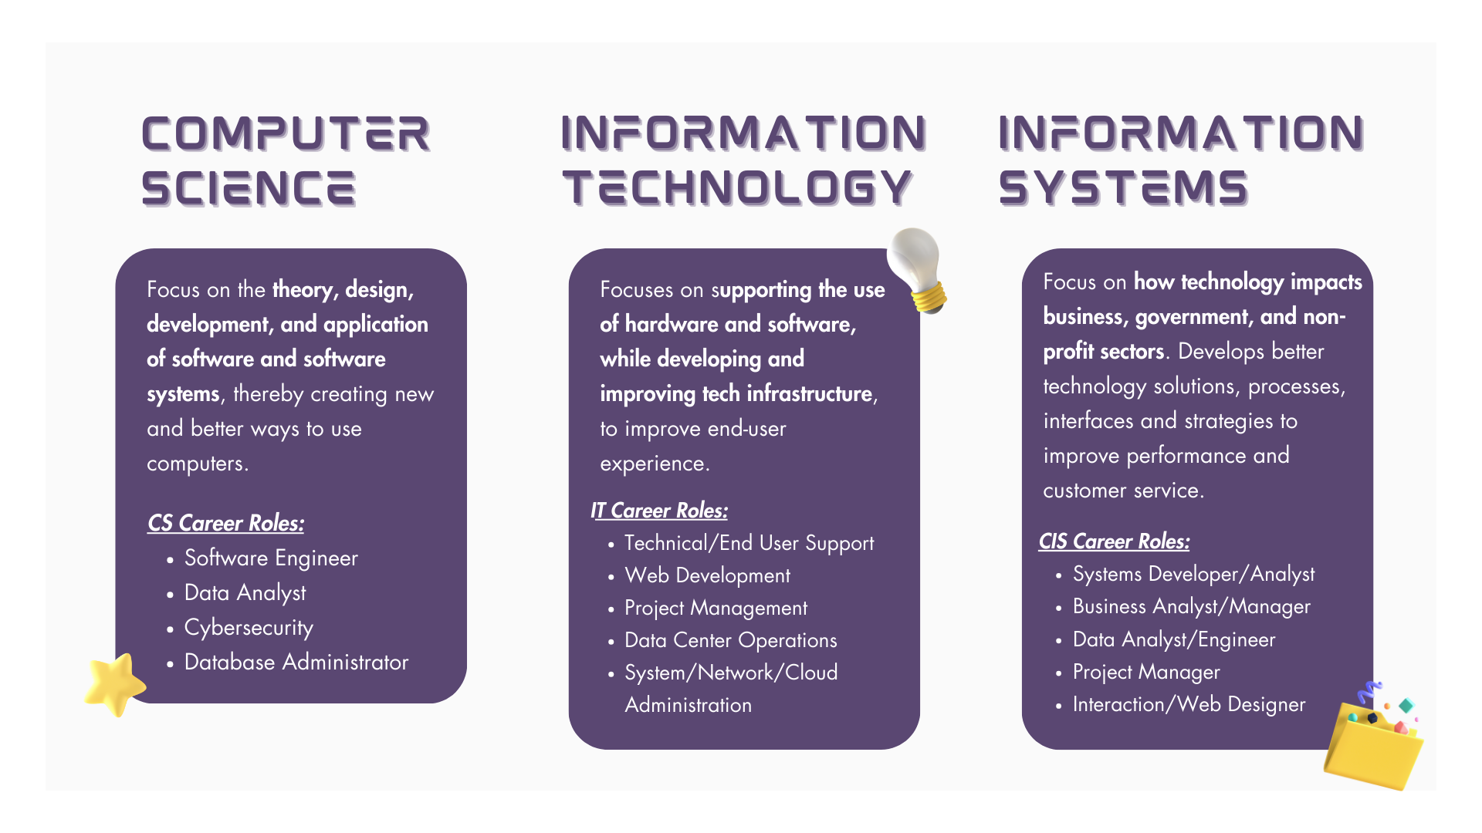
Notes:
The Computer & Information Sciences Department offers 3 distinctive majors: Computer Science, Information Technology, and Information Systems.
If you enjoy a good challenge and creative problem-solving, consider majoring in Computer Science! Within this major, you will learn to design and implement software to find new innovative ways to solve computing problems.
If you are interested in IT, you will learn about a range of skillsets such as optimizing networks and fortifying cybersecurity, to specializing in areas like network administration or IT consulting. IT offers endless possibilities to align your education with your unique passions, while acquiring the latest skills demanded by today's job market.
For majoring in IS, you will learn how to serve as a bridge between the technical employees and management at an organization. Throughout your courses at Towson, you will have enough know-how to question shabby work and/or explain necessary changes to all those involved in a project.
Feel free to pause here to read more about the majors and what career roles you can go into!

Slide 3
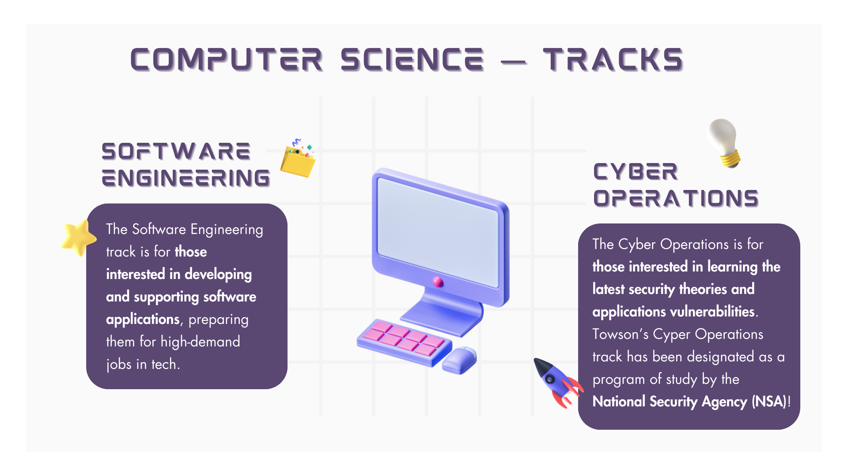
Notes:
Towson offers two tracks for CS majors: Software Engineering and Cyber Operations.
In the Software Engineering track, you'll be immersed in the world of developing and supporting software applications. Whether you're into coding, testing, or troubleshooting, we've got you covered. Our goal is to equip you with the skills and knowledge necessary to thrive in the dynamic field of software engineering.
The Cyber Operations track is designed for those who want to delve deep into the latest security theories and applications vulnerabilities. In an era where cybersecurity is more critical than ever, this track will empower you with the expertise needed to navigate the complexities of the cyber landscape. We are also proud to say that our Cyber Operations track is officially designated as a program of study by the National Security Agency (NSA)! This designation by the NSA underscores the track's commitment to excellence and its alignment with the highest standards in the field.

Slide 4
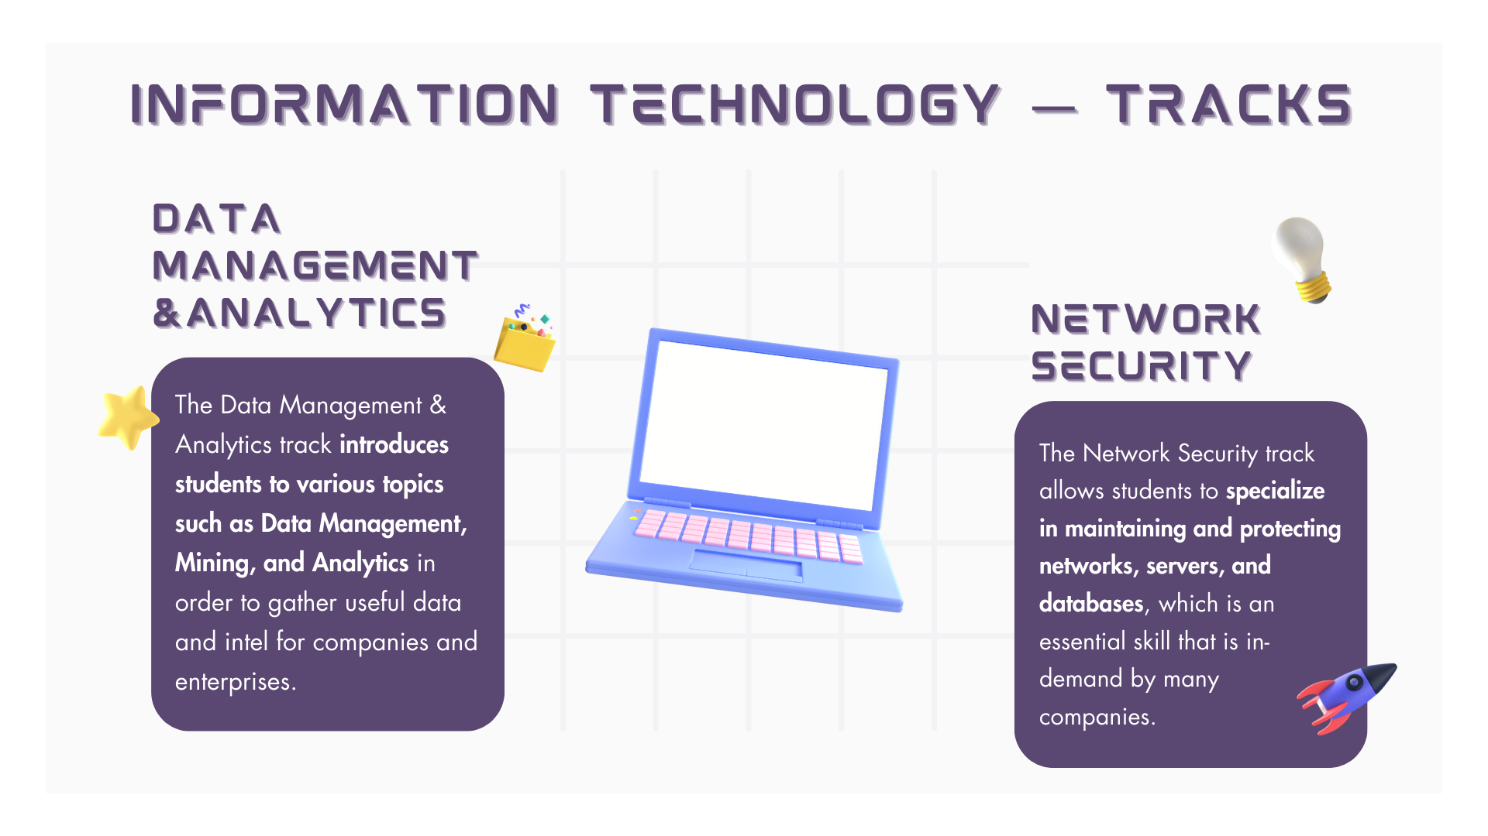
Notes:
For IT majors, there are two optional tracks that students can go into for a more specialized academic experience: Data Management & Analytics and Network Security.
In the Data Management & Analytics track, a variety of topics are covered in your courses, including Data Management, Mining, and Analytics. This means you'll be equipped with the skills to not only manage data effectively but also mine it for valuable information to turn raw data into actionable insights!
The Network Security track allows you to specialize in the essential skill of securing digital infrastructure. This is a skill that's in high demand across various industries. Companies rely on network security experts to safeguard their networks and data from potential threats.

Slide 5
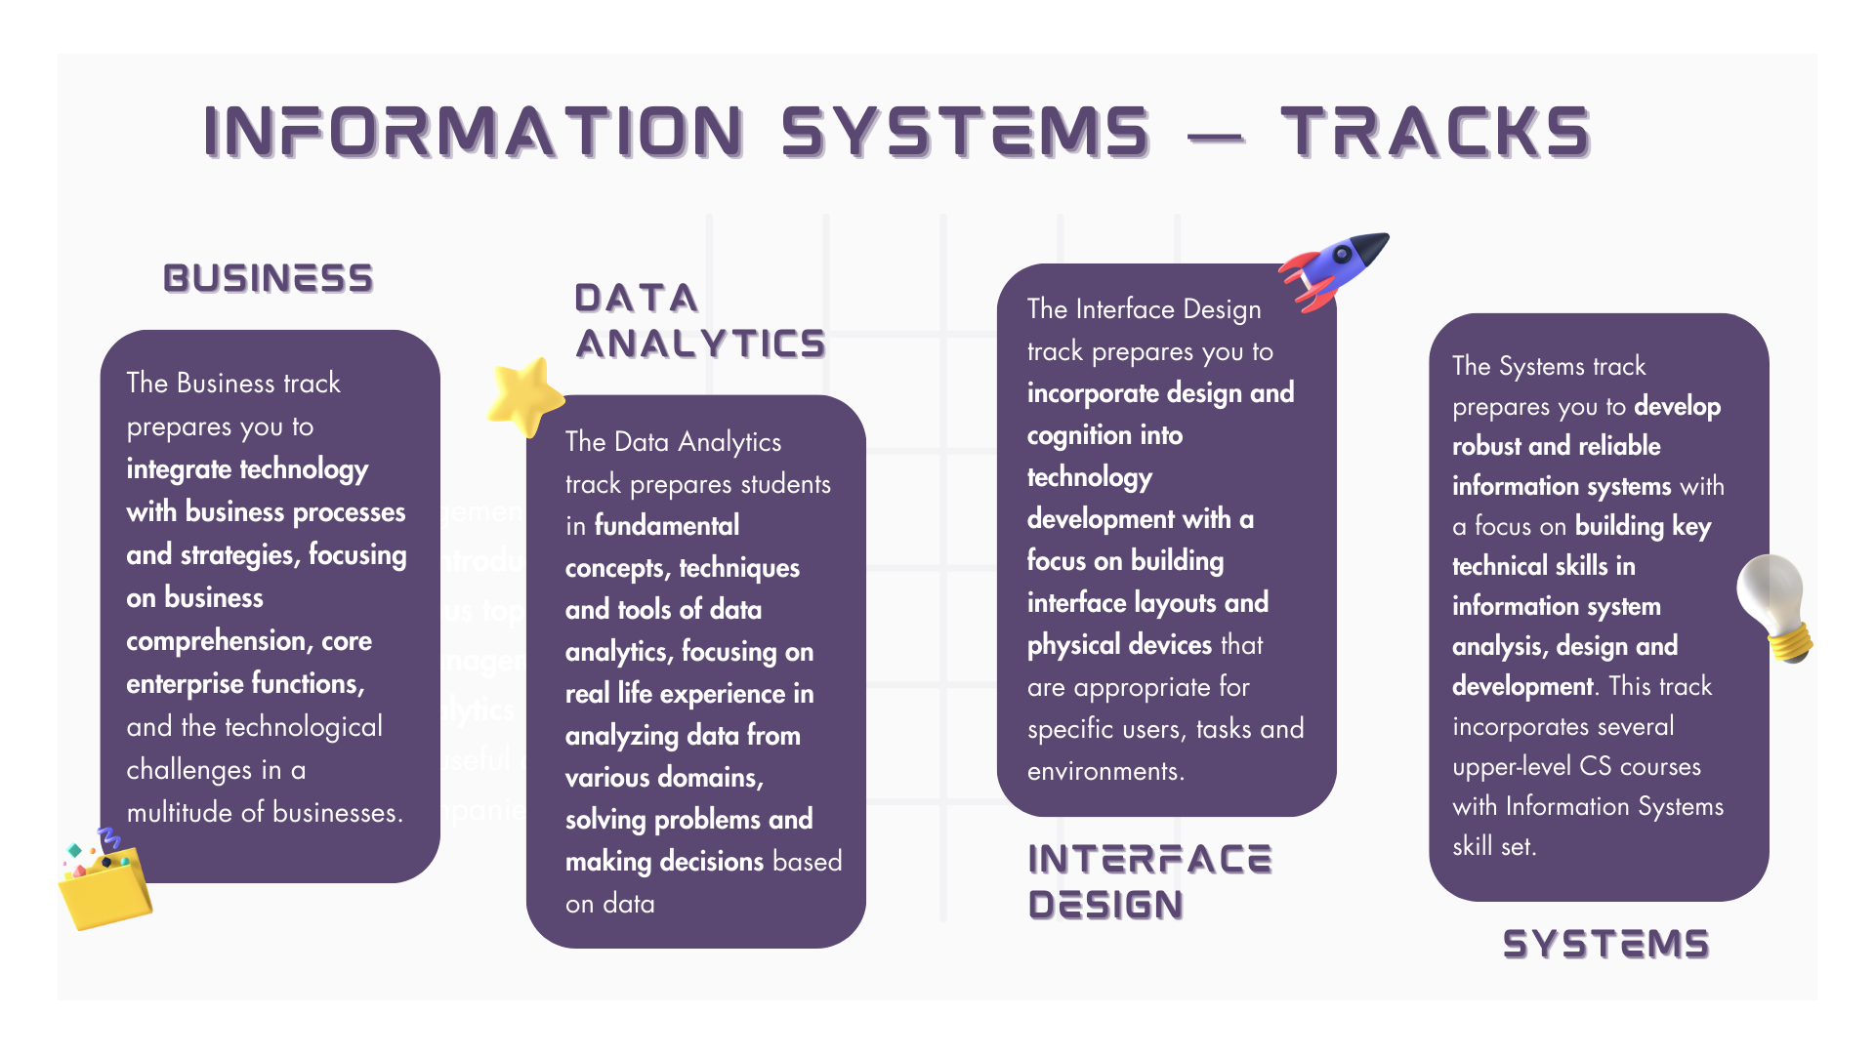
Notes:
The final computing major offered at Towson University is Information Systems where you can choose between four tracks! Whereas Computer Science and Information Technology tracks are optional, IS majors are required to choose a specialized track to complete their academic requirements at Towson.
If you're someone who's passionate about integrating technology with business processes and strategies, consider the Business Track. This track focuses on enhancing your business comprehension, core enterprise functions, and tackling technological challenges across various businesses.
Moving on to the Data Analytics track, if you find joy in unraveling the stories hidden within data, this track is designed just for you. As a Data Analytics track student, you'll have the opportunity to work with industry-standard tools, gaining hands-on experience that mirrors real-world scenarios. From predictive modeling to machine learning applications, this track equips you with the skills needed to navigate the rapidly evolving field of data analytics.
The Interface Design track creates a more creative outlet for those who have a knack for combining design and with technology development. You'll learn how to create interface layouts and physical devices tailored for specific users, tasks, and environments. It's about making technology user-friendly and seamlessly integrated into our lives.
Last but not least, we have the Systems track. This track is all about developing robust and reliable information systems. Here, you'll build key technical skills in information system analysis, design, and development.

Slide 6
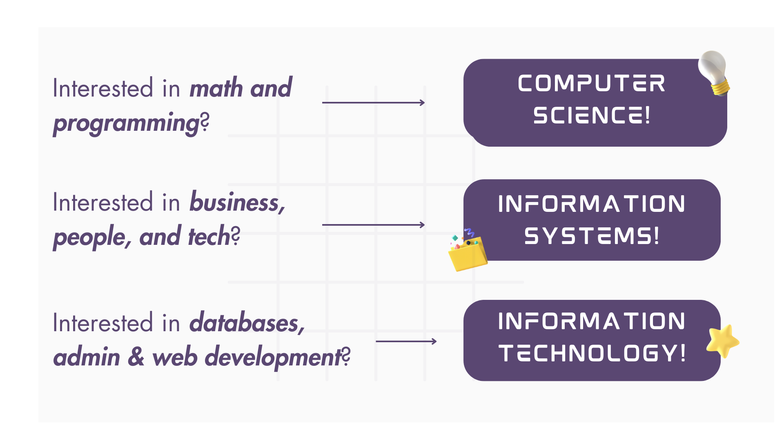
Notes:
Students within the CIS department generally decide which major to choose from based on the three majors’ different levels of math and programming skills.
Students highly skilled and interested in math and programming should consider majoring in Computer Science. Of the three majors, Computer Science requires the most math and programming courses. You need to complete a minimum of 18 college level math credits and a minimum of 8 credits lab science.
IT generally attracts students that are interested in databases, web development, or fully supporting the administrative aspect of an organization. The IT major requires the least amount of math and programming compared to the other two majors and usually requires a minimum of 6 college level math credits. Majoring in IT can offer more flexibility within class options, exploring the different technology topics that Towson offers.
Information systems is usually pursued by those that would appreciate the business aspect and enjoy coordinating the administrative tasks with technological ones. This major requires 9-10 college level math credits. As stated before, IS majors MUST choose a track, whereas CS and IT majors are not required to and can remain on the General track.

Slide 7
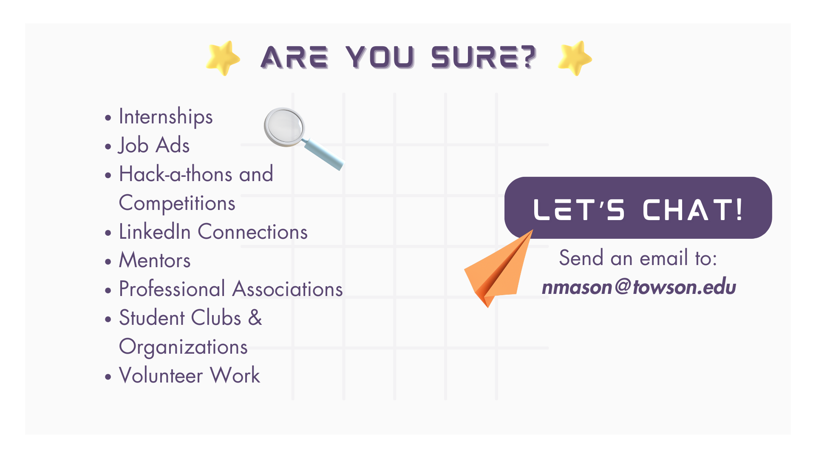
Notes:
Most important things to consider when choosing your major is what you want to do with your professional life and whether or not you have the skills, mindset, and determination to obtain that lifestyle. Here are some words of advice from Academic Advising Specialist, Nichole Mason, on how to choose the right major for you and what you should look for when considering what career path to pursue.
“Check the want ads, network and make in-person and online connections, do your research and ask questions. Which job descriptions appeal to you the most? What are their requirements? Which degree, certifications, and experiences are they looking for? What do your responsibilities look like on a day-to-day basis? What’s the salary? What can you do to stand out? The truth of the matter is, you might not know what you’ll like until you take yourself out of the classroom environment and experience the work field firsthand. Take the opportunity to get your hands dirty at least a few time before you leave TU with the things you plan to do as a career. Hackathons, Internships, clubs, and more can give you a much better understanding of what you like and what you’re good at.”
To discuss your decisions further and talk through your options, feel free to reach out to Nichole via the email provided.

Slide 8
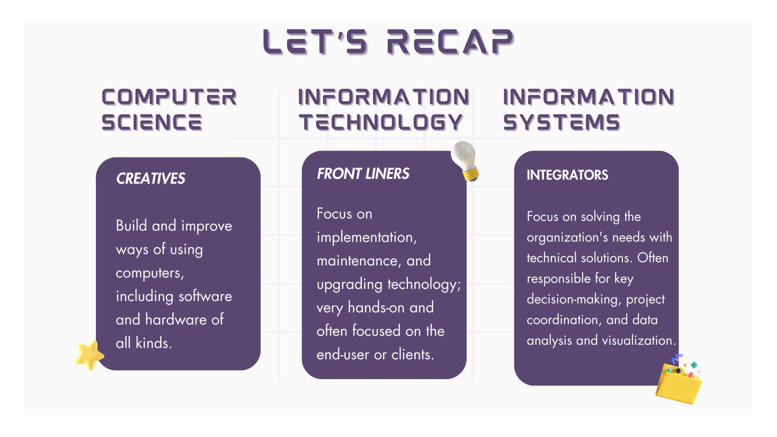
Notes:
After you make a list of your top wants and needs, consider your options at TU in the CIS department. To recap, let’s clearly map out the different professions our majors directly lead to:
CS majors are the out-of-the-box thinkers of the tech world, building new ways to use technology or improve it. This major requires a lot of logical and creative thinking, as well as, practice and patience.
IT majors can be categorized as the front liners of the tech field, because they are responsible for the end-user’s experience in a more immediate way. They implement changes, maintain and upgrade tech, as well as research and suggest new technology. Out of the three majors, they are very hands-on, generally do less programming than computer science majors, and enjoy working on teams.
IS majors are the human resource folks who are bridges between the technical professionals and administrators. They should know enough coding to determine if someone’s code is incorrect and why. They should be great communicators and project managers.

Slide 9
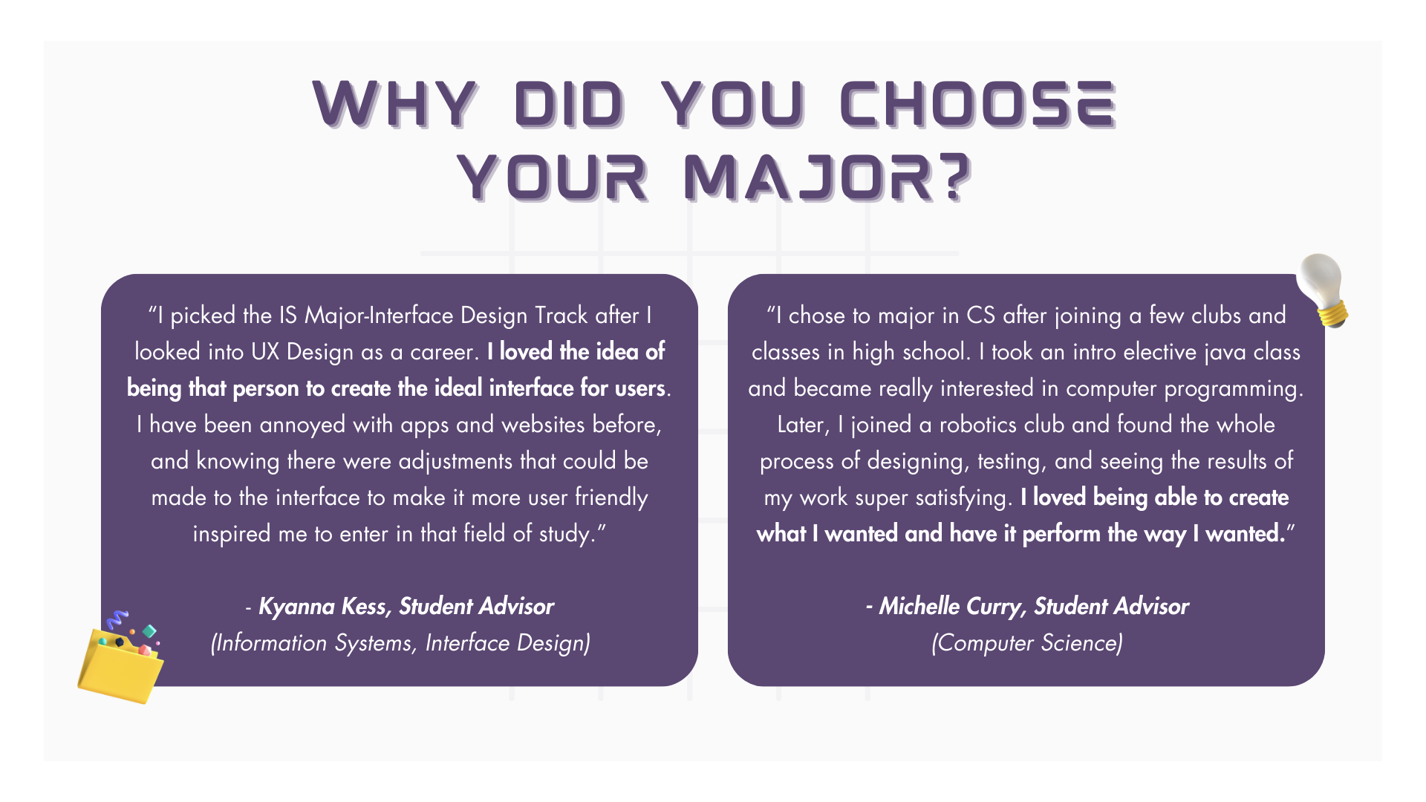
Notes:
The following slides are some reasons why current and past student advisors within the CIS department chose their majors and offered advice and insight into the three computing majors. Take a look at what your peers think!

Slide 10
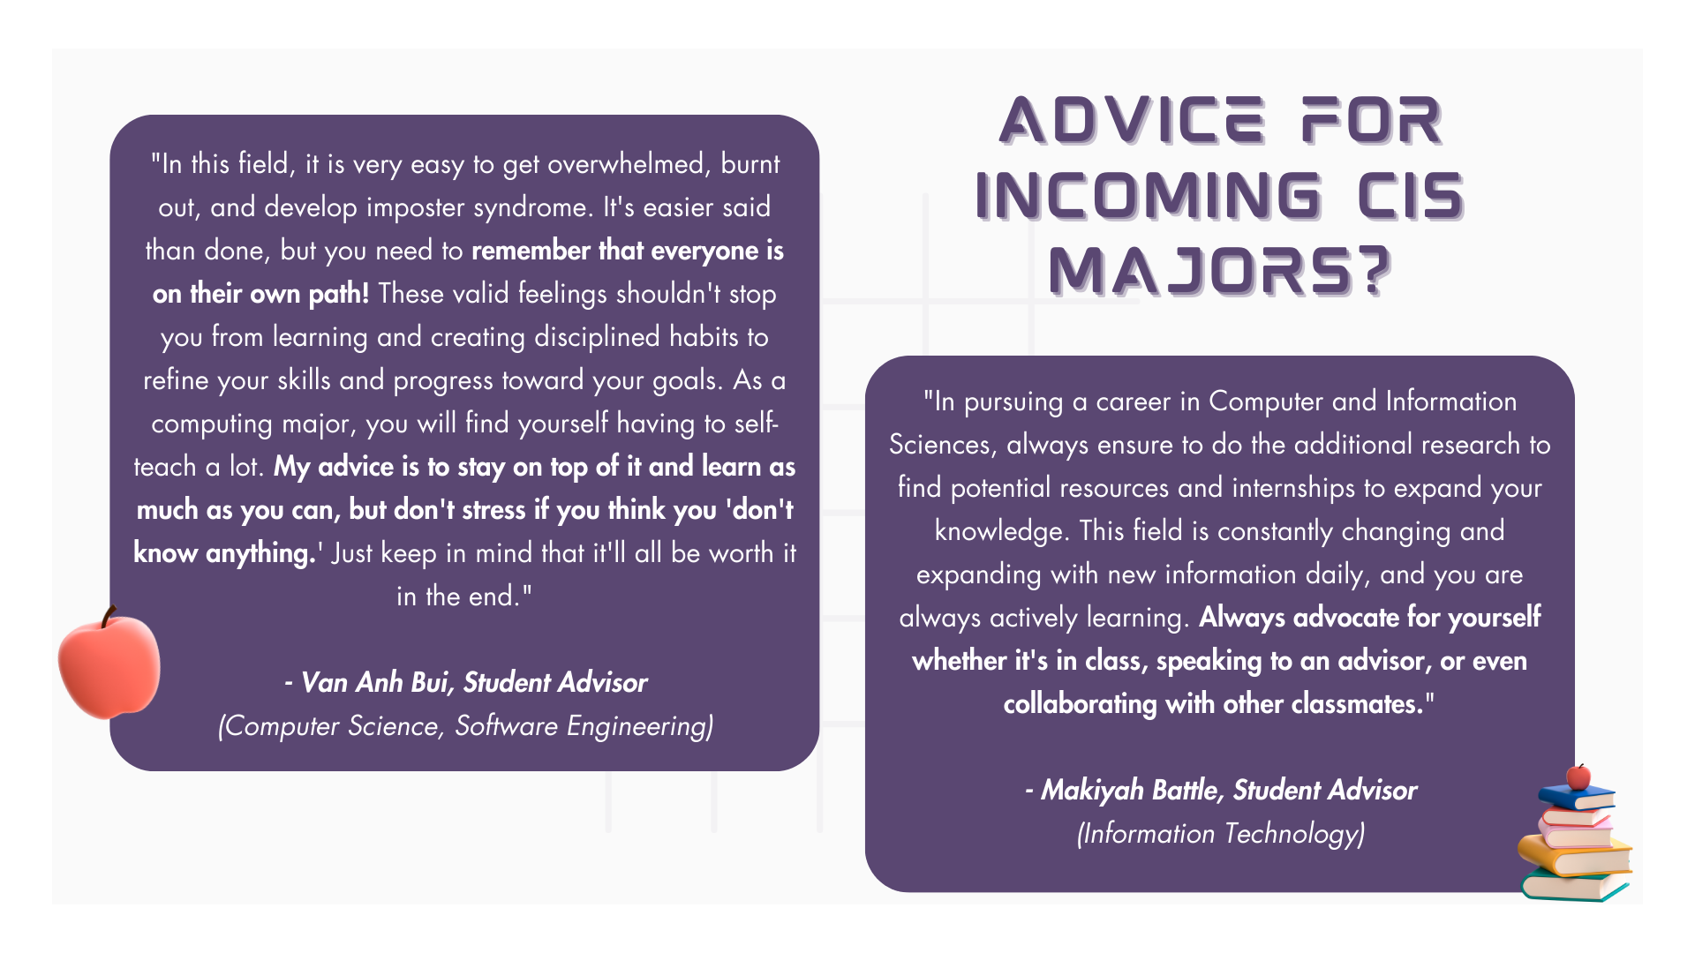

Slide 11
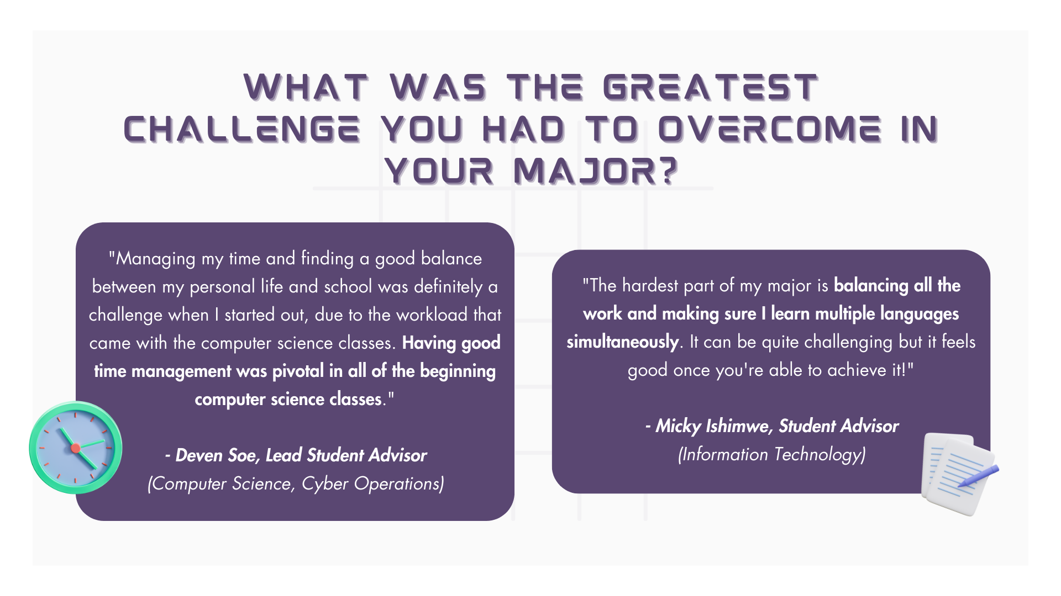

Slide 12
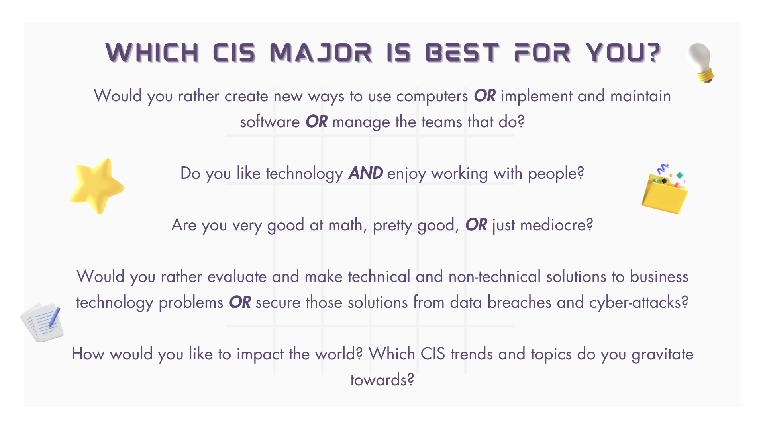
Notes:
Here are some additional questions to ask yourself in order to choose the right path for you!

Slide 13
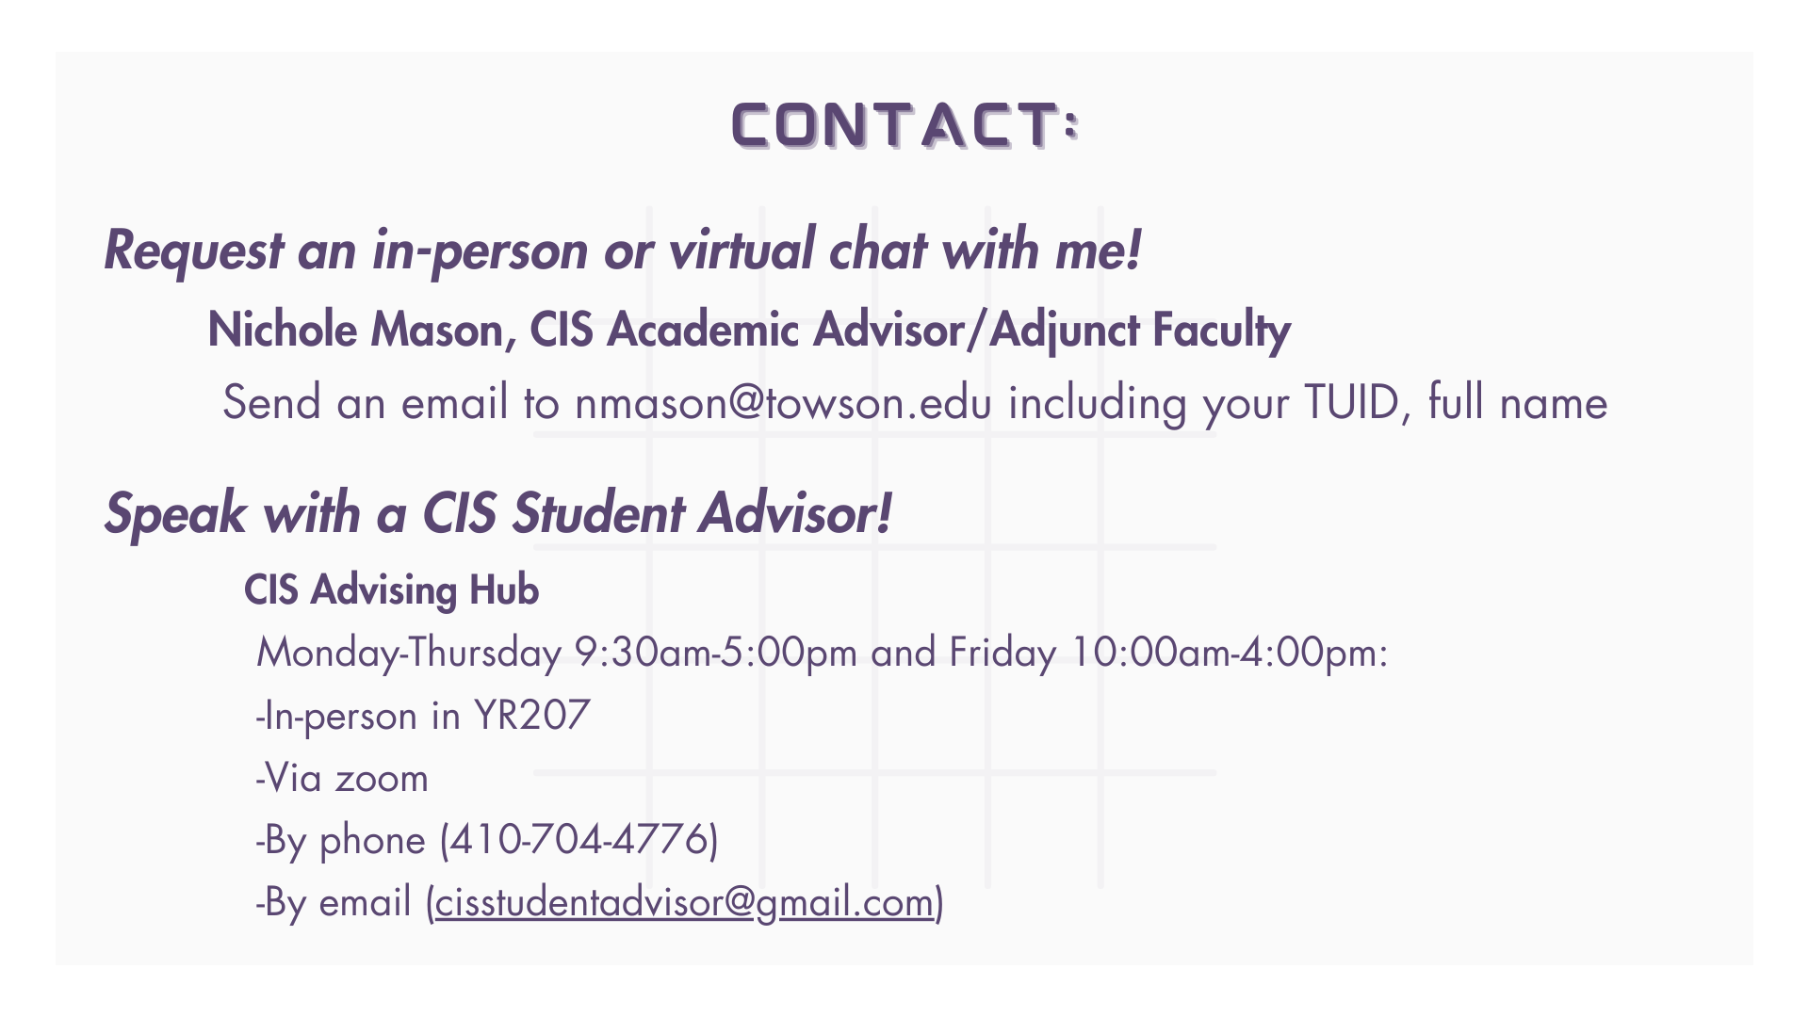
Notes:
Lastly, if you need to talk through your decisions or find out even more information, there are always friendly faces around the department to assist you!
This presentation was sent to you by Nichole Mason, a highly skilled Academic Advisor who is always willing to have a chat! Listed on this slide is her email and the proper way to get in contact with her.
You can also speak with a student advisor! The student advisors in the Advising Hub have been in your shoes and can offer personal insight on student life as a computing major. They are all well-versed in the courses offered at Towson and are a great resource to aiding you through your college career.
It is important to note that Towson University students must complete a minimum of 120 credits total to graduate, must satisfy their major requirements, as well as, completing their 14 core requirements. Once you choose your major, you can visit the Advising Hub where a student advisor can help you complete your Degree Completion Plan, which maps out what courses you are to take to graduate from Towson with your computing major.
Thank you for listening to this presentation and remember to do your research, ask yourself questions, and reach out to Nichole, your advisor, or a student advisor for help.

