Slide 1
www.towson.edu/cis
@tu_cis

Slide 2
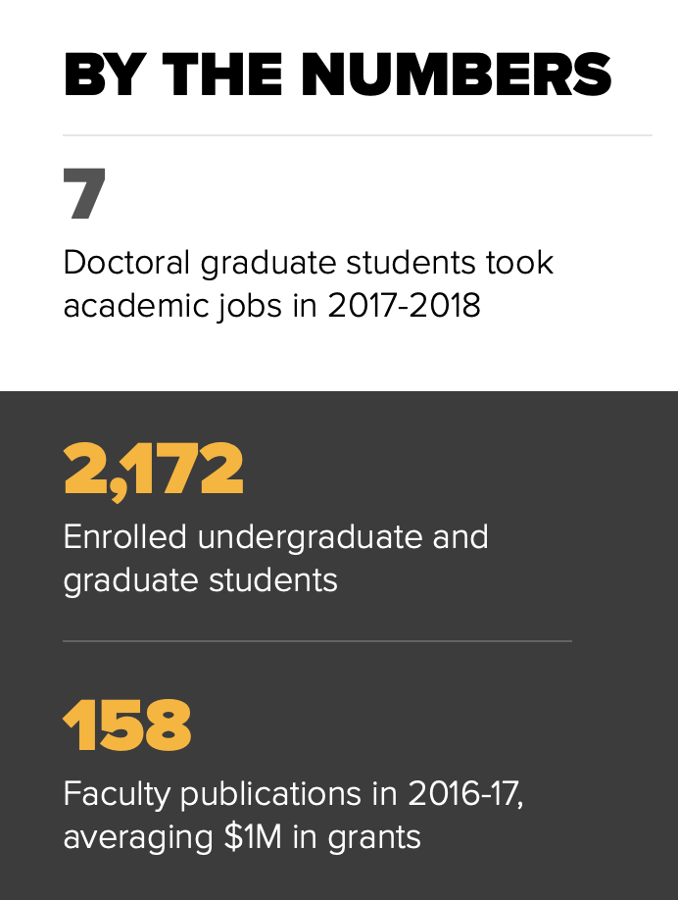
CIS Overview
Three undergraduate programs
  Computer Science
  Information Systems
  Information Technology
Three graduate programs
  M.S. in Computer Science
  M.S. in Applied Information Technology
  D.Sc. in Information Technology
Faculty
  40+ full-time faculty
  50+ adjunct professors

Slide 3

Undergraduate Programs
B.S. Computer Science
(~800 majors)
  ABET accredited B.S. Computer Science
  Two tracks/subplans: Cyber Operations and Software Engineering
  National Center of Academic Excellence (CAE) in Cyber Defense
  Education (CAE-CDE)
  NSA CAE in Cyber Operations (1 of 19 in the nation)
B.S. Information Systems
(~200 majors)
  Three tracks/subplans: Systems, Business
  and Interface Design
B.S. Information Technology
(~700 majors)

Slide 4
Graduate Programs
M.S. Computer Science
(~130 students)
  Four tracks: Software Engineering, Computer Security,
  Data Science, and e-Commerce
M.S. Applied Information Technology
(~200 students)
  Affiliated with School of Emerging Technologies
  Eight post-baccalaureate certificates
D.Sc. Information Technology
(~60 students)
  One track: Computer Science

Slide 5
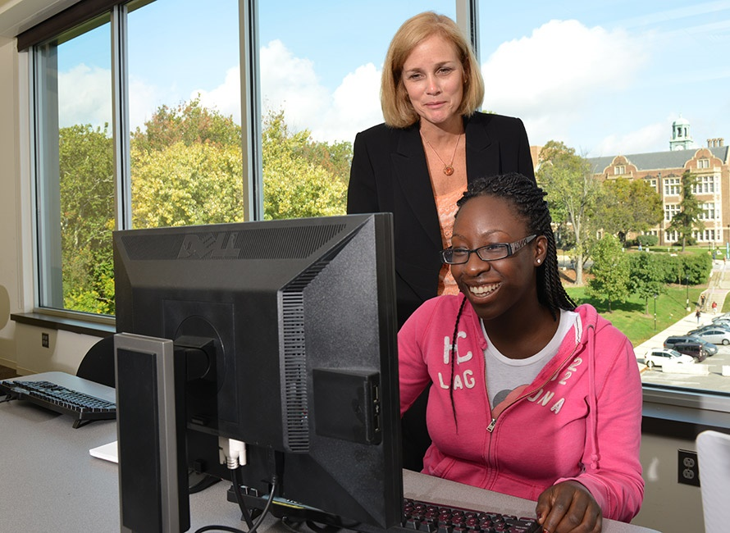
Cutting Edge Courses
Artificial intelligence
Bioinformatics
Computer graphics
Decision support systems
E-commerce
Human-computer interaction
Robotics
Mobile app development
Reverse Engineering/Malware Analysis
Social Network Analysis
Capstone courses
Scientific modeling/Simulation
Software engineering
Web-based programming
Operating systems security
Network security
Application software security

Slide 6
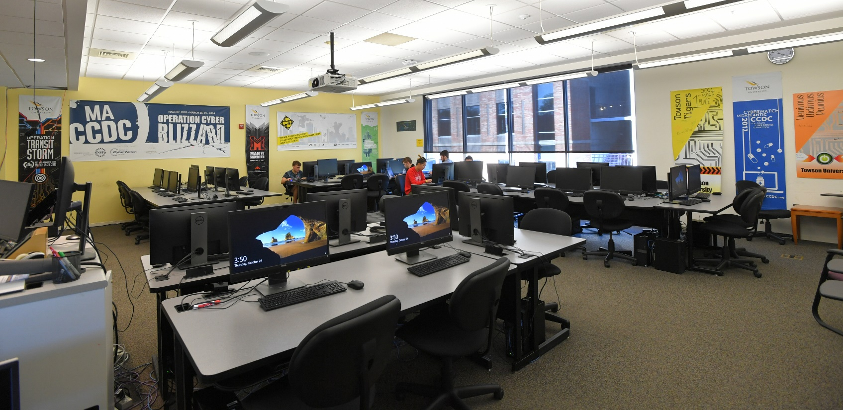
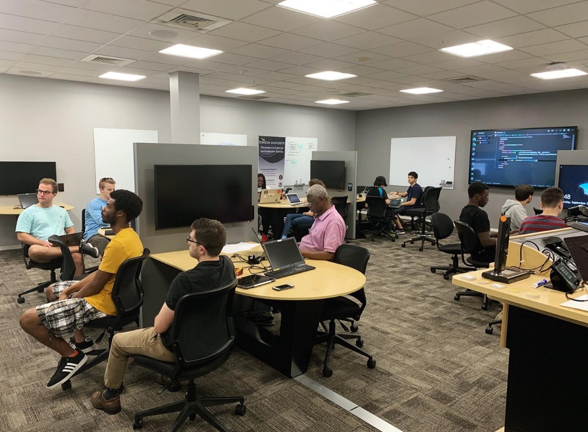
Classrooms / Labs
Smart classrooms
  Recording facilities
  Active learning labs
15 labs including:
  linux project lab
  software engineering lab
  security lab
  mobile development lab
  security injections lab
  bare machine computing lab
  human computer interaction lab
  cyber-physical systems lab
  computer vision lab
  computer forensics lab

Slide 7
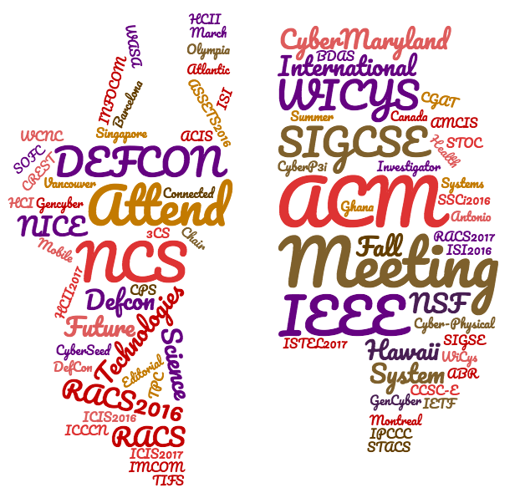
Faculty Professional Development
84 trips supported in
2016-2017
Faculty Development – Workshops
Research Presentations
Grant funded
Department funded
College Funded

Slide 8
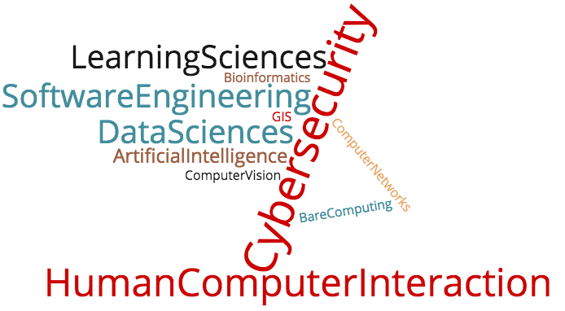
Research
Federal and state grants for both curriculum development and research
  Security Injections/Cyber4All, Cyber-Physical Systems, Wireless Security, Bioinformatics, Data Mining, Computer Vision, Application Development

Slide 9
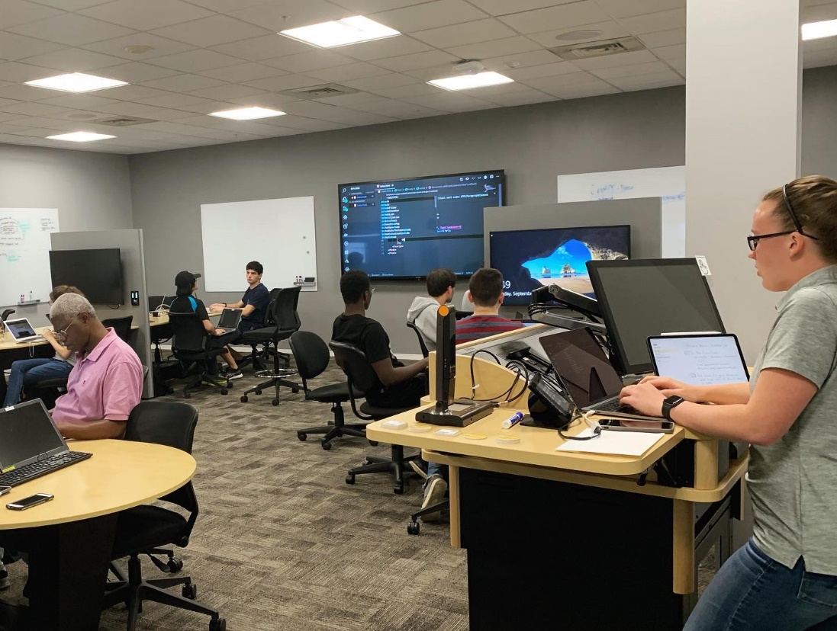

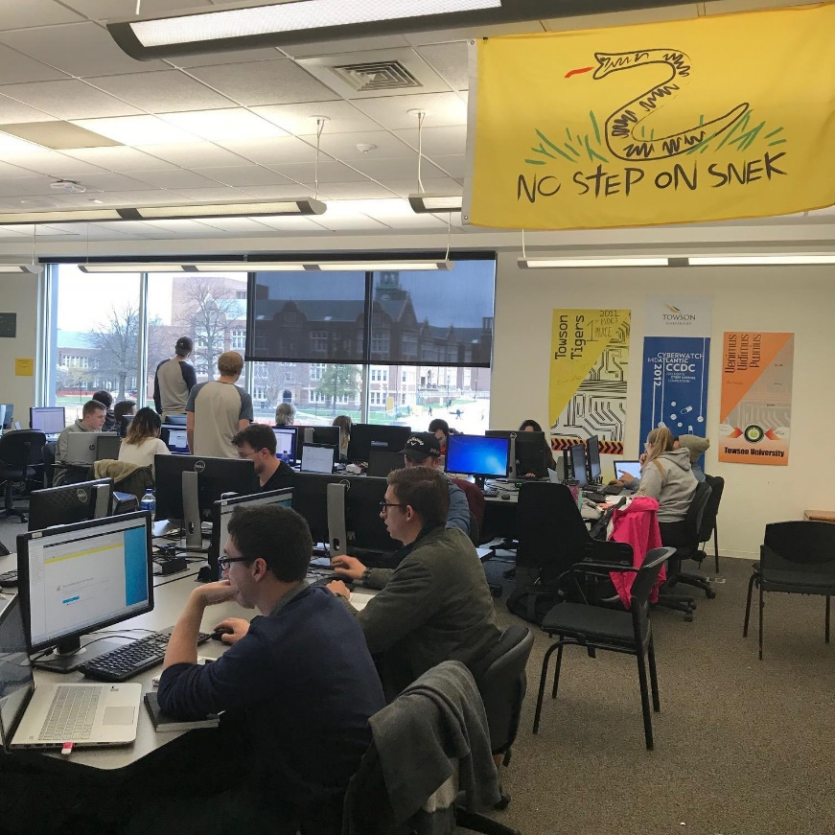
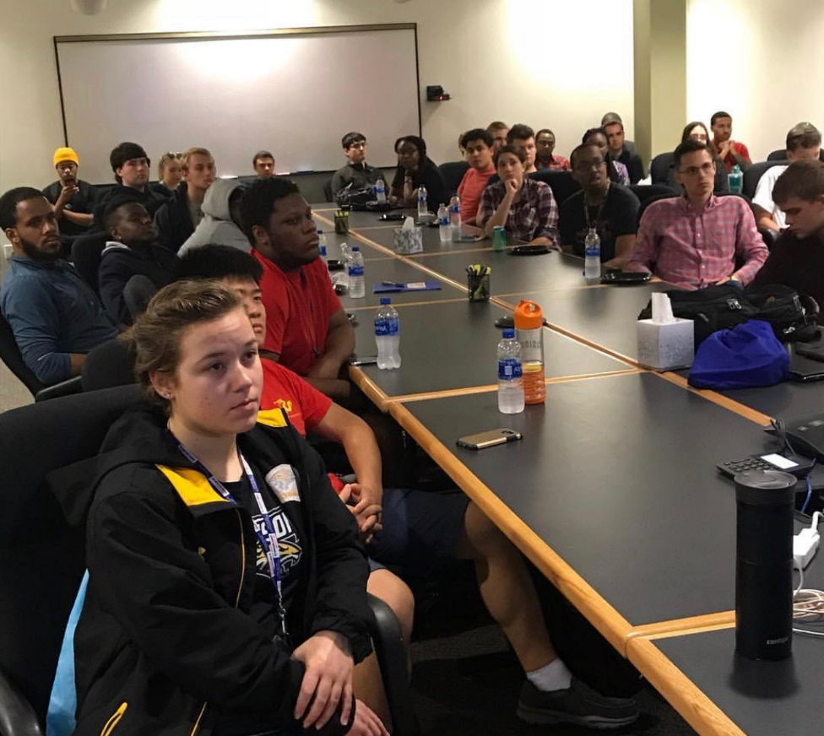
Learning outside the classroom
Software
Engineering
Club
Student Lead
Hackathon - 2017
Cybersecurity,
Mobile Dev, and
Research Seminar
Series
Active
Security Club

Slide 10
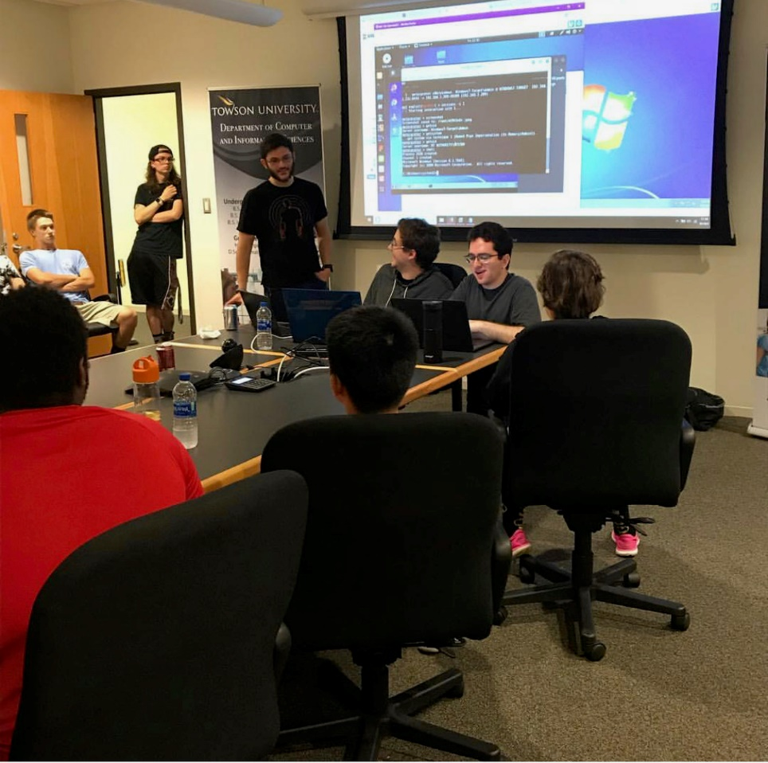
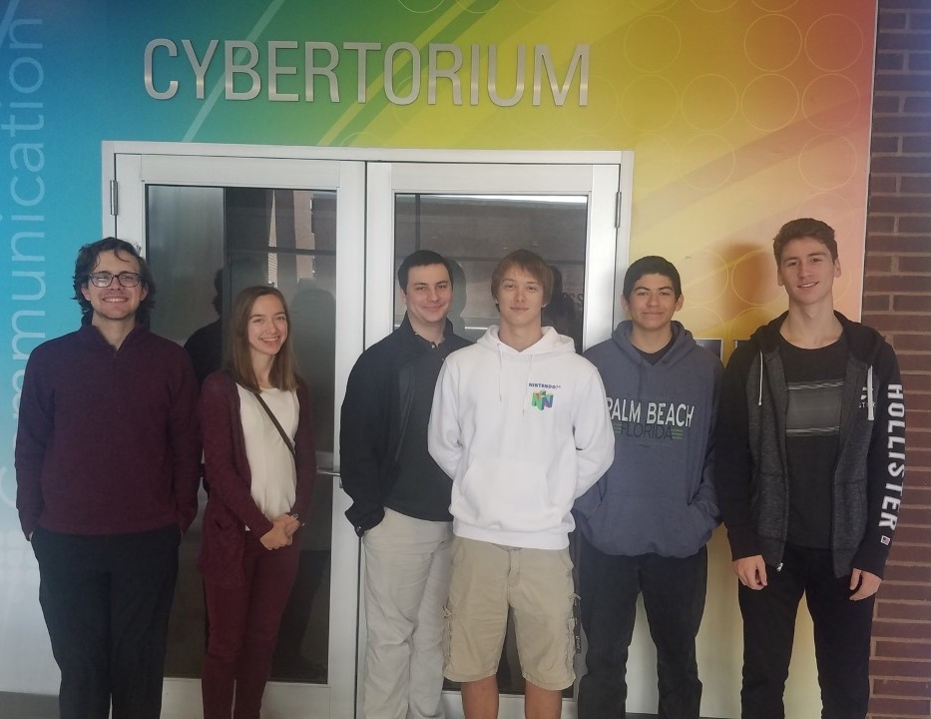
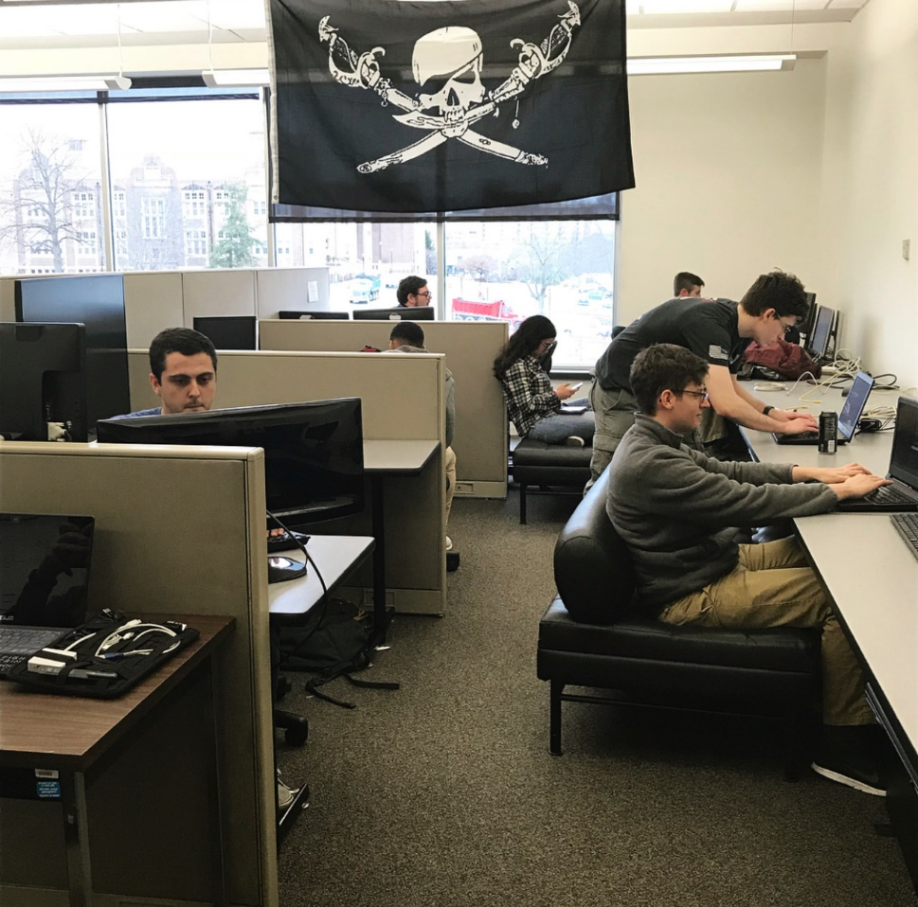
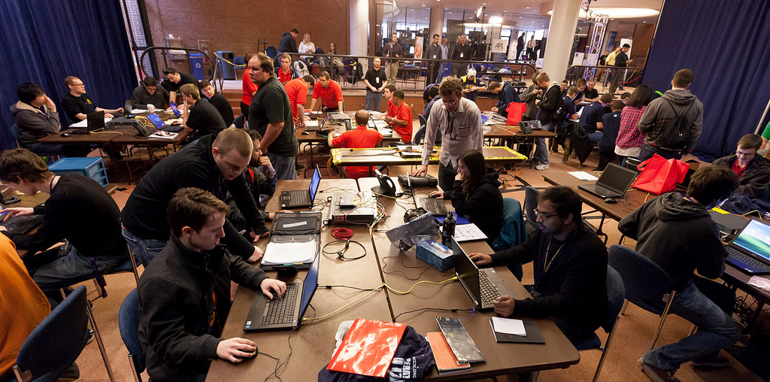
Award Winning
Cyber Defense Team
First in mid-Atlantic CCDC –
2010, 2012, 2014 and
ranked at the nationals

Slide 11
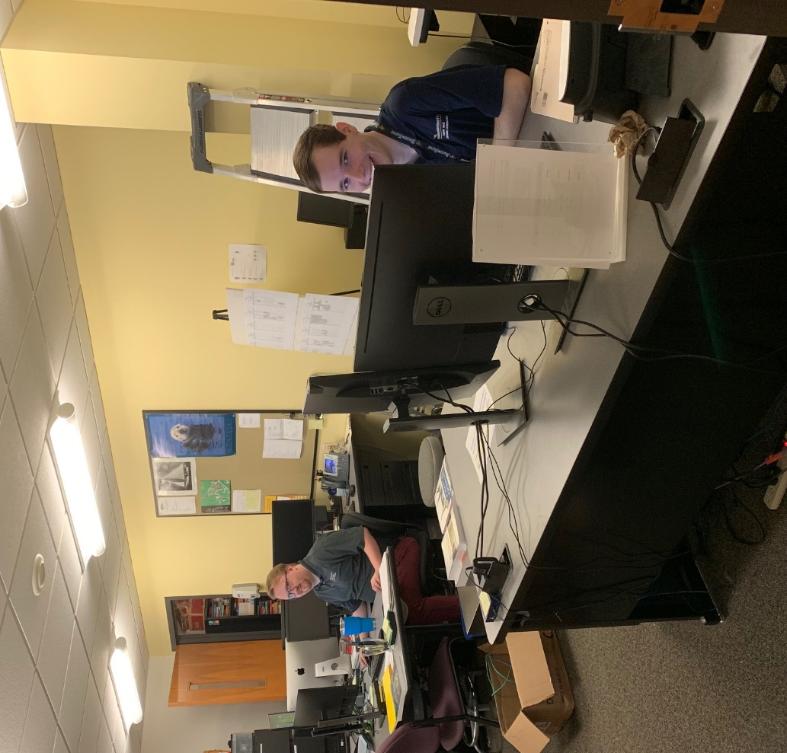
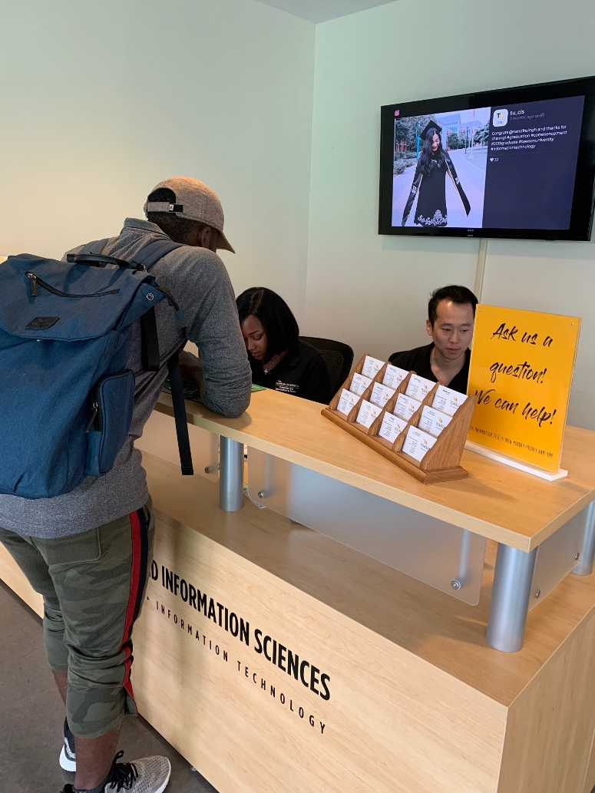
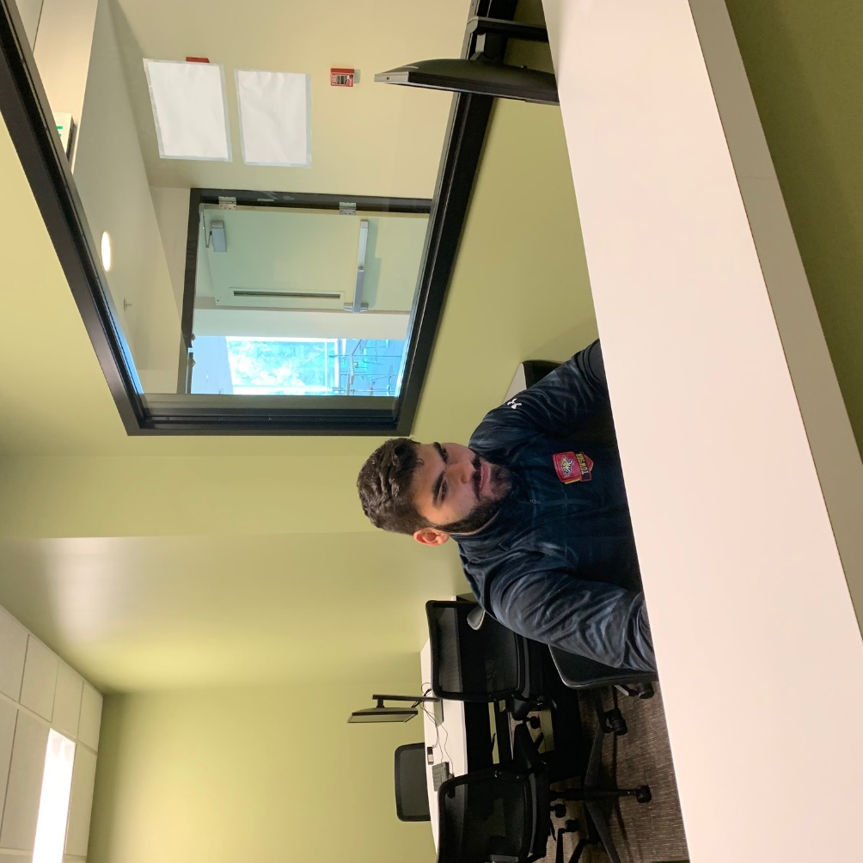
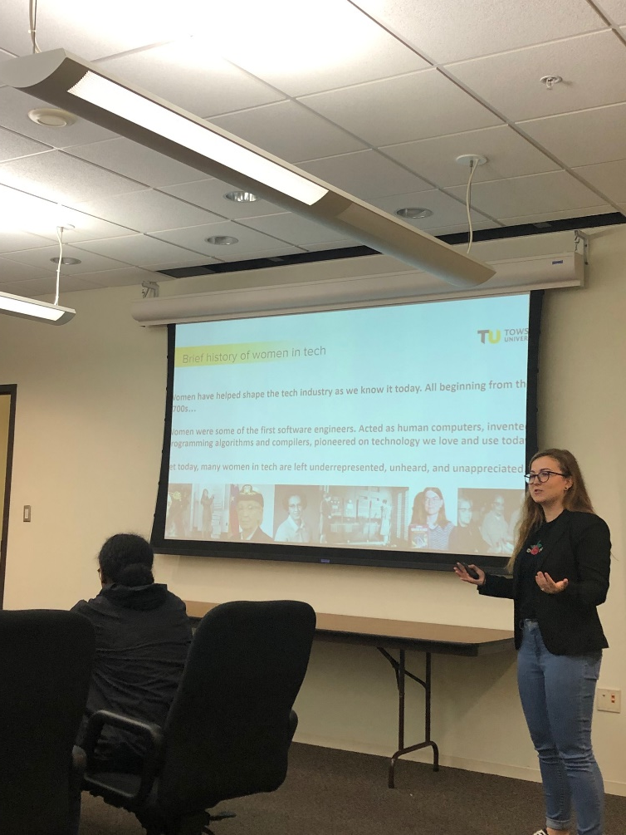
Student Resources
Research opportunities
Internships
Scholarships
Tutoring
Cyber Defense Team
iTech Club
Women in Tech Club
Data Science Club
Software Engineering Club
UPE Honor Society
CIS Help Desk and Lab Admins

Slide 12
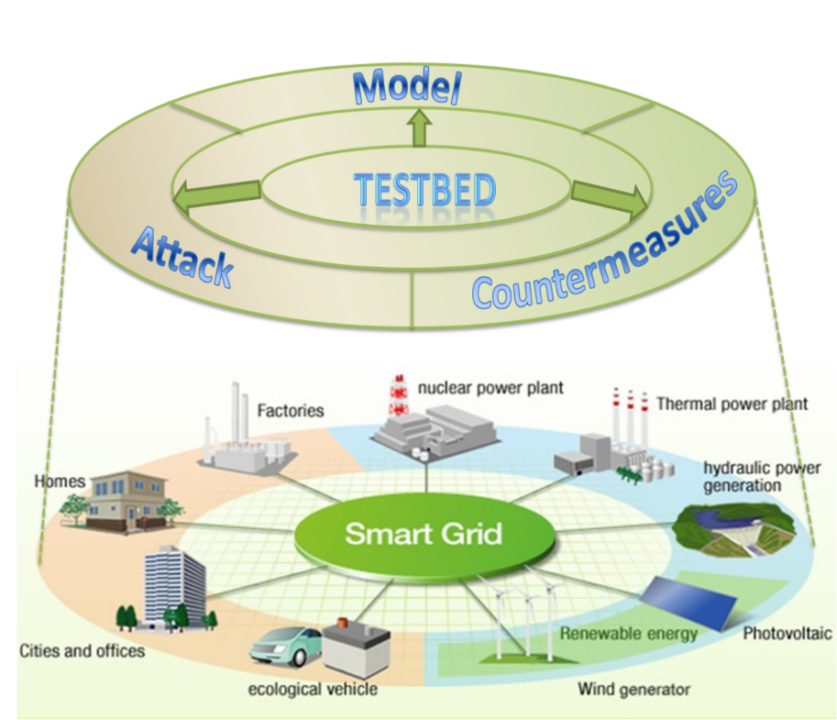
Cybersecurity Research Projects
Secured and Efficient Energy-based Critical Infrastructure
Cloud-Based Threat Monitoring and Detection on Heterogeneous Mobile Devices
Student learning and module effectiveness using eye-tracking

Slide 13
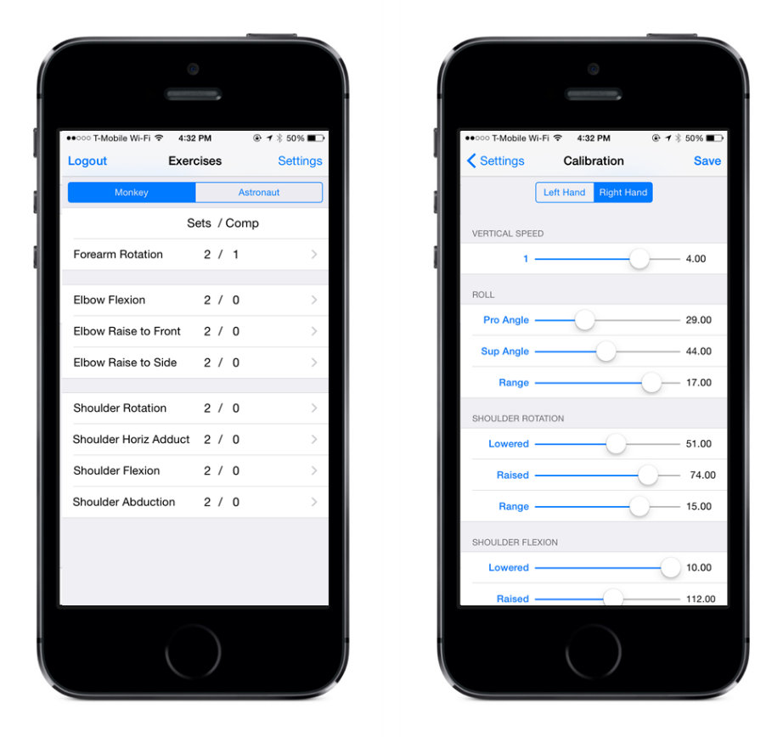
Software Engineering
Research Projects
Using Qualitative Analysis Methods in Requirements Engineering
Collaborative Rehabilitation Support System

Slide 14





CyberCorps®:
Scholarship for Service
    Scholarship Benefits :
      ~$23,000 stipend per year
      Fully paid tuition & fees
      $1,000 for textbooks
      $1,200 for health insurance
      $3,000 for travel to professional conferences and job fairs
http://www.towson.edu/cybercorps

Slide 15












Where our Graduates
are Employed

Slide 16
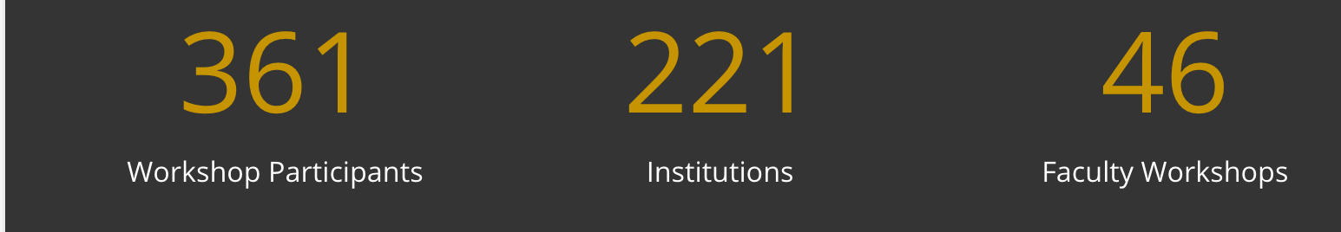
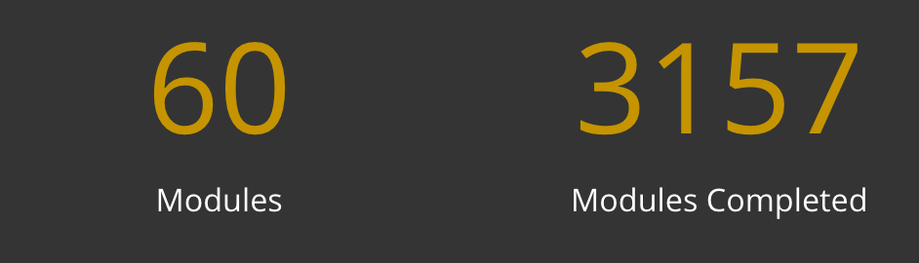
Cyber4All @Towson towson.edu/cyber4all
    Security across the curriculum
    Secure Coding
      CS0, CS1, CS2
      Early and often
      High-impact topics
      Security Checklists
      Minimally Invasive
    Other areas
      Computer Literacy
      Healthcare
      Risk Management
    Over $2 million in funding

Slide 17
www.towson.edu/cis
@tu_cis

