Slide 1

Ocean Acidification and Oysters
How might increasing levels of CO₂ affect Oysters in Maryland?

Slide 2
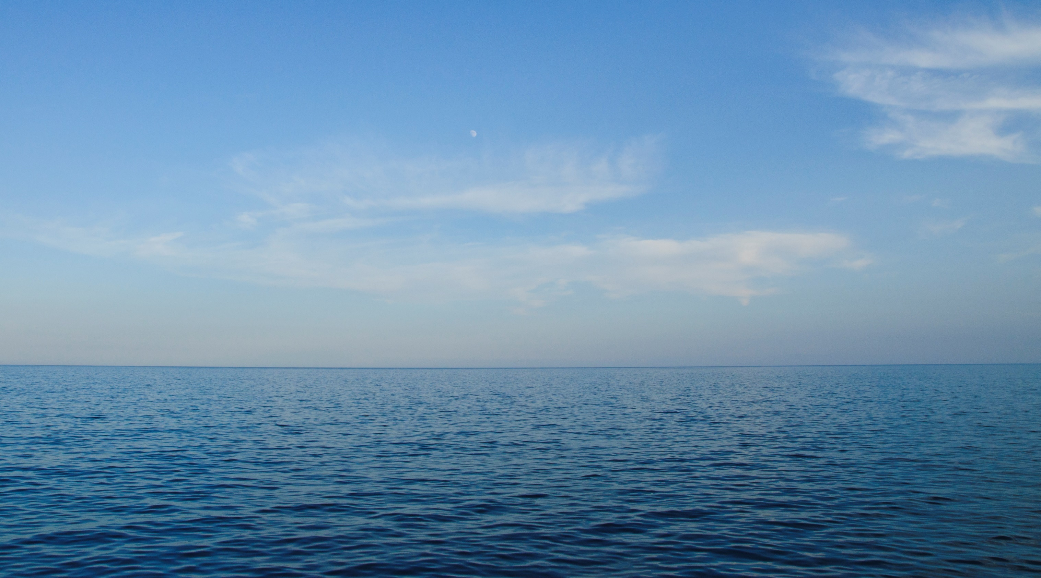
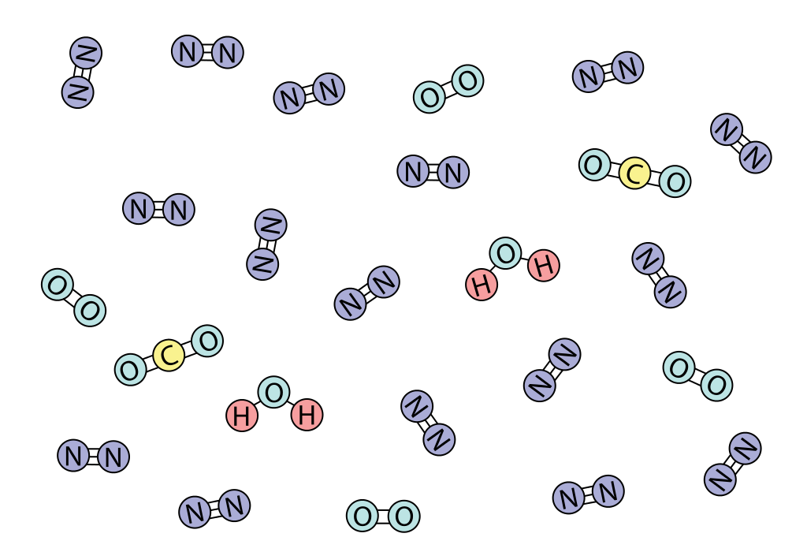
What does carbon dioxide (CO₂) in our atmosphere do for the Earth?
It’s a greenhouse gas that warms the earth (and it feeds plants).

Slide 3
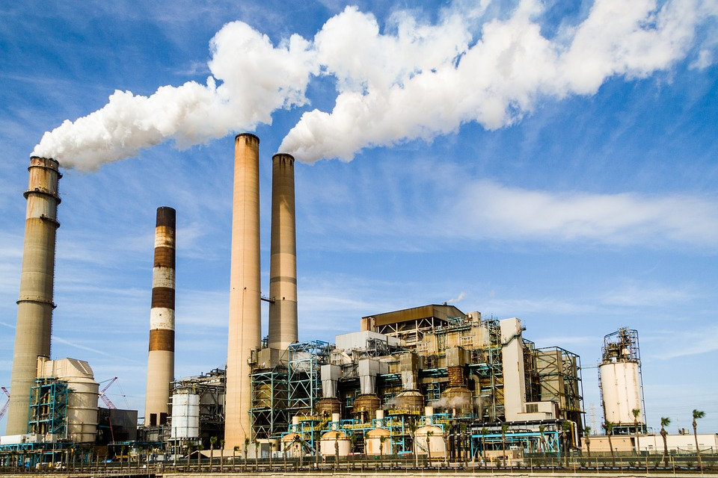
What happened when people starting burning fossil fuels for energy?
More CO₂ was released and it went into the atmosphere and oceans.
http://maxpixel.freegreatpicture.com/Industry-Plant-Industrial-Energy-Factory-Power-1827884

Slide 4
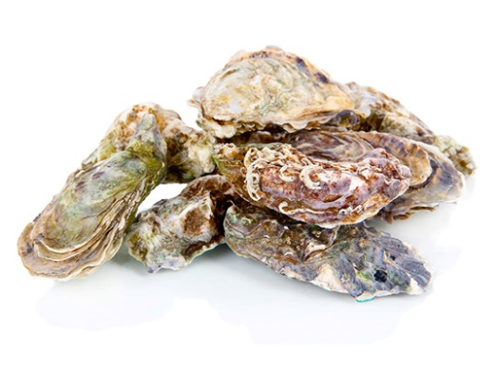
In the atmosphere, it caused the Earth to become warmer and warmer.
And in the oceans, it is affecting the organisms that live there. Like oysters.
http://maxpixel.freegreatpicture.com/Industry-Plant-Industrial-Energy-Factory-Power-1827884

Slide 5
You’re going to be figuring out how all this extra CO₂ is affecting marine organisms.
Like oysters.
http://maxpixel.freegreatpicture.com/Industry-Plant-Industrial-Energy-Factory-Power-1827884

Slide 6


Whaddya know?
In small groups, examine the object you’re been given and make observations and inference about the object.

Slide 7
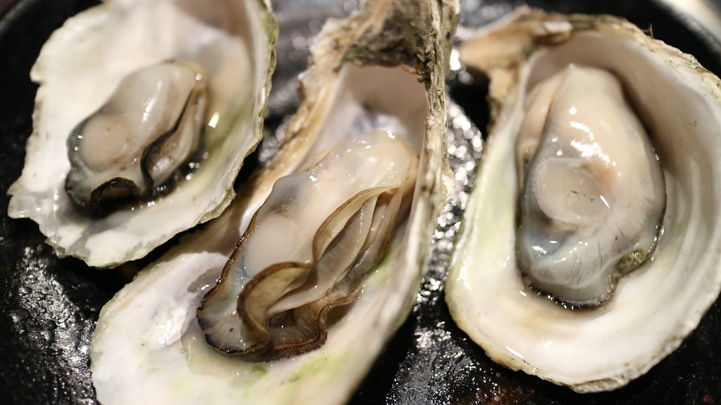
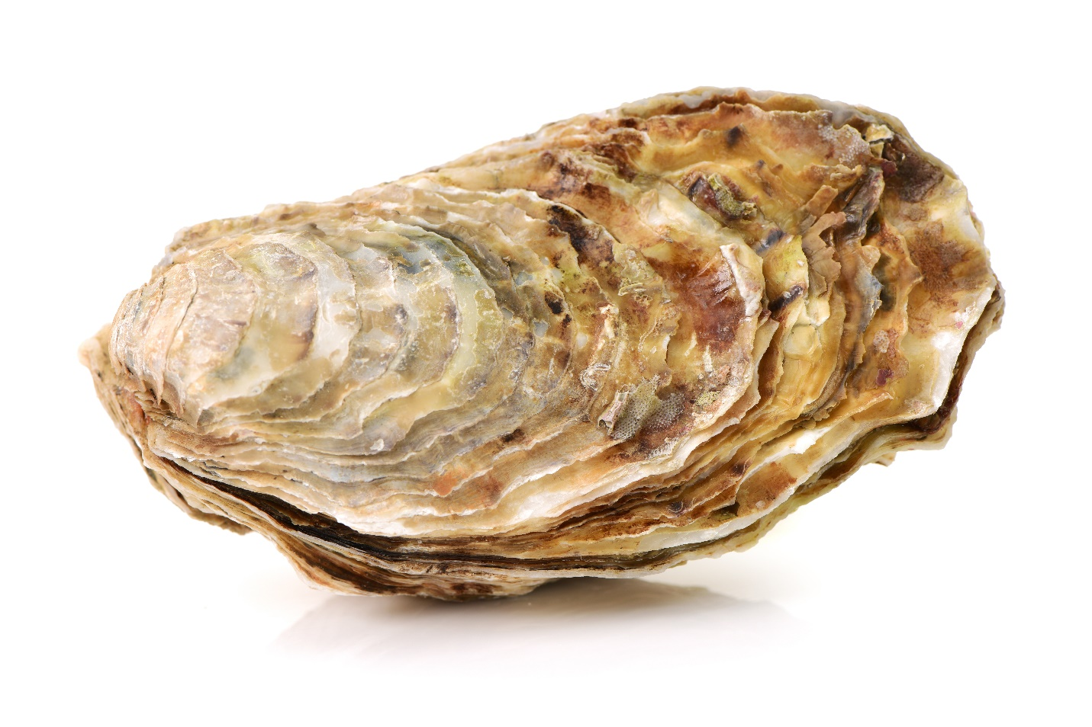
Whaddya know?
Read All About Oysters

Slide 8
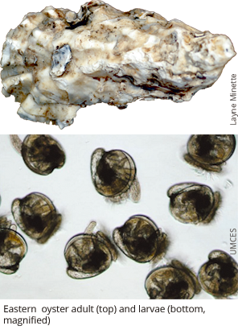
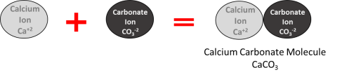
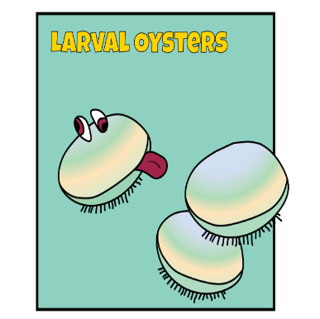
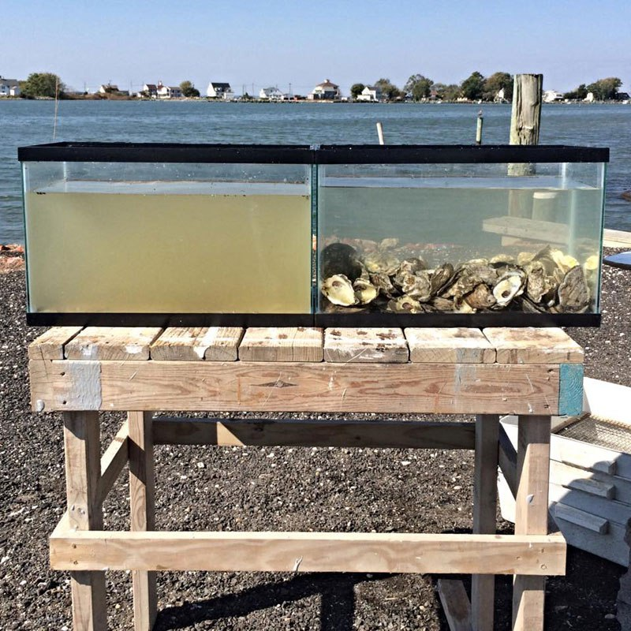
Photo credit Steve Vilnet
http://www.squidtoons.com/uploads/2/2/5/9/22596580/7373245_orig.png
Notes:
Key points from “All about Oysters” reading

Slide 9
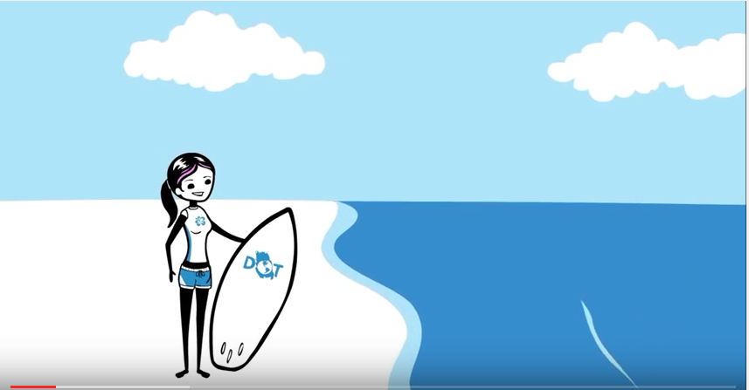
Now that you know a little bit about oysters…
https://www.youtube.com/watch?v=Wo-bHt1bOsw STOP at 1:13
Notes:
Ocean Acidification Video: STOP the video at 1 min 13 secs. If you do not, the video gives away the answers the students are working to figure out on their own throughout this activity.
By now you’ve heard that the way we’re living is filling up our atmosphere with CO2. As a result, the planet’s warming. Heat waves and floods are more likely to be extreme and people’s lives will get tougher. And the more we learn about climate change, the more risks we uncover. Since we started burning fossil fuels, the ocean has absorbed about half of all the co2 we humans have put out. That’s why it’s called the planet’s biggest carbon sink. Now this is good, because it’s kept a lot of CO2 out of the atmosphere. But as the ocean warms, it takes up less and less CO2. And with all that CO2 in the sea, scientists are shedding light on, well, an ocean of problems.
Ready for the first big problem? Some sea creatures like clams, oyster and coral, their shells and skeletons are getting weaker. Okay, you got bigger problems than easy to crack clams? Maybe not, if you’re among the 1 in seven people who get most of their protein from seafood. Or if you understand how unstable the world would be with a billion more hungry people.
This will link oysters to the concept of climate change. By stopping at 1:13, we don’t yet say what CO2 does to ocean.

Slide 10
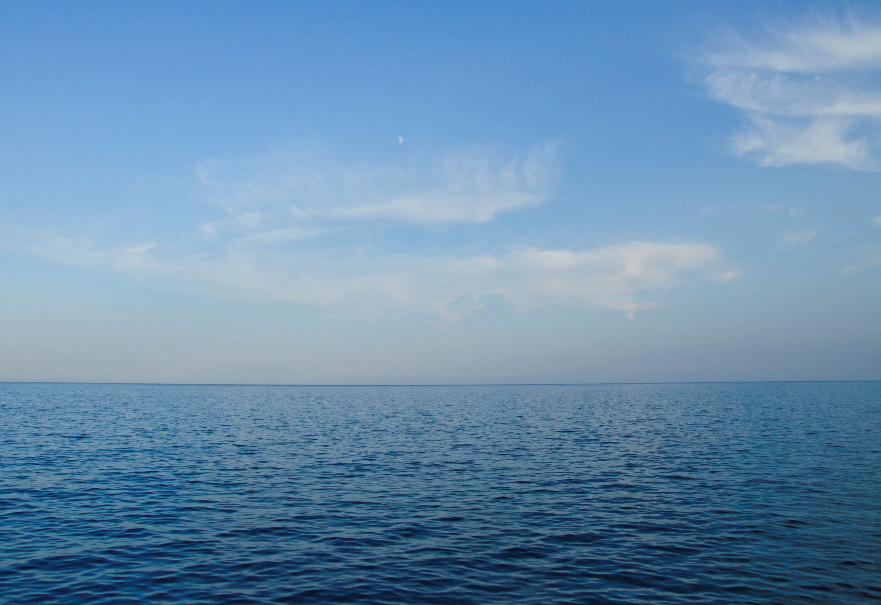
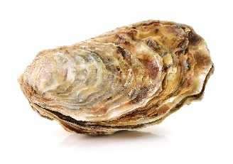
Increasing amounts of CO₂ in ocean are affecting lots of organisms that live in the ocean, including oysters.
https://s-media-cache-ak0.pinimg.com/originals/00/75/ee/0075eed2635f23fad42281deb9d633e9.jpg

Slide 11
Oysters clean the Bay.
Why does it matter that oyster populations are declining?
Organisms rely on oysters for habitat and food.

Slide 12


You will be exploring and answering the driving question:
http://maxpixel.freegreatpicture.com/Industry-Plant-Industrial-Energy-Factory-Power-1827884
How might increasing levels of CO₂ affect oysters in Maryland?

Slide 13

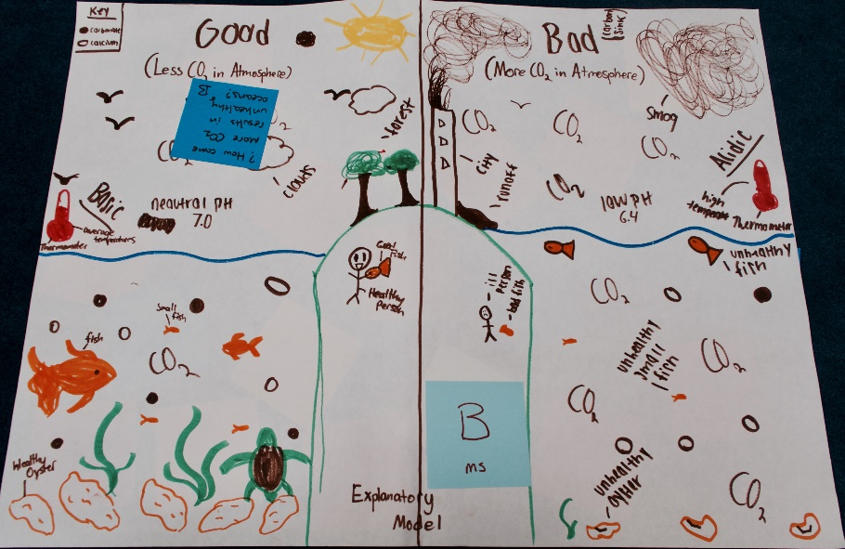
Building an explanatory model
An explanatory model contains pictures, diagrams and written explanations that describe how and why a phenomenon occurs.
Your model should include pictures, arrows, and words that will explain and clarify your ideas and explanations.
You will be building your own explanatory model to explain how increasing levels of CO₂ affect Oysters in Maryland.
You will be adding to, and revising, your model over the course of the next few classes.

Slide 14
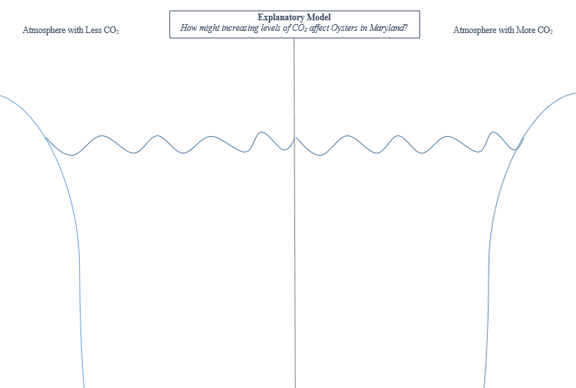
How might increasing levels of CO₂ affect Oysters in Maryland?
‘Gotta-Have’ ideas for your explanatory model
…
Begin constructing your explanatory model.
Notes:
See facilitation guide for list of ideas students might include.

Slide 15
What effect does increasing the amount of CO₂ in ocean have on ocean pH?
pH is a characteristic of water
Levels of pH can affect which organisms can survive in an environment

Slide 16
  What effect does increasing atmospheric CO₂ have on ocean pH?
Basic
14
pH is a measure of how acidic or basic something is
13
12
pH can be a measure of water quality. Many organisms can only survive in water with a specific pH level.
What is pH?
11
10
9
8
pH is measured on a scale from 0-14.
7
6
5
4
Can you give examples of substances with different pH values?
3
2
1
Acidic
0

Slide 17
  What effect does increasing atmospheric CO₂ have on ocean pH?
Basic
14
Bleach
13
12
pH of ocean water is ~8.1 but can vary depending which ocean you’re talking about and what part of the ocean.
Ammonia
11
10
9
8
The Chesapeake Bay water is similar in pH to ocean water, but can go up and down daily because of the Bay’s unique ecosystem.
7
Distilled Water
6
Milk
5
4
Tomatoes
3
2
1
Stomach Acid
Acidic
0

Slide 18
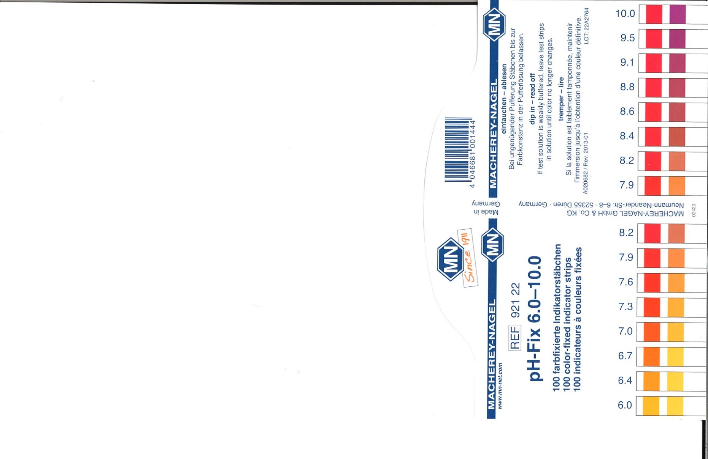
How to determine pH of a substance
b
a
c
Notes:
Teachers can press escape and use the mouse to move the example strips around.
Remind students to match both colors as best they can.
Kids might struggle to get an ‘exact’ match and that’s ok. Tell them to do the best they can.
A = ~7.6
B = ~6.4
C = ~9.5

Slide 19
What effect does increasing CO₂ in the atmosphere ocean have on ocean pH?
Increasing amounts of CO₂ in atmosphere means more CO₂ going into ocean.
How might more CO₂ in ocean affect the pH of the water?

Slide 20

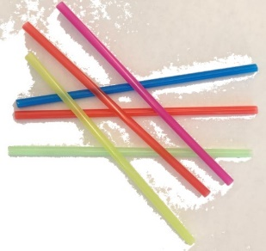
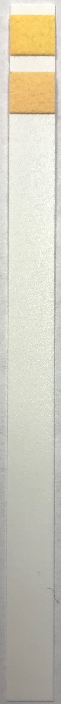
Design your own investigation!
What effect does increasing amount of CO₂ in oceans have on ocean pH?
Write your plan in your student handout. Give enough details so a friend could conduct your investigation without having to ask you questions.
pH test strips

Slide 21
Share your protocol
Share
Use Peer Review Rubric to help you give feedback
Discuss the feedback your group receives and make any changes or adjustments to your plan.

Slide 22

Conduct your investigation!

Slide 23
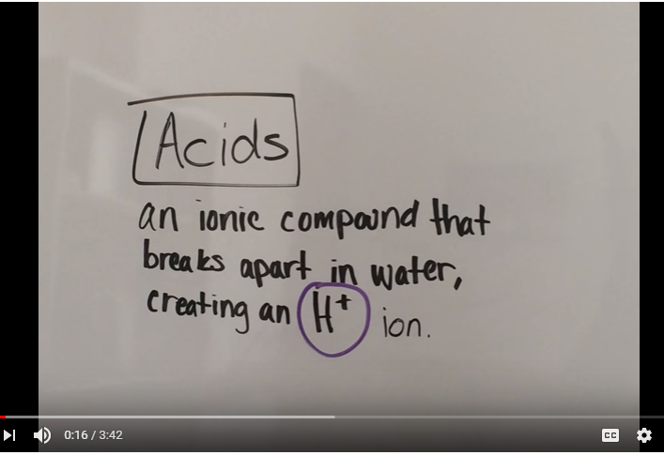
Acids, Bases and Ocean Acidification
https://www.youtube.com/watch?v=QH0HAyxqdoY
Optional High School video
Notes:
Video Transcript:
So, first we will explain the definitions of acids and bases. The definition of an acid is an ionic compound that breaks apart in water, creating a hydrogen ion. A base is also an ionic compound that breaks apart in water. But bases remove hydrogen ions, sometimes also creating a hydroxide ion.
When an acid and a base react, they form two things, a water and a salt. Remember that when we say salt in chemistry we’re not talk in about table salt necessarily, we’re talking about any ionic compound, which could include table salt. For example, let’s combine hydrochloric acid, an acid obviously. And sodium hydroxide (NaOH), a base. We are adding the sodium hydroxide slowly into the acid and we’ve used indicator to determine when they neutralize. As a result, we got water and table salt, or sodium chloride. We then boiled off the water to see the salt.
When talking about chemical reactions, there is a really big topic that comes up: equilibrium. Equilibrium can be explained as when a forward reaction happens at the same rate as the reverse reaction, making the products and the reactants stop changing. All reactions eventually reach equilibrium, the only exception is if the system isn’t closed. If the system is open, it’s possible the reaction will never reach equilibrium, since compounds can leave the system and come into the system.
In 1884 La Chatelier’s principal was proposed. La Chatelier’s principle is what happens in a system when it is taken out of equilibrium. There are three ways to take a system out of equilibrium, changing the temperature, pressure or concentration of the compounds. When you take a system out of equilibrium, it tries to get back to equilibrium since that is the desired state.
Let’s say you add more of the reactants. At first the equilibrium moves to the left. But what the system will do is it will start reacting with the reactants and creating products until it is balanced out again. If you increase the pressure, the system will react in a way that creates less molecules, and therefore lowering the pressure of the system. If you decrease the temperature, the system will heat itself up to regain equilibrium.
Huge unnatural amounts of carbon dioxide are emitted into the atmosphere by cars, factories and other man made fuels burning sources. This fairly recent and sudden mass release of carbon into the atmosphere is negatively affecting sea life. The carbon dioxide finds it’s way from the atmosphere into the ocean. When the carbon dioxide meets the water, it reacts and forms carbonic acid.
Each molecule of carbonic acid then releases two hydrogen ions, which increases the acidity of the water and in turn, dissolves the calcium carbonate of shells and exoskeletons of sea creatures. Zooplankton have very thin exoskeletons and the increased acidity of the ocean threatens to react with the calcium carbonate in their shells. Zooplankton are the base of the oceanic food chain, and without them the food chain would collapse, affecting the vast majority of marine species.

Slide 24
Scientific Explanation
Write a scientific explanation that answers the investigative question: What effect does increasing the amount of CO₂ in the ocean have on ocean pH?
Make sure to include:
  Claim
  Evidence
  Reasoning
Claim:
Evidence:
Reasoning:

Slide 25
How might increasing levels of CO₂ affect oysters in Maryland?
‘Gotta-Have’ ideas for your explanatory model
…
Continue building your explanatory model by adding new ideas and information and revising and correcting what you already have.

Slide 26

How do oyster larvae form shells?
Ca⁺²
CO₃⁻²
CO₃⁻²
CO₃⁻²
Ca⁺²
Ca⁺²
Carbonate
Calcium
Ca⁺²
CO₃⁻²
Ca⁺²
CO₃⁻²
CO₃⁻²
CO₃⁻²
Ca⁺²
CO₃⁻²
Ca⁺²
Calcium carbonate

Slide 27
How do oyster larvae form shells?
Ca⁺²
CO₃⁻²
CO₃⁻²
CO₃⁻²
Ca⁺²
Ca⁺²
Carbonate
Calcium
Ca⁺²
If oyster larvae can’t form shells, they cannot eat and they don’t survive to reproduce.
CO₃⁻²
CO₃⁻²
CO₃⁻²
Ca⁺²
Ca⁺²
CO₃⁻²
CO₃⁻²
Ca⁺²
Calcium carbonate

Slide 28
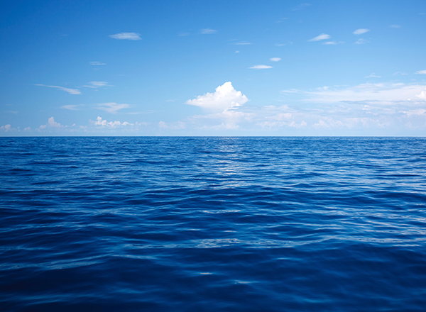
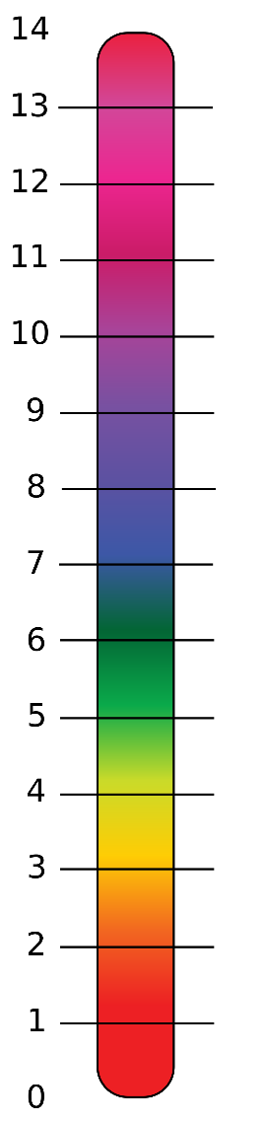
How does a more acidic ocean affect oyster larvae’s ability to build shell?

Slide 29
Models
Scientists use models to explain phenomena.
How are models used in science?
Scientists also use models to make and test predications about phenomena.

Slide 30
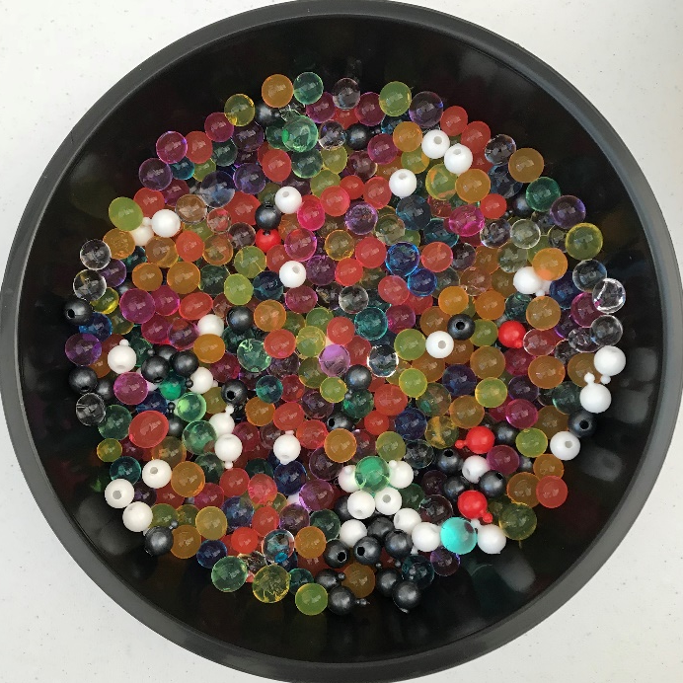
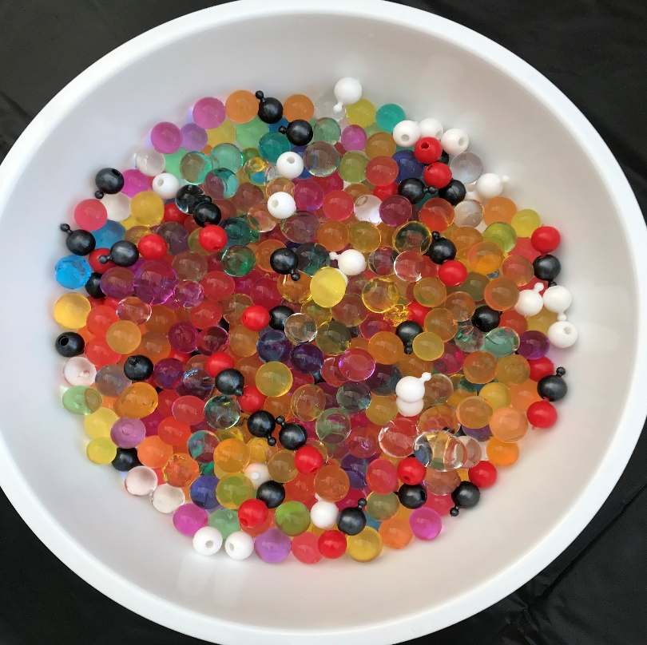
The Carbonate Model Challenge
Which of these oceans represents a healthy ocean and which represents an acidified ocean?
Ocean in
black bowl
Ocean in
white bowl

Slide 31
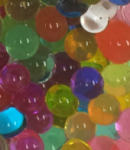


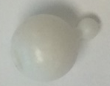
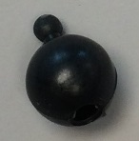
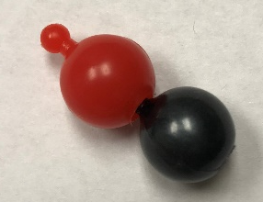
The Carbonate Model Challenge
What do the parts of this model represent?
Water molecules (H₂0)
Calcium ion (Ca⁺)
Carbonate ion (CO₃⁻²)
Bicarbonate ion (HCO₃⁻)

Slide 32
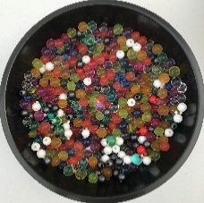
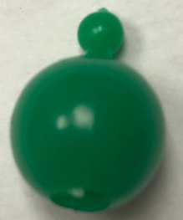

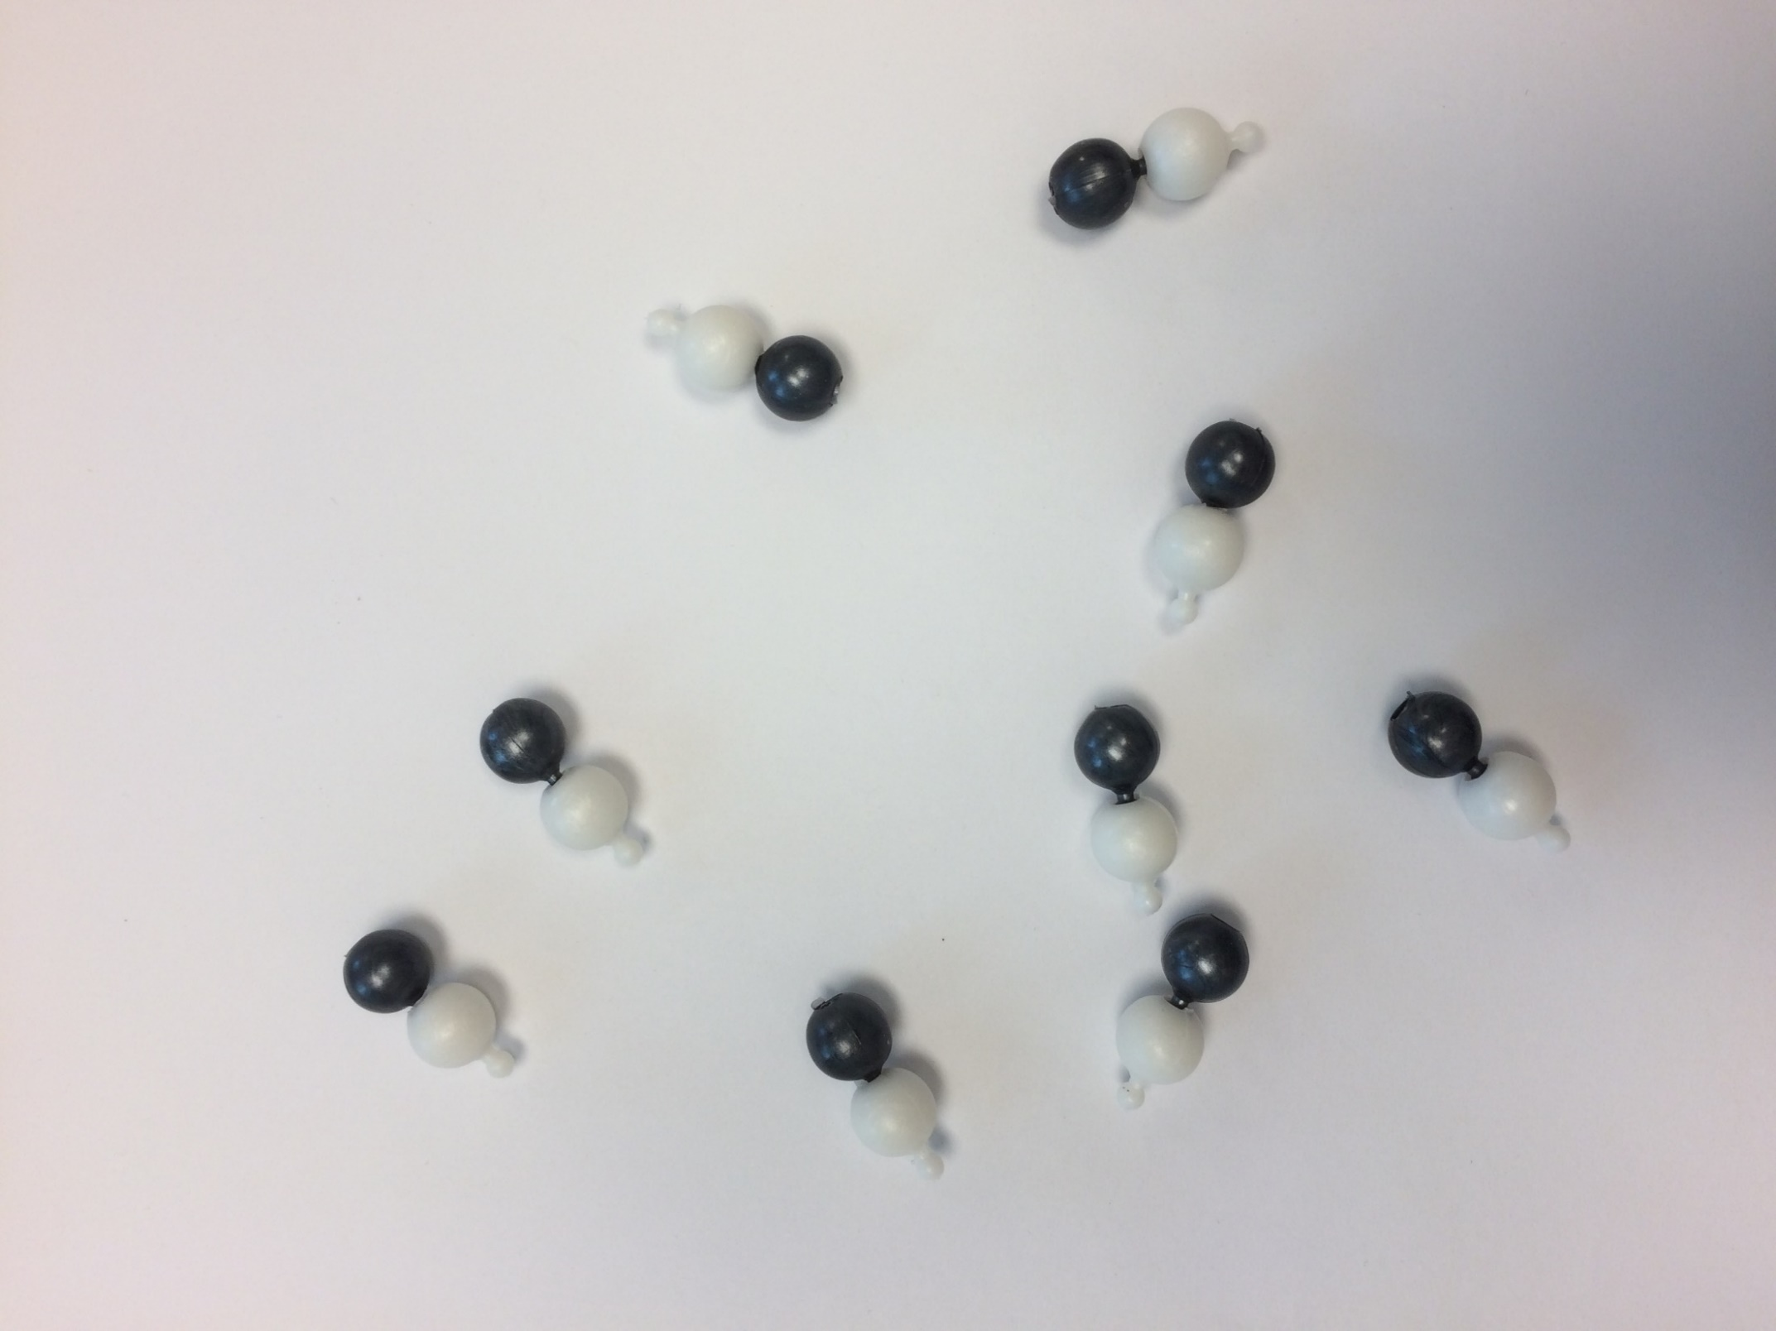
You will use the Carbonate Model Challenge to compare how oysters are able to make shells in an acidified ocean compared to a healthy ocean.
Let’s review what the parts of our model represent in real-life…
Calcium ion (Ca⁺²)
Water molecules
Bicarbonate ion (HCO₃⁻)
Carbonate ion (CO₃⁻²)
Oceans
Just for practice- doesn’t represent anything in the model
Calcium carbonate molecule (CaCO₃)

Slide 33
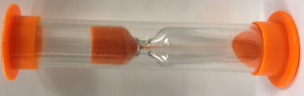



How many calcium carbonate molecules can an oyster larva make in 90 seconds in each ocean?
The Carbonate Model Challenge
Only one ‘oyster larva’ per ocean
Must form calcium carbonate molecules (so must have one black bead attached to one white bead)
Start when timekeeper says start
Stop as soon as timekeeper says stop
Do this twice, or enough times so each person in group gets turn to be the oyster larva looking for calcium carbonate at least once
Write the results from each trial on the laminated Carbonate Model Challenge instructions
Ocean in black bowl
Calcium Carbonate
Ocean in white bowl

Slide 34
Class data from Carbonate Model Challenge
 | # Calcium Carbonate Molecules/90 seconds
Group | Black Bowl (Ocean) | White Bowl (Ocean)
Average
Describe the patterns you see in the data on your student handout.

Slide 35
Carbonate Model Challenge Analysis
What patterns did you find in the data?
Why was it more difficult to make calcium carbonate in one of the models?
How is the model you used similar to the real-life system?
How is the model you used different than the real-life system?

Slide 36
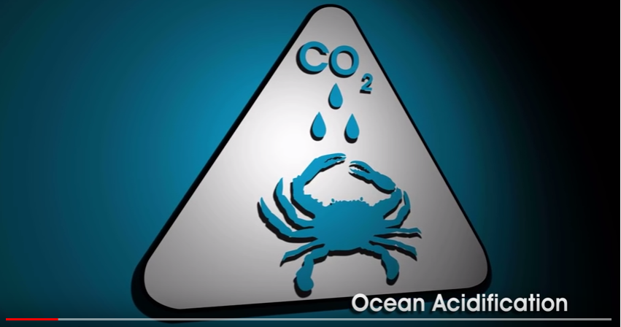
Effect of Ocean Acidification on Shell-building Organisms
https://www.youtube.com/watch?v=kxPwbhFeZSw
Notes:
https://www.youtube.com/watch?v=kxPwbhFeZSw
North Carolina building shells molecules
Video: 1 min, 48 seconds
Video Transcript:
Ocean acidification is causes by carbon dioxide emissions. It threatens the health of our oceans and the animals in it. Let’s start by looking at the formation of shells in animals. The shells of animals, like crabs, are formed primarily of calcium carbonate. Calcium carbonate is formed when calcium ions bind with carbonate molecules. Ocean acidification begins with CO2 emission. Most CO2 is produced when fossil fuels are burned for industrial and automotive purposes. Once in the air, CO2 is absorbed into the ocean through wave action. Once absorbed into the ocean, CO2 combines with water to form carbonic acid. Carbonic acid breaks down easily into bicarbonate molecules and hydrogen ions. Calcium and bicarbonate cannot bind together to form shells. Carbonate, that usually forms shells, binds more easily with the hydrogen ions. This makes them unable to form shells. Let’s review. In a normal ocean, calcium carbonate is taken from the water and combined with Calcium to form the shells of many animals. In an acidic ocean, abundant hydrogen ions bind with carbonate and prevent shell formation. Animals, like these crabs and those that depend on them for food may eventually disappear if they cannot easily form their shells.

Slide 37
Reflection questions on Effect of Ocean Acidification on Shell-building Organisms video
What two chemical reactions takes place when CO₂ is absorbed into the ocean?
What two types of ions do oysters need to form shells?
When CO₂ enters the ocean and undergoes chemical reactions, it produces lots of hydrogen ions. All these extra hydrogen ions make the ocean water more acidic (decreasing the pH). What happens to many of these extra hydrogen ions?
What happens to oysters if there are too many hydrogen ions in the ocean?

Slide 38
Ocean Acidification Causes, Chemistry and Impacts
Reading
How does carbon dioxide affect the pH of the ocean?
How do oysters build their shells?
Why do oysters have trouble building their shells in oceans that are becoming more acidic?
What other issues, besides ocean acidification, are facing oysters in the Chesapeake Bay?
Middle School

Slide 39
Ocean Acidification Causes, Chemistry and Impacts
Reading
What is causing the increase in carbon dioxide in the air and the ocean since the start of the industrial revolution?
How would you respond if someone asked you if oceans were considered acidic or basic?
Why do oyster larvae have difficulty building shells in oceans that are more acidic?
In the example given in the reading, describe how each would the following affect the pH of the Bay?
  Algal bloom
  Algal blooms blocking SAV access to sunlight
  Massive algal bloom die-off
High School

Slide 40
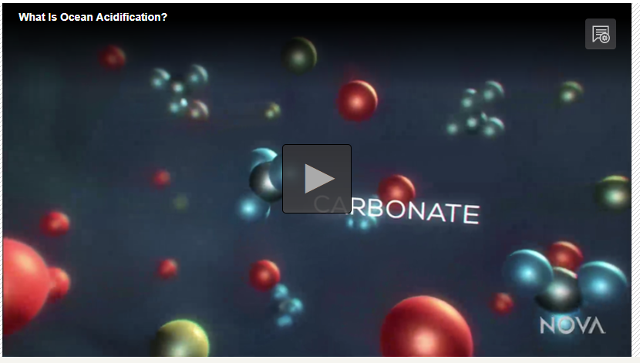
What is Ocean Acidification? Video
https://mpt.pbslearningmedia.org/resource/nvls-sci-acidification/what-is-ocean-acidification/#.WepH_CiGO71
Notes:
Video: https://mpt.pbslearningmedia.org/resource/nvls-sci-acidification/what-is-ocean-acidification/#.WepH_CiGO71
4 min 7 seconds
Samples taken around the globe over the last 40 years reveal that ocean acidity is increasing by about 5% every decade. Why is this happening? It turns out the driving force of ocean acidity is the same thing that is responsible for global warming. When we burn fossil fuels they release carbon dioxide gas, or CO₂ into the atmosphere. Much of that CO₂ blankets the planet and raises the global temperature. But about a quarter of that gas is absorbed into the oceans.
At first scientist thought this was beneficial, since the more CO₂that goes into the ocean means less in our atmosphere, reducing the warming effect. Oceanographers knew for years that carbon dioxide from the atmosphere was being absorbed into the oceans. And everyone thought, Oh perfect, this a service that the ocean is preforming for us. Storing the gas that we’re releasing. It’s a pollutant. It’s a product of our activities. So everybody thought this is awesome. But scientists soon realized that this service comes at a cost. The extra carbon dioxide absorbed by the ocean is dramatically changing the water’s chemistry.
We’re dissolving 30 million metric tons of carbon dioxide into the surface of the ocean each and every day, and that is what’s driving down the pH or increasing the acidity.
This is how it works. When carbon dioxide dissolves into the ocean, it reacts with water, H₂O. to form a weak acid called carbonic acid. This almost immediately breaks apart, releasing hydrogen ions. Those are hydrogen atoms stripped of their electrons. This is what increases the water’s acidity. And it can have a devastating effect on marine life, like oysters. Healthy baby oysters are busy building their shells. They pull the ingredients they need from the surrounding water, including calcium and a substance called carbonate, combining them into a tough matrix, calcium carbonate. But when too much carbon dioxide gets into the mix, the resulting acid can radically alter one crucial ingredient. Carbonate. There’s plenty of calcium in the ocean. The carbonate is kind of what we call the limiting ingredient. There’s not a lot of carbonate. When acidity rises and there are lots more hydrogen ions floating around, the react with carbonate, taking away this essential molecule. Instead of carbonate being all over the place, they’re few and far between. So what happens is physiologically, its much more difficult to make shell. Without enough carbonate in the water, the baby oysters simply can’t build their shells and as a result they die. It’s not just oysters that need carbonate to survive. The changing chemistry of the ocean threatens all kinds of shelled creatures. Scientists now face an urgent challenge. To understand what this will mean for life in the sea. Along with the oysters, how many other species will struggle to survive?

Slide 41
Which bowl represented a ‘healthy’ ocean and which bowl represented an ‘acidified’ ocean?
Construct a scientific argument
In your response, make sure to include evidence and reasoning to support your claim.
Claim:
Evidence:
Reasoning:

Slide 42
How might increasing levels of CO₂ affect Oysters in Maryland?
‘Gotta-Have’ ideas for your explanatory model
…
Continue building your explanatory model by adding new ideas and information and revising and correcting what you already have.

Slide 43
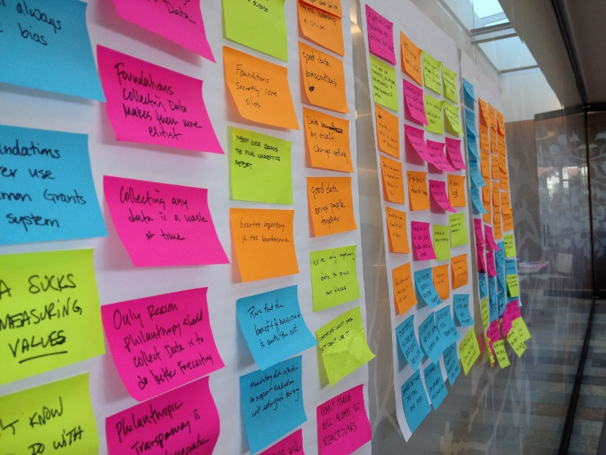
Explanatory Model Gallery Walk
Evaluate your peers’ models. Consider the following in your evaluation:
  Are the ideas presented relevant to the driving question?
  Are there important ideas that are missing?
  Do the explanations in the model make sense?
  Are ideas in the model you don’t understand, or think are incorrect?
  Are the symbols in the diagram labeled and explained?
Use the Post-It notes to provide feedback. Consider using the following sentence started to provide constructive, specific feedback.
  I wonder ___________ .
  I like ______ because _______ .
  Have you thought about _____.
  I would like to see _________ .

Slide 44
Explanatory Model Revision
How might increasing levels of CO₂ affect Oysters in Maryland?
Based on the feedback you received during the gallery walk, make revisions to your model.
Continue building your explanatory model by adding new ideas and information and revising and correcting what you already have.

Slide 45

What can YOU do about ocean acidification?
Learn more about it
Share what you learn with others
Reduce your carbon footprint
  Use less energy
  Conserve water
  Reduce, Reuse, Recycle and REFUSE
    Don’t buy bottled water
    Don’t use straws
    Bring your own reusable bags to stores
  Walk and bike instead of riding in car
Become a scientist and research issues about ocean acidification and climate change

