Slide 1
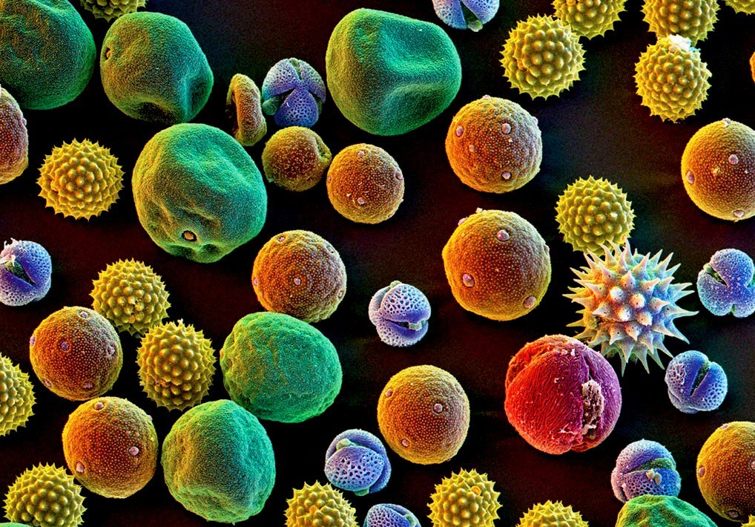


Looking Backwards, Looking Forward
Exploring how proxy data provides evidence for past climatic events
http://keepingbee.org/wp-content/uploads/2012/10/Bee-pollen-supplements1.jpg
Notes:
Version: 14OCt16_mks

Slide 2
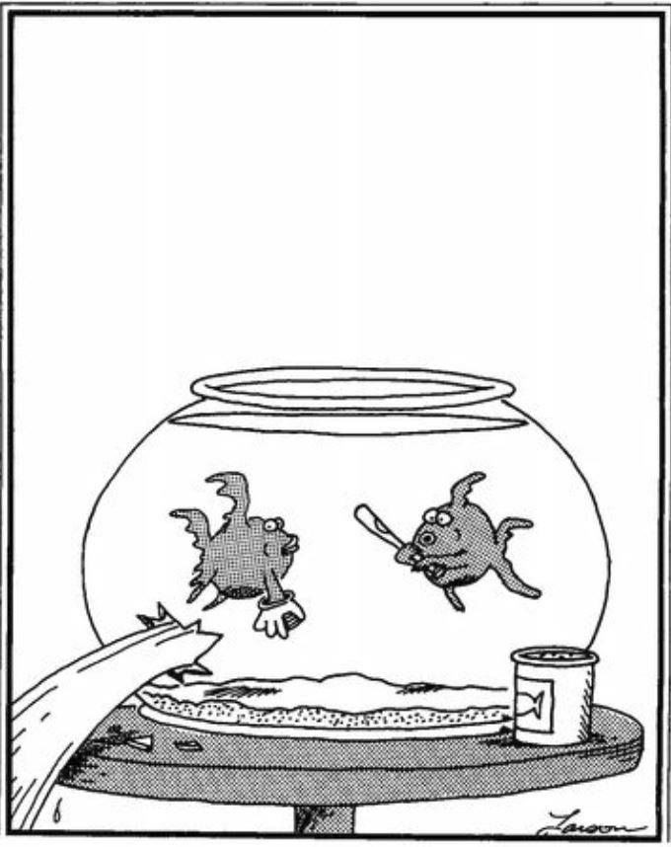
Write down 3 observations for the cartoon. Observations are what you can detect with your five senses.

Slide 3
Student Responses
…

Slide 4
Observation is what you can detect with your five senses
Inference is a conclusion reached based on evidence (including observations) and reasoning.
Observation: The fish is holding a long object.
Inference: There fish is holding a baseball bat.
Inference: The fish hit a baseball through the glass bowl.
Observation: There is a hole in the container.
Inference: The fish is surprised and worried.
Observation: The fish’s eyes are wide.

Slide 5
Examine your initial ‘observations’. Are any of them inferences? Label any that are inferences, not observations.

Slide 6
Do you think scientists make observations and inferences like you did? Why do they make observations and inferences?
Scientists use observation and inference to understand how the world works and make sense of scientific phenomena.

Slide 7
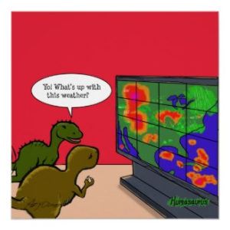
Today you will be working as a paleoclimatologist to explore what the Earth’s past climates were like.
What was the climate like in the Anacostia watershed over the past 12,500 years?
A paleoclimatologist is a scientist who studies past climates.

Slide 8
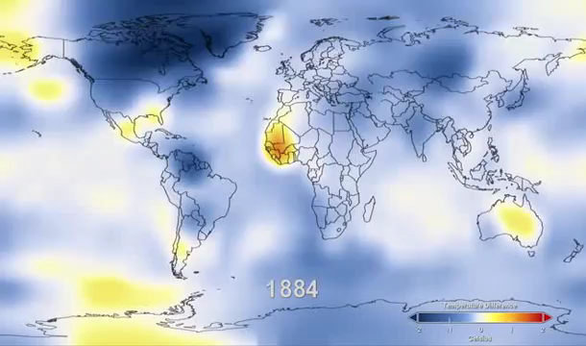
What does this video show?
https://youtu.be/gEFFeAA3MN4

Slide 9
Weather and Climate are not the same thing
Weather is what happens on a short-term basis
Climate is the long-term average of weather
Climate is what you expect, weather is what you get!

Slide 10
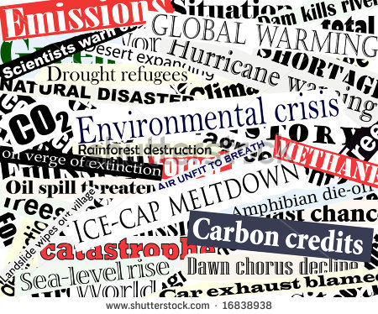
The video showed evidence that the earth has been warming since 1884.

Slide 11
How do scientists know what the earth was like in the past if they weren’t around to see it or if there are no records?
Do a think-pair-share with someone sitting near you and discuss this question.

Slide 12
…
Student ideas
How do scientists know what the earth was like in the past if they weren’t around to see it or if there are no records?

Slide 13
Scientists make inferences based on observations.
How do scientists know what the earth was like in the past if they weren’t around to see it or if there are no records?

Slide 14
Proxy Data for Climate
Can you think of sources scientists might use as proxy climate data?
Proxy data are reserved physical characteristics of an environment that serve as indirect ways of getting information about a past environment.

Slide 15
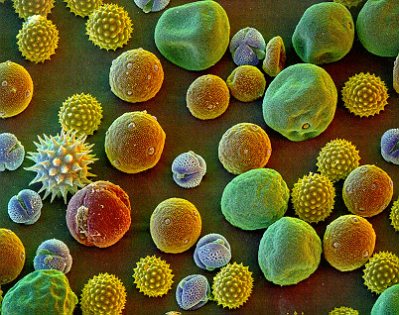
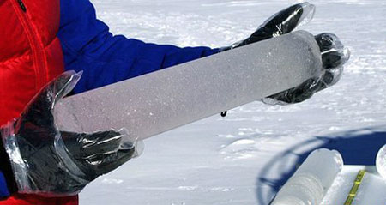
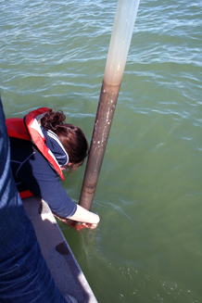
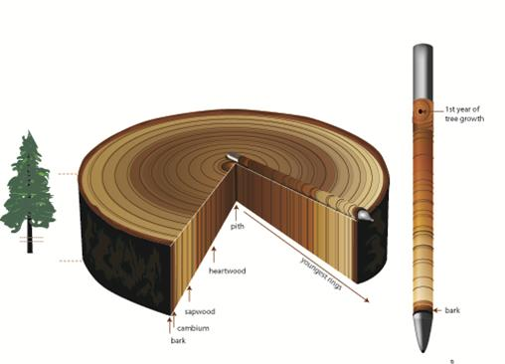
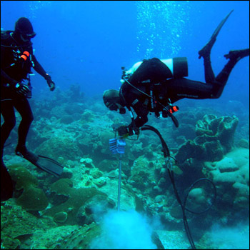
Proxy Data for Climate
Preserved physical characteristics of an environment that serve as indirect ways of getting information about a past environment.
http://www.thenakedscientists.com/forum/index.php?topic=12824.0
http://www.bibliotecapleyades.net/imagenes_ciencia/asteroids_comets70_01.jpg
Preserved pollen grains that were produced by plants thousands of years ago can tell scientists about past climate conditions.
Ice cores can tell scientists about temperature, precipitation, atmospheric conditions, oceanic activity and wind patterns.
Sediment from lakes and ocean contains lots of clues about past climate in the forms of fossils and chemicals.
http://www.nps.gov/lake/learn/nature/images/Sediment-Core.jpg
Data from coral skeletons provide information about water temperature during the time the coral was growing
http://www.treeringpens.com/tree-ring-science/
Because climate conditions influence tree growth, patterns in tree-ring widths, density, and isotopic composition reflect variations in climate.
http://earthobservatory.nasa.gov/Features/Paleoclimatology_CloseUp/Images/coral_core_drilling.jpg
https://www.ncdc.noaa.gov/news/what-are-proxy-data

Slide 16
Why are data important in science?

Slide 17

Why are data important in science?
Scientists rely on data to provide evidence to support their claims. Data and evidence are critical in science.

Slide 18

Form expert groups for background research
  What is pollen and how is it distributed?
  What are sediment cores and how are they used by scientists?
  How do plant communities reflect local climate and climate change?
  How are proxy data used to learn about past climate?

Slide 19
Placemat Graphic Organizer
Pollen
How can we infer past climates from the plants that were growing in an area?
Plant Communities and Climate
Sediment Cores
Climate Proxy Data

Slide 20
Expert Groups
Pollen
…
Plant Communities and Ecosystems
…
Sediment Cores
…
Proxy Data
…

Slide 21
Form sharing groups to answer Challenge Question
Make sure to include information in your answer from each of the topics represented by your experts on:
  Pollen
  Plant Communities
  Sediment Cores
  Proxy Data
How can we infer past climates from the plants that were growing in an area?

Slide 22
Sharing Groups
Group 1
…
Group 2
…
Group 3
…
Group 4
…
Group 5
…
Group 6
…

Slide 23
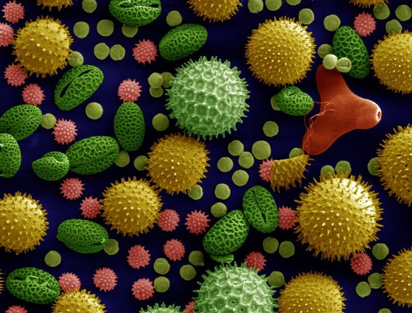
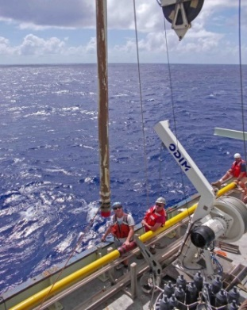
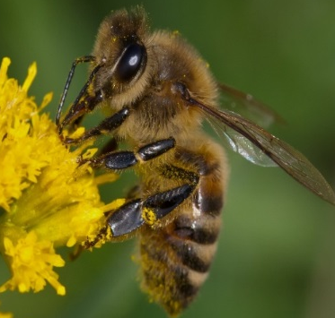


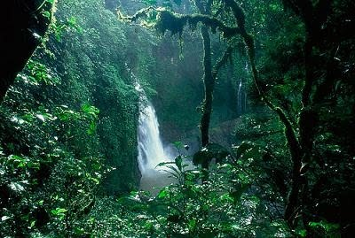

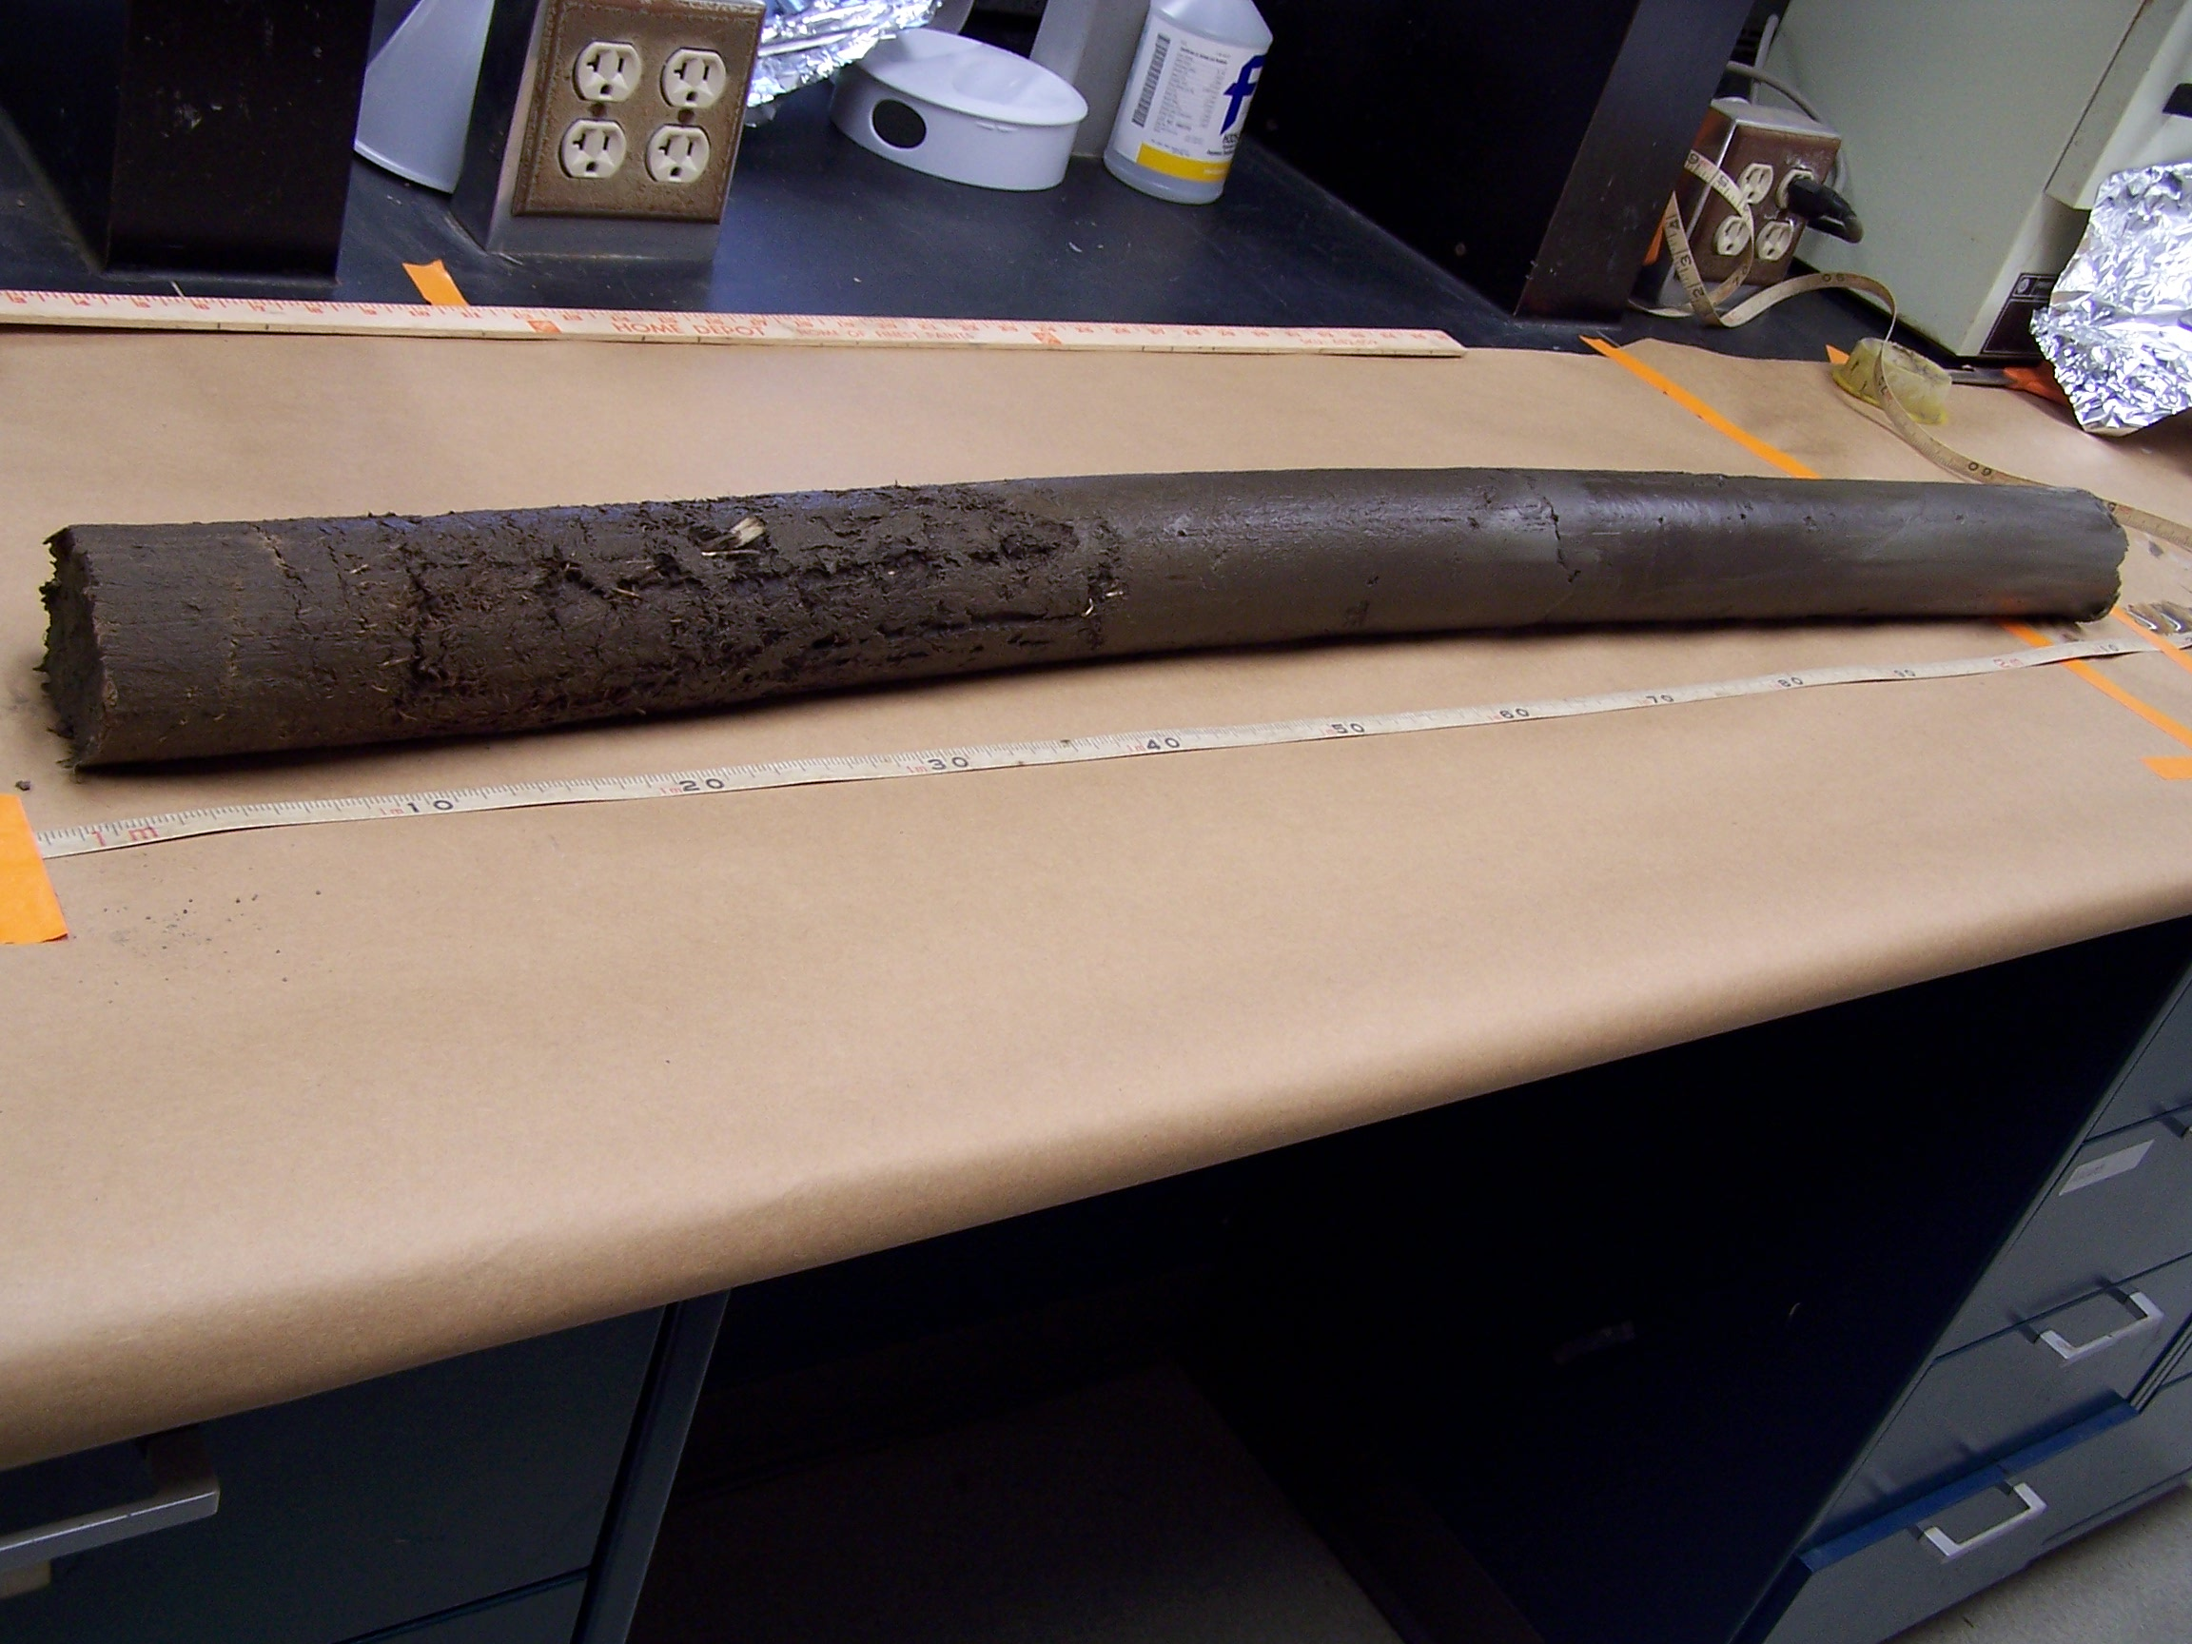
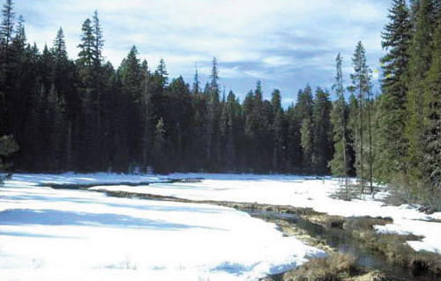
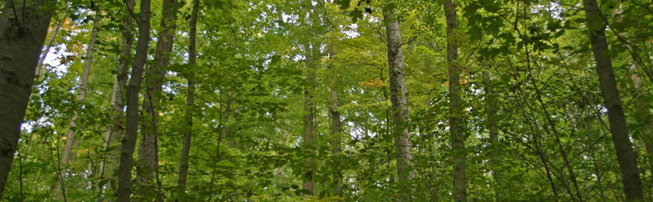
How can we infer past climates from the plants that were growing in an area?
https://researcherridge2014.wordpress.com
Frode Jacobsen
https://researcherridge2014.wordpress.com
Frode Jacobsen
Dartmouth Electron Microscope Facility, Dartmouth College
Dartmouth Electron Microscope Facility, Dartmouth College
Plant Communities
https://sites.google.com/site/roxym304/_/rsrc/1397797367372/hon-biology-units/unit-9---ecolosystems/tropical-rainforest-
https://biomesfirst10.wikispaces.com/Temperate+Deciduous+Forest+Home
https://biomesfirst10.wikispaces.com/Temperate+Deciduous+Forest+Home
G. Brush

Slide 24
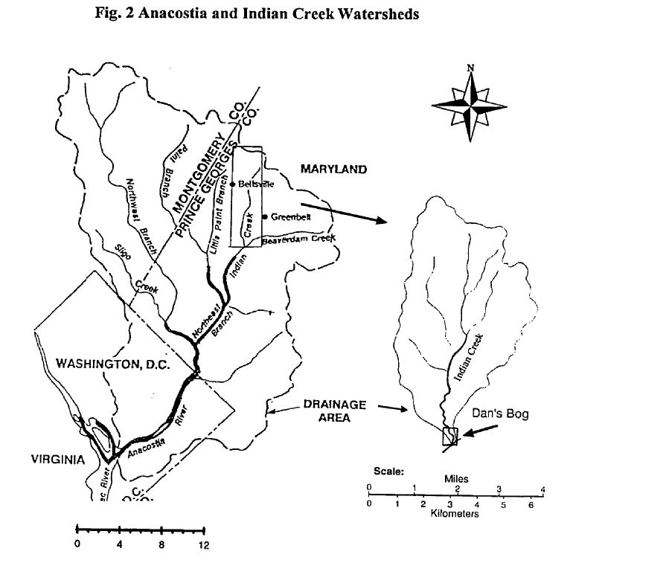
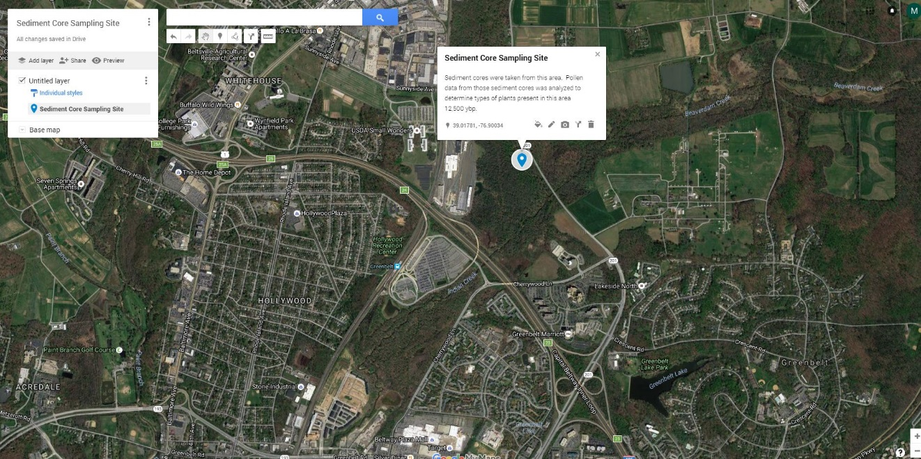
What was the climate like in the Anacostia Watershed over the past 12,500 years?
Forested floodplain on Indian Creek, a tributary of Anacostia River in Prince George’s County, Maryland
Area is currently 100 acres of wetland
Click on image above to access interactive Google map

Slide 25
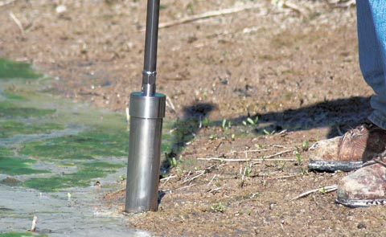
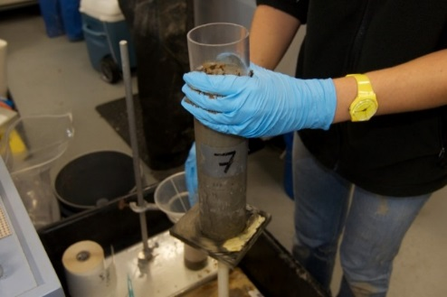
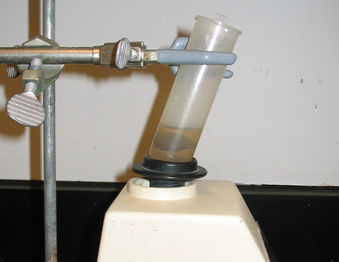
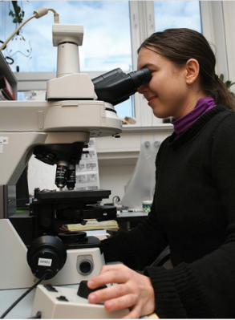
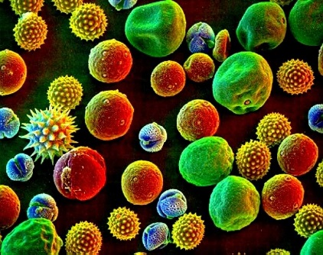
Getting the sediment core sample
This end was closest to surface
This end was the deepest.
http://www.ams-samplers.com/media/catalog/category/multi-stage-sludge-sampler-use-2.jpg
0 – 340
ybp
3,400 – 6,000
ybp
6,000 – 11,000 ybp
11,000 – 12,500 ypb
Go into the field and drill a sediment core sample
Bring sample back to lab and cut into thin slices, each representing a piece of geological time
Chemically treat each sample so to filter out the very tiny grains of pollen
Identify each pollen grain so they could determine which types of plant were present thousands of years in the past
http://schmidtocean.org/wp-content/uploads/2012-11-09-dnm-pushcoreupclose-768x512.jpg
http://www.lpc.uottawa.ca/resources/Pollen%20heavy%20liquid%20pics/vortex.bmp
http://iansa.eu/papers/IANSA-2012-02-bernardova-web-resources/image/5609.png
https://ferrebeekeeper.files.wordpress.com/2010/04/pollen-header.jpg
Data adapted from Yuan, 1995.

Slide 26
Examining a 12,500 year pollen sediment core
This is a reminder that you have registered to attend a focus group to discuss the next generation mobile laboratory currently under development at MdBio Foundation.
DATE: February 4, 2016
TIME: 4:00 – 6:00PM
LOCATION: WSSC, 14501 Sweitzer Ln, Laurel, MD 20707
Parking: There is parking available at the WSSC building
Upon arrival: Please visit the security guard in the main lobby, provide your name and tell them you are on site for the MdBio Foundation educator focus group. You may need to provide identification. The guard will direct you to the correct floor and room location.
Dinner: A light dinner will be served during the meeting.
Focus group participants will be asked to provide ideas, guidance and expertise on a variety of issues, including content area selection, curriculum and activities, target audiences, logistics and details, marketing, outreach and future educational needs.
Thank you for your insight as we build the next generation mobile laboratory to serve Maryland schools. Your input is valuable and we appreciate you joining us.
If you have any questions or are unable to attend please reply to this email or call/text me at 410.570.8814.
This end of the sediment core was closest to the surface.
4
This end was closest to the surface
Slice 4: ~340 ybp
Slice 3: ~3,000 ybp
Slice 2: ~10,000 ybp
Slice 1: ~11,900 ybp
3
What does “ybp” stand for?
2
This end of the sediment core was the deepest.
1

Slide 27

You’re going to examine a model of a sediment core.
Dartmouth Electron Microscope Facility, Dartmouth College
1 bead represents a pollen grain from a specific taxon (type of plant) in your sample.

Slide 28
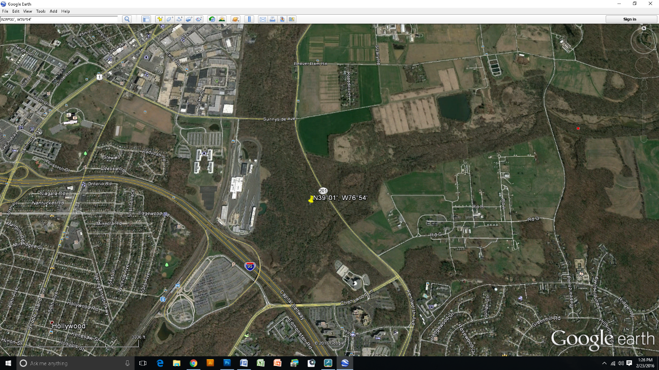
What was the climate like in the Anacostia Watershed over the past 12,500 years?
Forested floodplain on Indian Creek, a tributary of Anacostia River in Prince George’s County, Maryland
Area is currently 100 acres of wetland

Slide 29
Collecting Pollen Data
Each group is being assigned a sample from one slice of the sediment core:
What type of information will you need to collect? As a group, create a table on your white board where you will write you data.
Sort though your sediment sample for pollen, and fill in your data table on your white board
Calculate the percentage of each type of pollen in your sample
Add your percentages of pollen to the class data set
4
Slice 4: ~340 ybp
Slice 3: ~3,000 ybp
Slice 2: ~10,000 ybp
Slice 1: ~12,500 ybp
3
2
1

Slide 30
Class Data Table. If more than one group collected data for a time period, record the average of the two groups.
Bead Color | Pollen Taxa | % Pollen ~340 ybp | % Pollen ~3,000 ypb | % Pollen ~10,000 ypb | % Pollen ~12,500 ypb
red | Alder
white | Birch
yellow | Fir
green | Hemlock
black | Oak
brown | Pine
blue | Ragweed
purple | Sedges
orange | Spruce
pink | Viburnum

Slide 31

Graphing the Data
Make a graph of the percentage of each pollen species for each time period (you will be making 4 graphs
In order to facilitate comparison later make sure to do the following:
  Arrange the taxa along the x-axis in alphabetical order
  Leave a space for all taxa, even if none were counted
  Use a common scale (0% – 50%) on the y-axis

Slide 32

What do you need to do next to be able to answer your question?
What was the climate like in the Anacostia Watershed over the past 12,500 years?

Slide 33

Data analysis and interpretation
Look for patterns in your data to answer the question.
Use the Plant Characteristics Table if you need more information about the preferred climate of each taxon.
Consider the following:
  Which taxon are most represented in your sample?
  Which taxon are NOT represented in your sample?
  Are the percentages of specific taxa going up or down through time?
  What type of climate does each taxon do best in? Wet? Dry? Cold? Hot?
What was the climate like in the Anacostia Watershed over the past 12,500 years?

Slide 34
Scientific Argument
Claim: Answer to the question What was the climate like in the Anacostia watershed over the past 12,500 years?
Each person in your group needs to write a scientific argument (a claim, supported by evidence and reasoning) about what the climate was over the past 12,500 years in the Anacostia watershed.
You can ask your group members for help, but you must write your own scientific argument.
Evidence: The data that support your claim. Must be appropriate and sufficient.
Reasoning: Explains how the data support the claim. Includes scientific principles.

Slide 35
Scientific Argument Peer Review
You will be paired up with a person from another group.
You will compare your responses and critique your own scientific explanations.
Use the rubric provided to assess your CER.

Slide 36
Scientific Argument Peer Review
Using the feedback from your peer review session, revise your scientific explanation about what the climate was like in this region over the past 12,500 years.

Slide 37
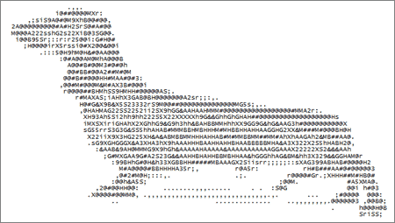
An important aspect of science is identifying and explaining patterns in nature. Explain why this is important for scientists to do, using an example from your climate investigation.

Slide 38
An important aspect of science is identifying and explaining patterns in nature. Explain why this is important for scientists to do, using an example from your climate investigation.
Science assumes that objects and events in natural systems occur in consistent patterns that are understandable through measurement and observation. By studying these patterns, scientists can understand how the natural world works. By understanding past patterns of climate change, scientists are able to develop a better understanding of current causes of climate change.

Slide 39
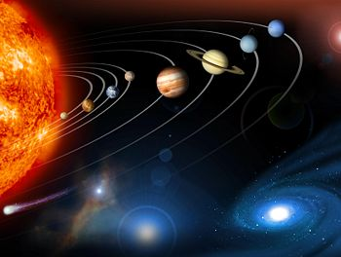
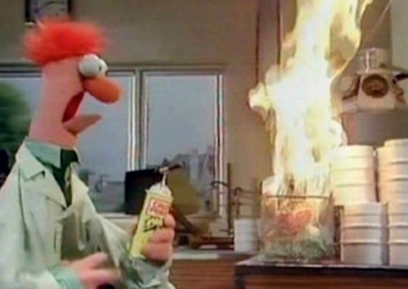
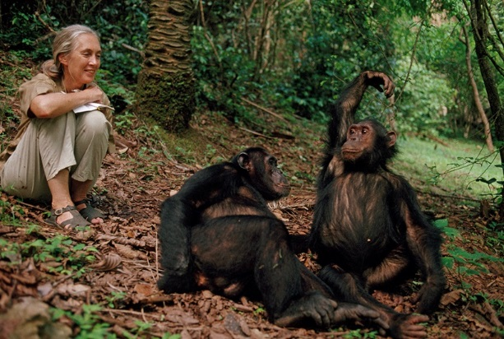
Does all science require controlled experiments? Provide specific examples from this activity to support your answer.

Slide 40
Does all science require controlled experiments? Provide specific examples from this activity to support your answer.
Not all scientific knowledge comes from controlled experiments. For example, in astronomy scientists cannot manipulate planets or star but they are still able to make observations and inferences and learn about how the universe works. In the work we have been doing with pollen and climate, we did not create a controlled experiment. Rather, we made observations and inferences of data from different time periods to infer what past climates were like.

Slide 41

Climate Change Past and Present
Read the passage on pages S7-S8 in your student hand-out.
Answer the Discussion Questions

Slide 42
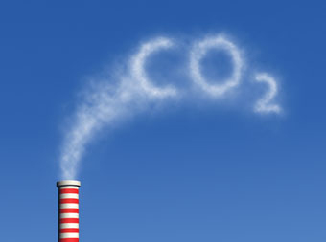
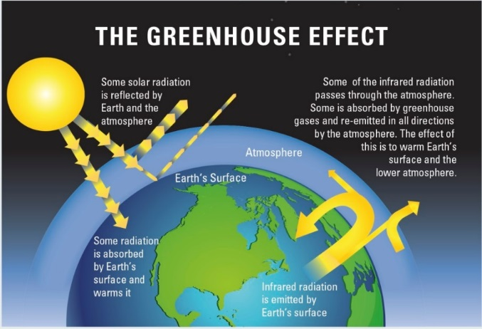
Why is our climate changing so quickly now?

Slide 43
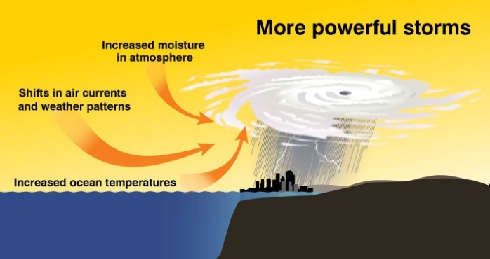
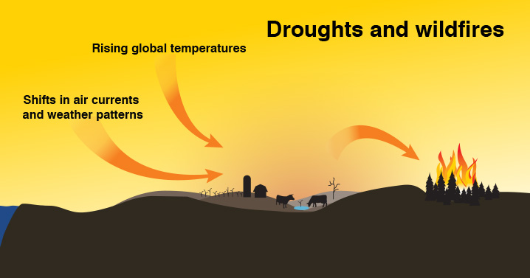
What are the effects of the fast rate of climate change we are currently experiencing?

Slide 44


How would you respond if you heard someone say…
I heard that the climate has changed before and this current climate change we are talking about is just like that. So we don’t have to be worried. It’s the same thing.

Slide 45
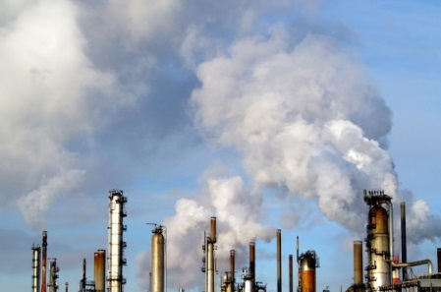
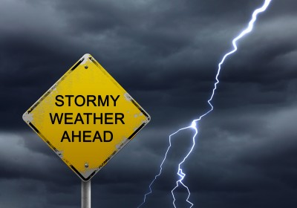
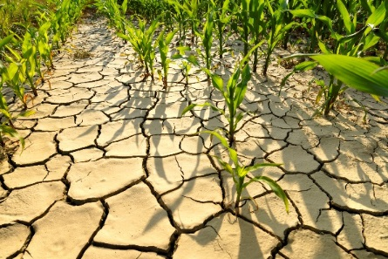
How is current climate change different than past climate change?
Our climate is changing at a much faster rate than even before!
This change is due to humans releasing CO₂ into the atmosphere.
This is a problem because a changing climate results in:
  Increasing sever weather events
  Affects how we grow and produce food

Slide 46
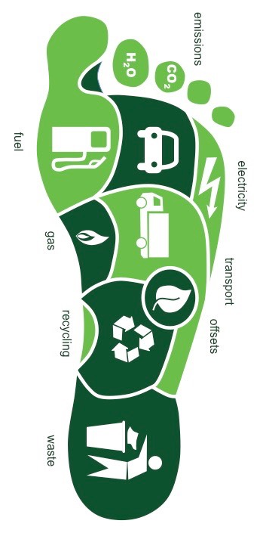
What can we do about Climate Change?
Reduce our Carbon Footprints by:
  Using less energy
    Drive less
    Use less electricity
    Reduce, reuse and recycle
  Develop alternative sources of fuel
    Wind
    Solar
    Algae-based fuels
    Etc….

