Slide 1
It’s A Gassy World!

Slide 2
What do you know about…
Global Warming
Climate Change
Carbon Dioxide (CO₂)
Note down what you know and questions you have in the “K” column!
Notes:
Limit some time here or encourage 2-4 comments to get the students thinking about the topic. Summarize their responses on a white board or poster so they can refer to them later – see next slide.

Slide 3
What do you know?
What did you learn?
What is your evidence?
What are you wondering?
Notes:
Summarize the student responses to what they KNOW and QUESTIONS here.

Slide 4
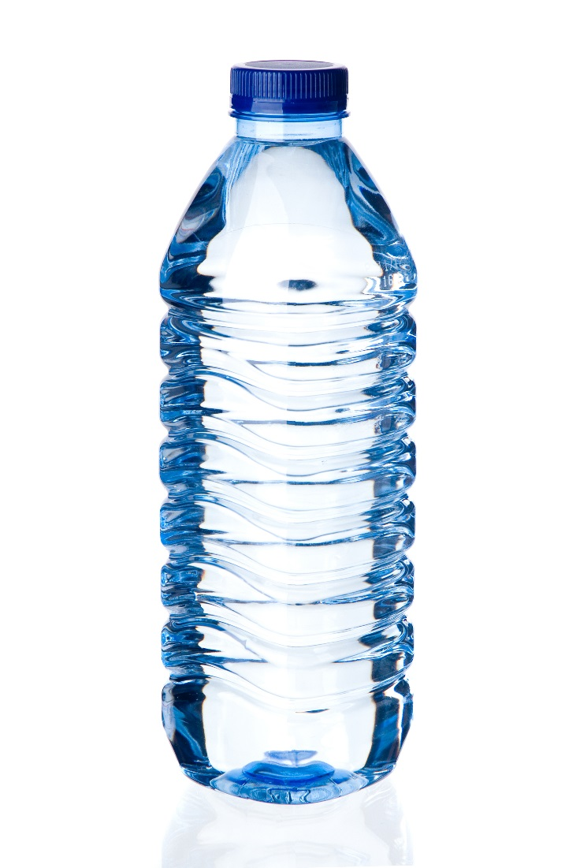
What happens when you open this bottle?
Notes:
Use this demonstration to help students practice observation, predictions, and inference. Have them capture their observations and predictions on a white board. Divide the white board in half and mark “observations” on one half and “predictions” on the other half. After opening the bottle, then flip to next slide

Slide 5
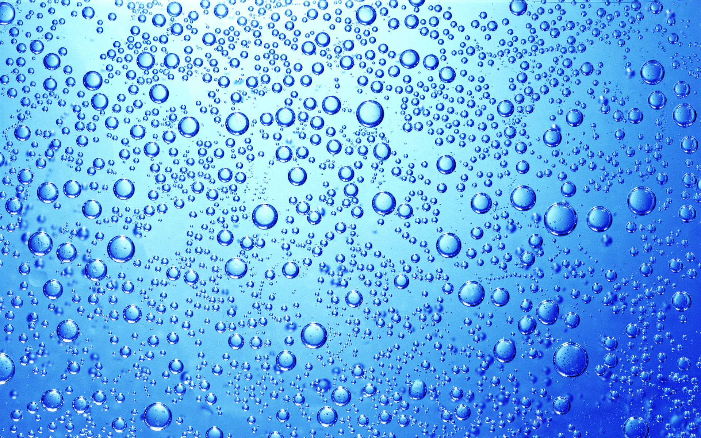
CO₂
CO₂
CO₂
When the bubbles get to the top of bottle and come into contact with the air, they pop and release their CO₂
CO₂
CO₂
The bubbles, carrying the CO_{2,} float to the top.
Every bubble in a carbonated drink is full of carbon dioxide, which we call CO₂
Notes:
After the demo, use this slide to discuss states of matter (gas is the CO₂ escaping; liquid water; solid ice – not pictured) and that CO₂ can dissolve as a gas into the liquid. Ask students, “So…..can water absorb and hold CO₂ ?”

Slide 6
What do you know?
What did you learn?
What is your evidence?
What are you wondering?
Notes:
Summarize the student responses to what they KNOW and QUESTIONS here.

Slide 7
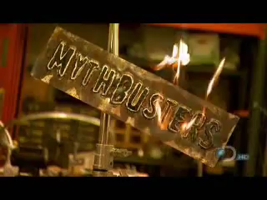
Connection between CO₂ & warming Earth?
Mythbusters test global warming theory, https://youtu.be/pPRd5GT0v0I
Notes:
3 min video: Reference student notes from the KLEW chart in the beginning of the lesson. Even in the beginning, students usually make the connection between CO2, greenhouse gas, and warming temperatures. Don’t confirm this yet, but raise the point and tell them we’re going to watch a scientific test of this connection. This video is also a great way to start making the connections between fair tests, controls, and designing investigations – which they’ll be doing later in this lab!

Slide 8

Records from the late 1800s to the early 2000s show the average temperature of the Earth is increasing
Agree
Not Sure
Disagree

Slide 9
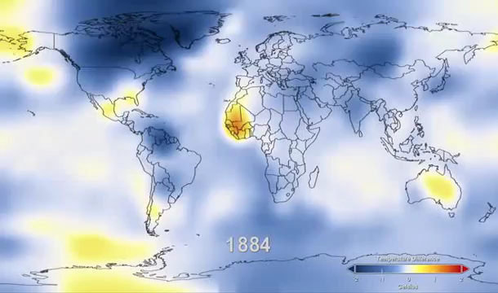
Warming Earth?
3-Watch 131 Years of Global Warming in 26 Seconds,
http://www.climatecentral.org/blogs/131-years-of-global-warming-in-26-seconds
Notes:
Now that we know that CO2 retains heat, we can explore the question of if we’ve been able to measure Earth’s temperatures over time. Is the Earth warming? If so, is it warming evenly? Show this video several times, and make sure the students note that meaning of the colors, and that the temperature increases are happening over both oceans and continents. Allow students a few minutes to record new information in their KLEW charts.

Slide 10
What do you know?
What did you learn?
What is your evidence?
What are you wondering?
Notes:
Summarize the student responses to what they KNOW and QUESTIONS here.

Slide 11
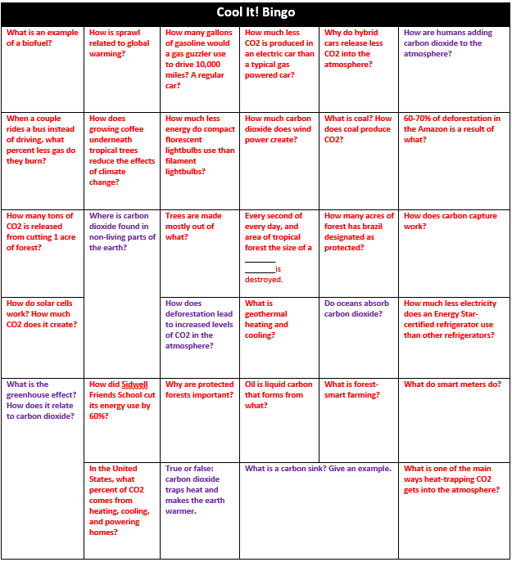

Slide 12
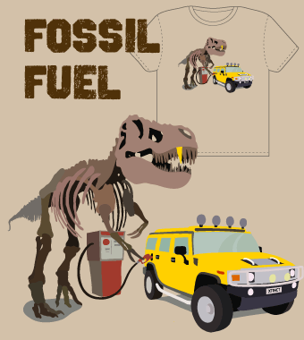
Climate Change and Global Warming
The global climate is changing due to humans burning fossil fuels (from gas and coal).
Burning fossil fuels releases carbon dioxide (CO₂) into the atmosphere.
CO₂ is a greenhouse gas that causes the earth’s surface to warm up.
Notes:
To summarize your scavenger hunts….

Slide 13
What do you know?
What did you learn?
What is your evidence?
What are you wondering?
Notes:
You can take a minute for the students to add to their KLEW charts.

Slide 14
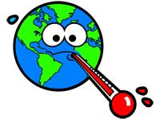
Driving Question
So far, we’ve seen:
CO₂ holds heat…
Earth’s temperatures are increasing….
Earth’s oceans are increasing in temperature, too…
…so, will warming oceans be better or worse at absorbing CO₂?
Image from climatekids.nasa.gov

Slide 15
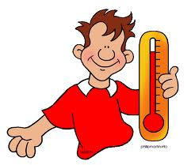


Today’s Challenge!
You’re going to play the role of climate scientists today. Your goal is to determine how temperature can affect the amount of CO₂ that is in water.
Talk with your partner and come up with some ideas of how you could do a scientific experiment to answer the question:
Will warming oceans be better or worse at absorbing CO₂?

Slide 16
Where will we get CO₂ from?
Notes:
Give students a few minutes to think about this question, brainstorm ideas.

Slide 17
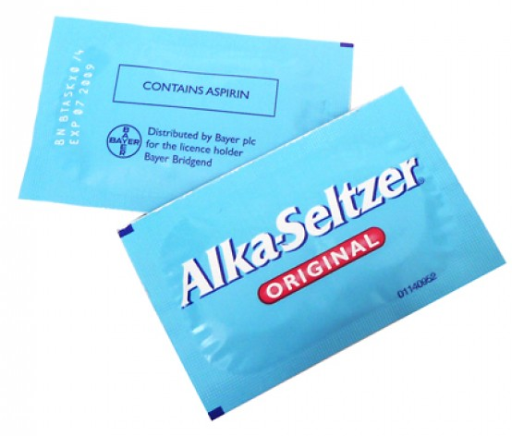
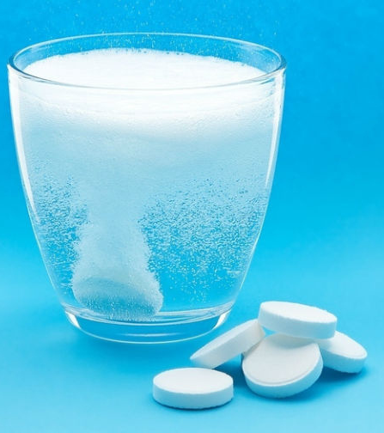
Where will we get CO₂ from?
Alka-Seltzer tablets are used to treat stomach aches.
They contain the gas CO₂, which is released when placed in water.
Alka-Seltzer tablets can serve as a source of CO₂ for your investigation.

Slide 18
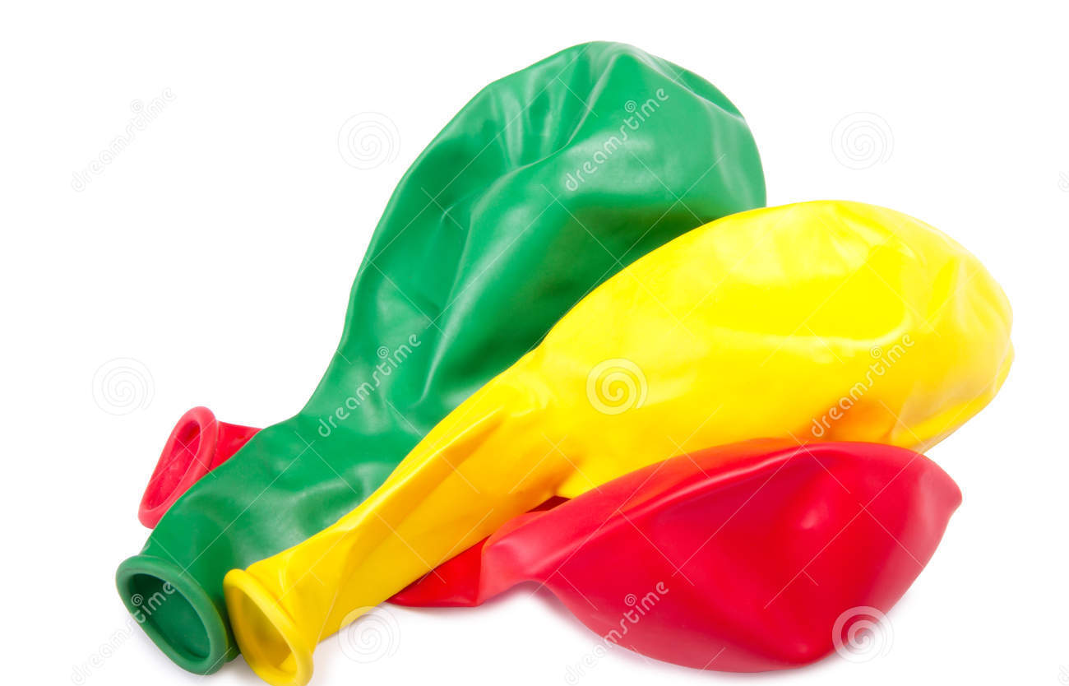
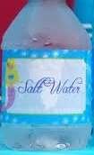
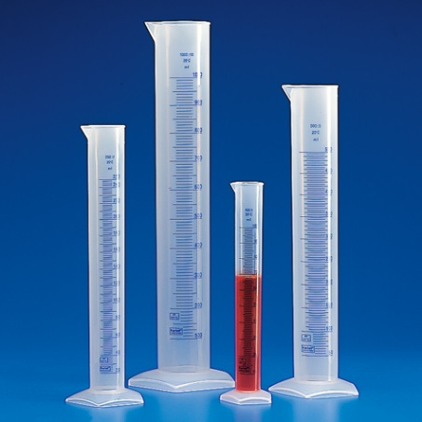
Will warming oceans be better or worse at absorbing CO₂?

Slide 19

Design your investigational procedure!
Image from www.freepik.com

Slide 20
Peer Review
Scientists often seek feedback and ideas from each other.
Share your investigational procedure with another group.
Respectfully provide feedback and constructive criticism that will help improve the investigations.
Incorporate any feedback you received that will help improve your investigation.

Slide 21
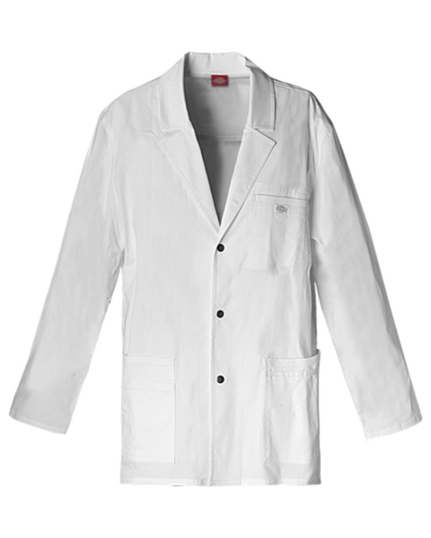
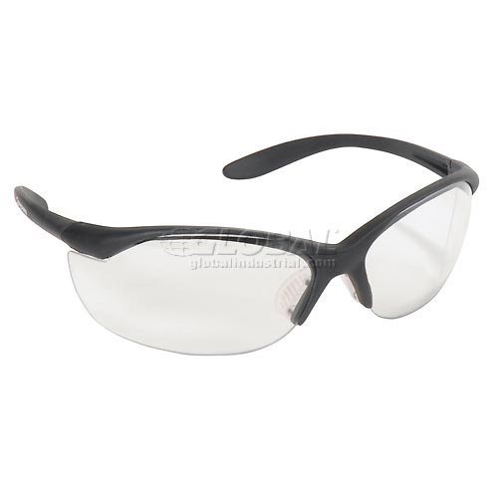
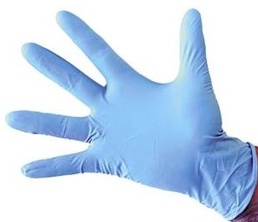


SciTech Lab Safety
Notes:
Remind students of safety rules before going into the lab – explain each lab rule and take any questions before escorting class to SciTech lab (i.e. tell students to ask questions if they are unsure of directions, that they are not allowed to roam through the halls, that they must not take food/beverages into the lab and all gum must be spit out, that cell phones have to be turned off or on vibrate and can not be used, etc.).
Let them know that these rules are also posted in the SciTech lab (for their reference).

Slide 22
Data Analysis
Create a bar graph to summarize the data you collected
Complete the Claim-Evidence-Reasoning Chart
Answer the analysis questions

Slide 23
Claim:
Evidence:
Reasoning:

Slide 24
Claim:
Cold Water absorbs more CO2 than hot water.
Evidence:
Reasoning:
The size of balloons increases due to CO₂ being released from water in the flask.
The balloon on the flask filled with warm water and CO₂ gas was bigger than the balloon on the flask with cold water and CO₂ gas.
This indicates that more CO₂ gas was absorbed in the warm water (and less was released into the balloon).
Warmer water increases the speed of the CO₂ molecules, allowing them to escape into the atmosphere (balloon) faster.

Slide 25
Analysis Questions
Why do we need some greenhouse gases, like CO₂ in the atmosphere?
What happens if people add extra greenhouse gases, like CO₂ to the atmosphere?
How does the ocean affect the amount of CO₂ in the atmosphere?
What will warmer oceans, due to climate change, do to the amount of CO₂ in the atmosphere?

Slide 26
K-L-E-W Chart
What do you know?
What did you learn?
What is your evidence?
What are you wondering?

Slide 27
What can YOU do to stop Climate Change?

