Slide 1
“The Mystery Disease”
Guided Inquiry Version

Slide 2
Patient Description - 1904
In 1904, a student from the West Indies came to a Chicago physician, Dr. James Herrick, with a puzzling condition. Below is a summary of some of the observations Dr. Herrick made. Your job is to learn more about this condition and to find out how the disease affects the body.
The patient reports feeling well most of the time. But he also reports odd, reoccurring events. For instance, one day after a short swim, he became so tired that he could hardly move. He became short of breath and complained of pain in his joints and muscles, especially in his arms and legs. He felt unusually weak and required bed rest lasting a few weeks. These symptoms occurred repeatedly during his youth. He also had frequent fevers and infections.
The patient complained of fatigue and soreness in the joints. Upon inspection, the whites of his eyes had a yellowish tint. He complained of pain in the left abdominal area, which was tender to the touch.
A family history reveals that he has two brothers and three sisters. None of them have this condition. His uncle and his grandmother often had similar symptoms. His grandmother died a young woman. His parents do not have this condition.
` James Herrick, M.D.

Slide 3
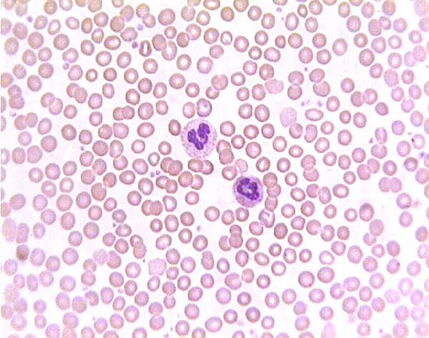
Histological Examination
Normal Patient’s Blood
Mystery Patient’s Blood

Slide 4
Blood Flow Diagram

Slide 5
Pedigree Analysis - 1923
Generation
I
Key to Symbols
= Male
= Female
= Affected Male
= Affected Female
= Deceased
? = Condition
Unknown
II
III
IV

Slide 6
Possible Single Gene Inheritance Patterns
Genetic conditions caused by a mutation in a single gene follow predictable patterns of inheritance within families. Single gene inheritance is also referred to as “Mendelian” inheritance after Gregor Mendel & his research on peas. There are four types of Mendelian inheritance patterns:
Autosomal dominant X-linked dominant Autosomal recessive X-linked recessive
Autosomal: the gene responsible for the phenotype is located on one of the 22 pairs of autosomes (non-sex determining chromosomes).
X-linked: the gene that encodes for the trait is located on the X chromosome.
Dominant: conditions that are revealed in heterozygotes (individuals with just one copy of the mutant allele).
Recessive: conditions are only revealed in individuals who have two copies of the mutant allele (are homozygous).

Slide 7
Emmel’s Test of 1917
Place blood in center of slide
Surround sample with wax ring

Slide 8
In-Vitro vs In-Vivo
Researchers were puzzled that the blood of both the severe sufferers of the disease (like the mystery patient) and the mild sufferers changed shape under Emmel’s 48-hour test. Why was this occurring? Was there some change occurring in the blood with respect to the shape of the red blood cells that was not being caught by the in-vitro test?
Read “Between Body and Petri Dish”

Slide 9
Pedigree Analysis - 1947
Generation
II
Key to Symbols
= Male
= Female
= Affected Male
= Affected Female
= Deceased
? = Condition
Unknown
III
IV
V

Slide 10
Differential Diagnosis (DDx)
A differential diagnosis in medicine is a systematic diagnostic method used to narrow down the possibilities when attempting to identify a disease or condition presented by a patient.

Slide 11
Gel Electrophoresis Results:
What do you think is going on here?
How do these results support your prediction about the mystery disease?

Slide 12
A Closer Look at Hemoglobin:
What steps are needed to determine an amino acid sequence from a DNA sequence?
What strand of DNA is used as a template during the first step of protein synthesis?

Slide 13
Gel Electrophoresis Results:
S = Sickle Hemoglobin
Charge of -1
How does the amino acid analysis help explain the hemoglobin gel electrophoresis results?
A = Normal Hemoglobin
Charge of -2

Slide 14
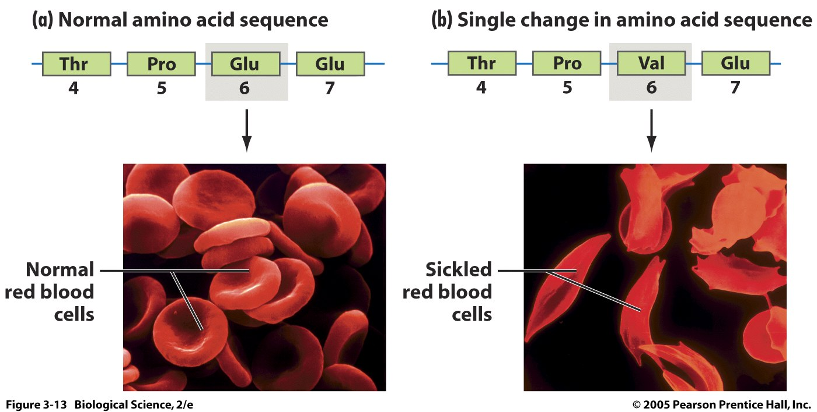
Different proteins result in different traits!
-1
-1
0
-1

Slide 15
Hb Electrophoresis Patterns in Various Hemoglobinopathies
How do these electrophoresis results help narrow your choice about the cause of the patient’s disease?
Note the normal migration sites for a normal person with HbA, HbA2, and HbF. Patients with HbSA (trait) have ~40% HbS, with the remainder representing A, A2 and F. In HbSS (disease), there is no HbA and varying amounts of HbF, the latter a potent inhibitor of sickling (the more the better). b-Thal major has a proportionately greater concentration of HbF than all the other types, while b-thal minor has a slightly increased amount of F and A2.

Slide 16
Putting it all together!
Explain how each type of evidence contributes to diagnosing sickle cell anemia.
Blood smear or blood cell activity (histology)
Family history chart (pedigree)
Gel electrophoresis results (molecular biology)

