Slide 1
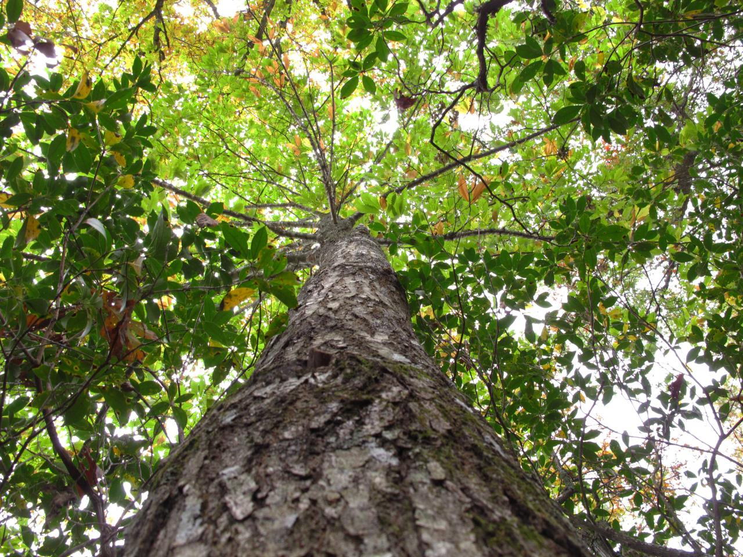
The American Chestnut Tree
dakotafire.net
Towson University’s Center for STEM Excellence

Slide 2

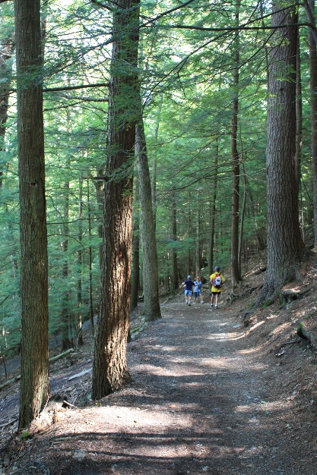
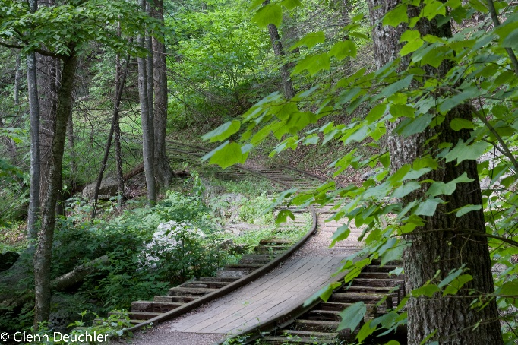
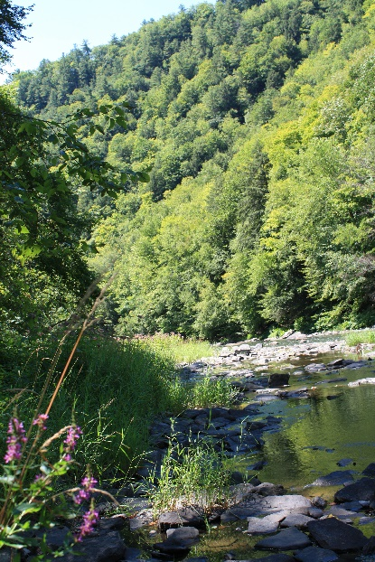
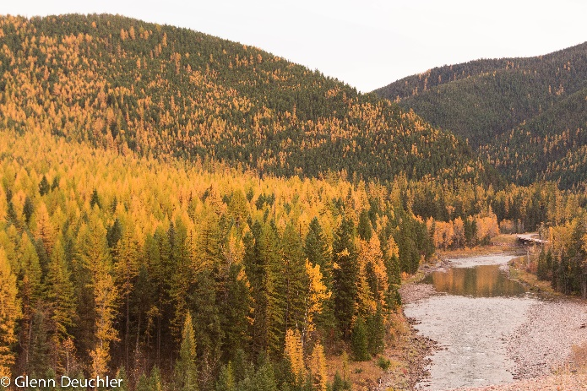
Forests and YOU
Describe or draw a wooded area where you have a special connection.
Describe or draw a wooded area from a book, movie, poem, etc.
Compare these areas to one of the pictures below.
What is it that makes your described forest unique and special?
How would your area change if a tree species disappeared?

Slide 3
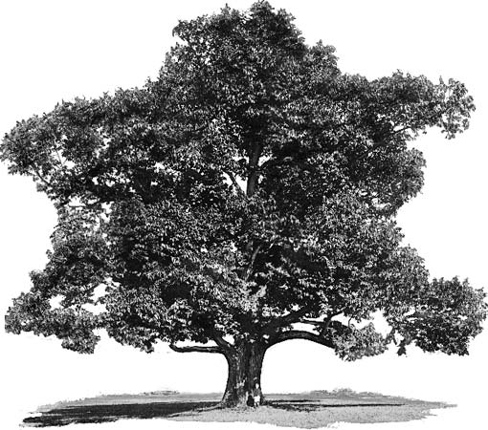
Jigsaw – YOU, the Expert
Chestnut Tree Experts
Chestnut Blight
Biotechnology I
Biotechnology II
Viruses & Biocontrol
kids.britannica.com

Slide 4
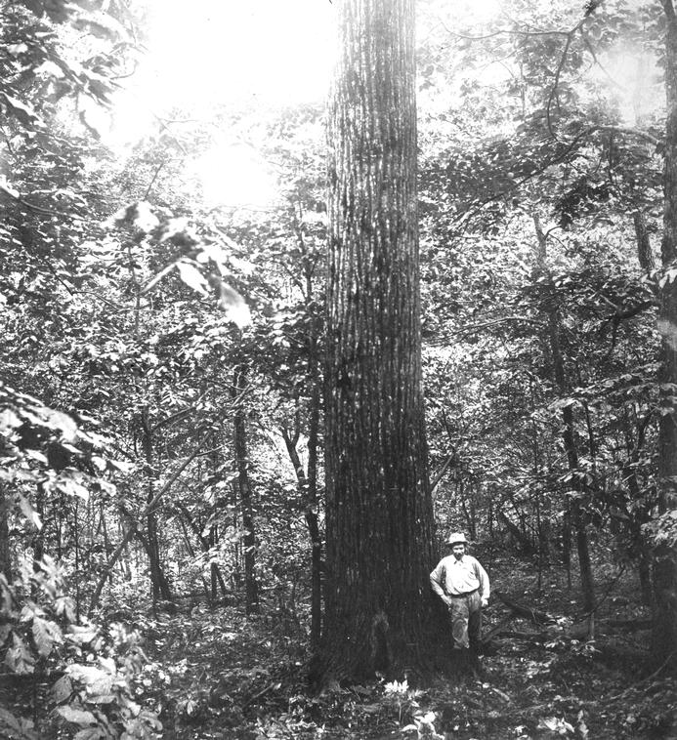
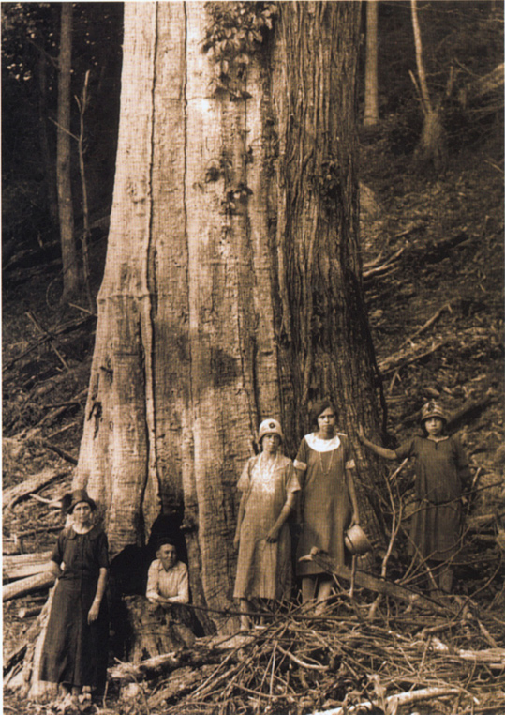
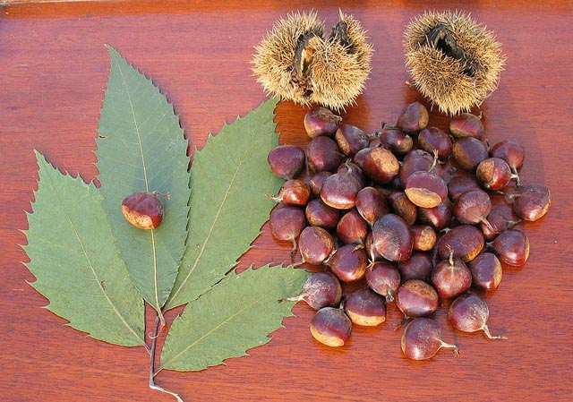
Jigsaw – Chestnut Tree Experts
Chestnut Tree Experts
  History
  Ecology
  Human uses (economics, aesthetics)
www.nyrp.org
http://www.botany.hawaii.edu/faculty/wong/BOT135/Lect07.htm
www.scrgeek.com

Slide 5
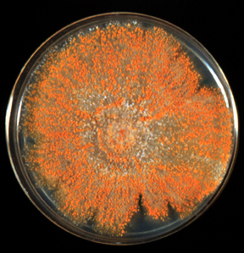
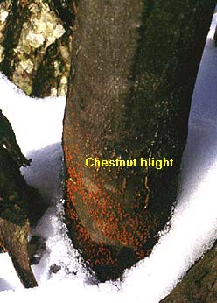
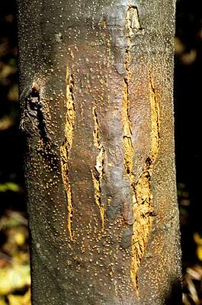
Jigsaw – Chestnut Blight Experts
www.clarku.edu
2. Chestnut Blight
  Cause
  Signs, symptoms, prognosis
  Treatment
dendro.cnre.vt.edu
www.botany.hawaii.edu

Slide 6
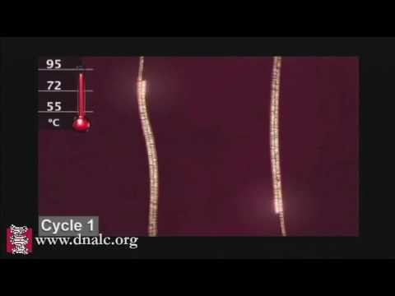
Jigsaw – Biotech Experts, Part I
3. Biotechnology I
  cDNA
  PCR
  RT-PCR
Video of PCR process

Slide 7
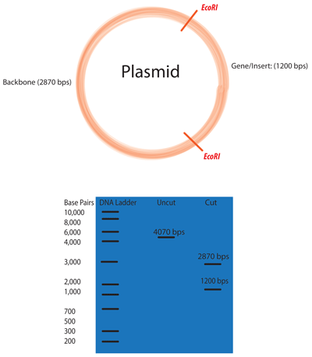
Jigsaw – Biotech Experts, Part II
4. Biotechnology II
  Genetic tags
  Restriction enzymes
  Gel electrophoresis
www.addgene.org

Slide 8
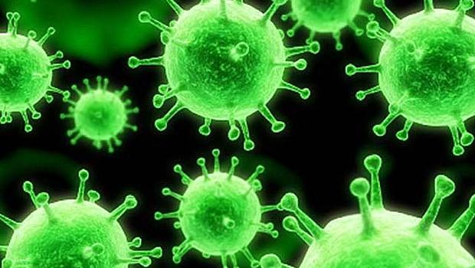
Jigsaw – Viruses & Biocontrol Experts
5. Viruses & Biocontrol
  Specificity of target cells/hosts
  Are there viruses which targets fungi, esp. the fungus causing chestnut blight?
  What is biocontrol?
www.cbsnews.com

Slide 9
KLEW Chart
 | What do you know? | What did you learn? | What evidence do you have? | What are you wondering?
Chestnut Trees
Chestnut Blight
Biotechnology
Viruses & Biocontrol

Slide 10
Good news! There IS a virus which will kill the chestnut blight fungus! BUT….
Would the chestnut blight virus pose a risk to the chestnut tree?
Why would researchers want to track the spread of a virus?
How can we test a canker to see if it has a virus?
If we can we tell the difference between wild type and genetically tagged viruses?

Slide 11

Scientists NEEDED!
There is a team of biologists trying to treat the fungus found in blight cankers on chestnut trees with a vegetative compatible fungus that contains a virus, which is debilitating to the original fungus that caused the canker. The hope is to use the fungus that contains the hypovirulent virus to stop the growth and spread of the cankers on the chestnut trees. YOU are part of this team and they are investigating whether the fungus from three cankers found on one tree are infected with this hypovirulent virus.
One of the biologists believed that they have previously treated one of these cankers with the genetically-tagged virus and that one of the other cankers may have had the naturally occurring wild-type virus and there is a new canker. YOUR goal is to determine from the three canker samples if they are infected at all with a virus and if so, if it is with a wild-type or genetically-tagged virus. Any uninfected fungal samples would later be treated by this team. You will need to understand what RT-PCR is and how the cDNA in this lab was obtained.

Slide 12
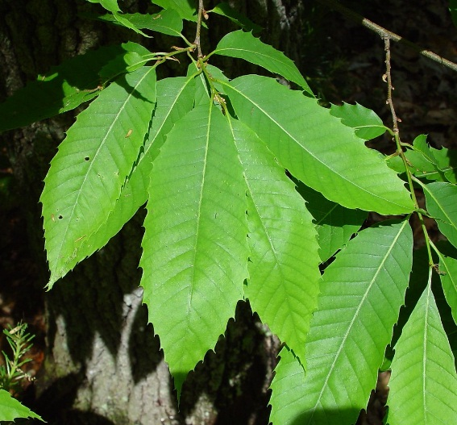
Investigation Design
This is a BROAD investigation plan, NOT a detailed one, addressing the microliters to pipette!
What is the question we are trying to solve?
Can we use the technologies we studied to help our investigation?
What data would be collect?
What would be our comparison?
gobotany.newenglandwild.org

Slide 13
Paper DNA Lab
Practice with paper before we move to the wet lab.
How will we read results? What do you expect to see if it’s a WT virus? No virus? GT virus?

Slide 14
Micropipette Challenge
Practice with micropipette for increased accuracy during wet lab.
Careful handling – micropipette helpers are expensive!
  Don’t turn past the numbers indicated on helper.
  Don’t flip upside down.
  Use stops appropriately – follow your teacher’s instructions.

Slide 15
Wet Lab
Follow instructions carefully!
DNA extraction and RT-PCR have already been done for you.
You’ll need to run the gels and read the results on the same day.

Slide 16
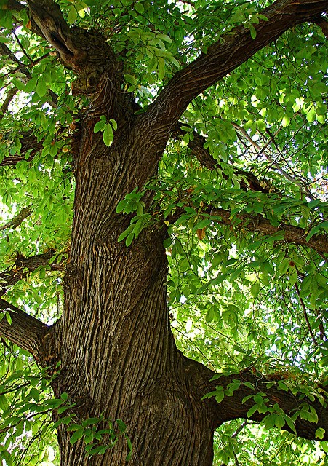
Post-lab and Extension
What happened? Was the canker infected with a WT or GT virus? How do you know?
How else can you use these technologies?
poesypluspolemics.com

