Slide 1

Maryland’s New Curriculum
Transitioning to the Common Core State Standards

Slide 2
Timeline
2010 CCSS adopted
2011 – 14 Transition planning
2013 – 14 Full curriculum implementation
2011 – 14 Curriculum Writing/Resources
2014 – 15 PARCC Assessments operational

Slide 3
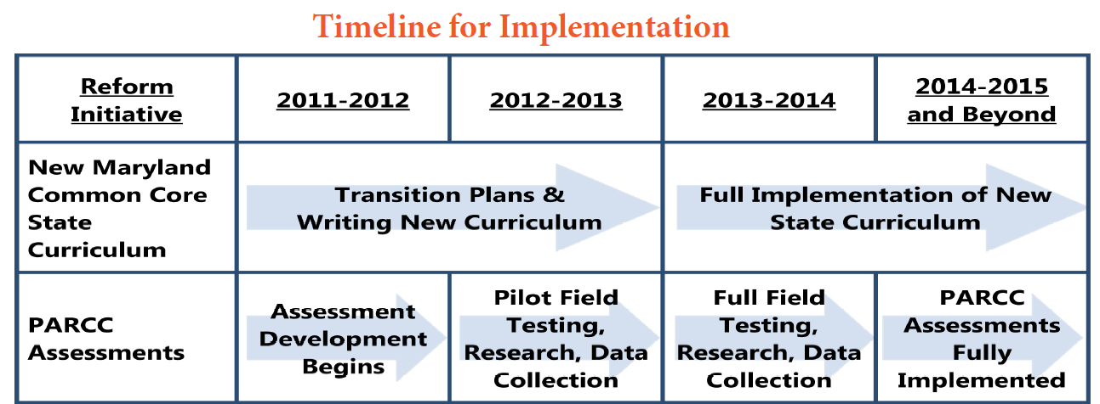

Slide 4
Changes
The Common Core State Standards will require significant shifts in our curriculum
Maryland is committed to creating a state curriculum built on the principles of Universal Design for Learning
Maryland is committed to using technology to enhance student understanding, engagement, and access

Slide 5
Shifts
In mathematics
  FOCUS
  COHERENCE
  RIGOR
In ELA
  Complex text and academic vocabulary
  Balance of informational and literary text
  Writing to source

Slide 6
Model Lessons and Units
Not exemplars
Developed by Maryland educators
IHE involvement*
Rubric for evaluation
Notes:
Before I show you some examples, I would like to share with you a little information about the units and lessons that are being written.
Okay, let’s look at math.

Slide 7


Mathematics

Slide 8
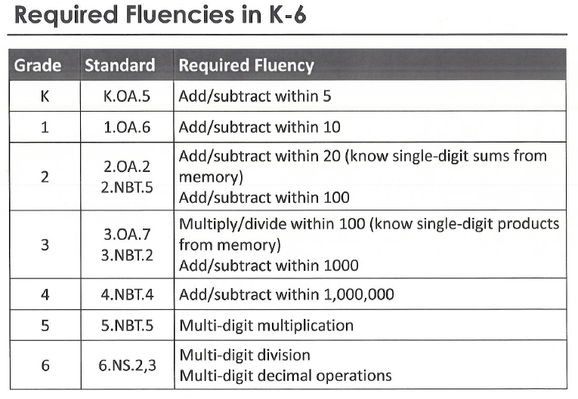
Common Core Fluency

Slide 9
Changes in Math, grade 3
In Common Core:
Students should be fluent with multiplying and dividing within 100, knowing single-digit products from memory
In current curriculum:
Students should be able to represent multiplication and division basic facts using number sentences, pictures, and drawings

Slide 10
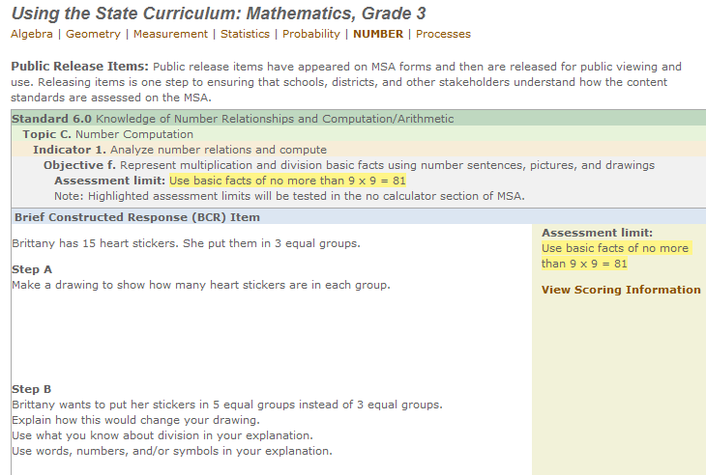
Expectations

Slide 11
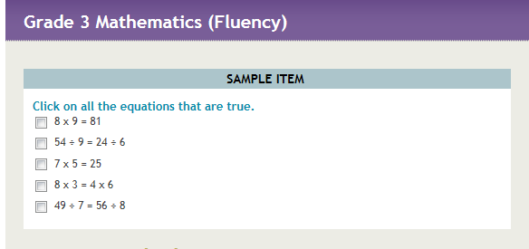
In Common Core

Slide 12
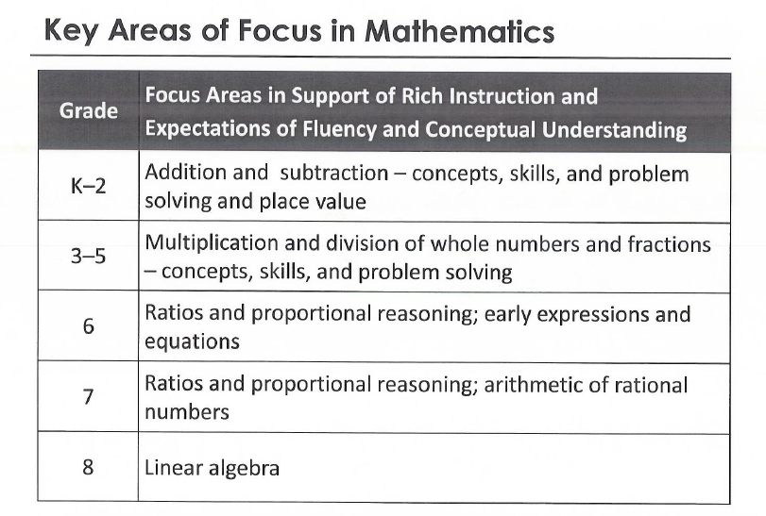
Common Core Focus

Slide 13
Changes in Math, grade 6
In Common Core:
Students should be able to understand ratio concepts and use ratio reasoning to solve problems.
In current curriculum:
Students should be able to represent ratios in a variety of forms and use ratios and unit rates to solve problems

Slide 14
Expectations
Currently, ratios are not assessed in grade 6
Common Core sample assessment in grade 6 focuses on a conceptual understanding of ratios, a subject that is first introduced in 6th grade

Slide 15
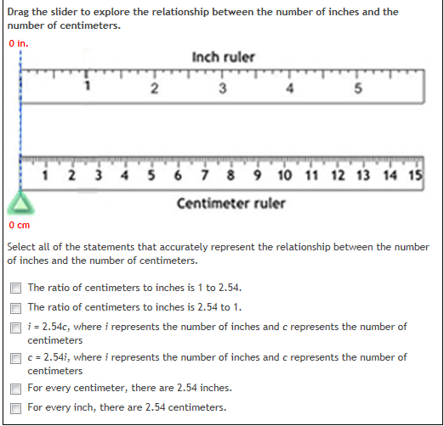
Sample Item

Slide 16
Major Algebra I Content
Interpret the structure of expressions
Perform arithmetic operations
Create equations that describe numbers or relationships
Understand solving equations as a process of reasoning and explain the reasoning
Solve equations and inequalities in one variable
Represent and solve equations and inequalities graphically
Understand the concept of a function and use function notation
Interpret functions that arise in applications in terms of context
Notes:
According to the PARCC Model Content Framework for High School Mathematics the following clusters should be considered Major Content. This means more time should be devoted to developing these areas. The concepts should be developed more deeply than they have been in the past.
Reflect on what this means – Look at each cluster and discuss how the instruction on these topics should go deeper that it has in the past. What kinds of learning experiences do teachers need to provide-what kinds of instructional materials should we be looking for?

Slide 17
RIGOR
3 Aspects of Rigor
Conceptual Understanding
Procedural Skill and Fluency
Applications

Slide 18



English Language Arts

Slide 19


Overview of the
Writing Standards
  Expect students to compose arguments and opinions, informative/explanatory pieces, and narrative texts based upon sources
  Focus on analytic writing and the use of reason and evidence
  Emphasize ability to conduct research – short projects and sustained inquiry
  Require students to incorporate technology as they create, refine, and collaborate on writing
  Expect students to meet each year’s grade-specific standards and retain or further develop skills and understandings mastered during the preceding grades
What do you think are the big ideas or themes in the CCSS writing standards?

Slide 20

Common Core State Standards
An Instructional Shift in Writing
Analytic Writing by Writing to Sources and Writing Using Sources—student writing (argument, informational, narrative) is in response to text, rather than de-contextualized writing prompts. Students stay grounded in the text, responding to high quality text-dependent questions with evidence-based written responses.
Notes:
Explain that writing to source is the act of including textual evidence in the writing. Writing using sources is using the source as a stimulus for writing.
Tell participants that in this session they will take a look at both writing to source and writing using sources. We will begin with writing to source.

Slide 21
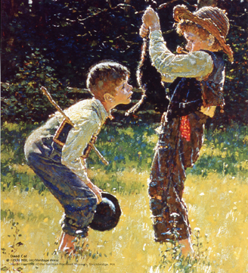
The Adventures of Tom Sawyer by Mark Twain
Tom and Huck discuss different
methods of removing warts, such as
saying charms and using dead cats
and frogs. They speak in the dialect of
their time period. Devise your own charm to
remove warts. Use cultural ideas or artifacts from today that could be used in the charm. Develop a method that would incorporate items and dialect from today.
Notes:
Note: This is the first of the two prompts and is decontextualized.
This example is not text dependent. It uses the source (Tom Sawyer) but is not dependent on the text; therefore it is not writing to source.

Slide 22
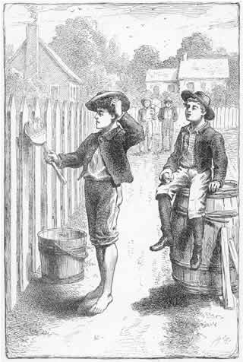
The Adventures of Tom Sawyer by Mark Twain
Tom hesitates to allow Ben to paint the fence. Explain why he hesitates. Analyze how his word choice reflects that hesitation and the effect Tom’s hesitations have on Ben.
Notes:
This example is text dependent. It is dependent on the text; therefore it is writing to source.

Slide 23
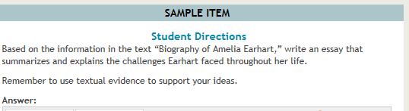
Expectations
Currently, writing is not assessed.
Common Core sample assessment item:

Slide 24
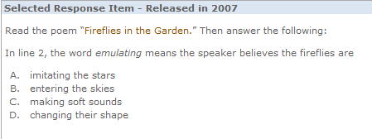
Expectations
In current curriculum, students use context to determine vocabulary

Slide 25
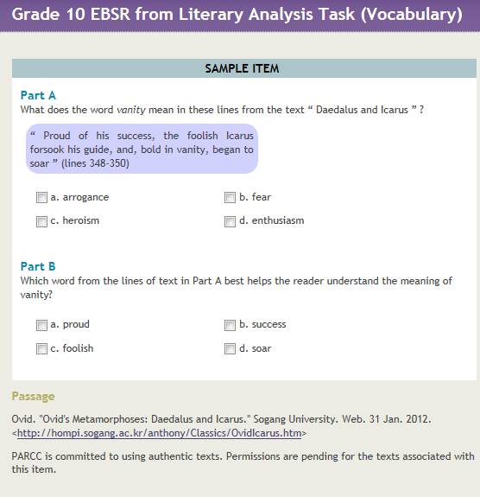
In Common Core, students use context and must show evidence from text
Notes:
One more step: identifying appropriate context clue.

Slide 26

Close Analytic Reading
A close reading is the careful, sustained analysis of any text that focuses on significant details or patterns and that typically examines some aspect of the text’s form, craft, meanings, etc.
http://owl.english.purdue.edu/owl/resource/751/01/
R/ELA.EEA.2012.©MSDE
9/18/12
26
Notes:
26
The MT should display this slide and conduct a discussion of the key ideas in this statement.
What are the key terms in this definition? (sustained analysis, significant details or patterns, form, craft, meanings) Note the broad definition of “text.” Where is strategy instruction in this definition?

Slide 27
Challenges!
In mathematics:
In English/Language Arts:

Slide 28
Model units and lessons may be found on www.mdk12.org/instruction/academies/index.html
We welcome curriculum writers!
Sign up sheet available

Slide 29
Contact Information
Judy Jenkins
Director of Curriculum, MSDE
jjenkins@msde.state.md.us

