Slide 1
Faculty Development & Research Committee (FDRC) Award Guidelines

Slide 2
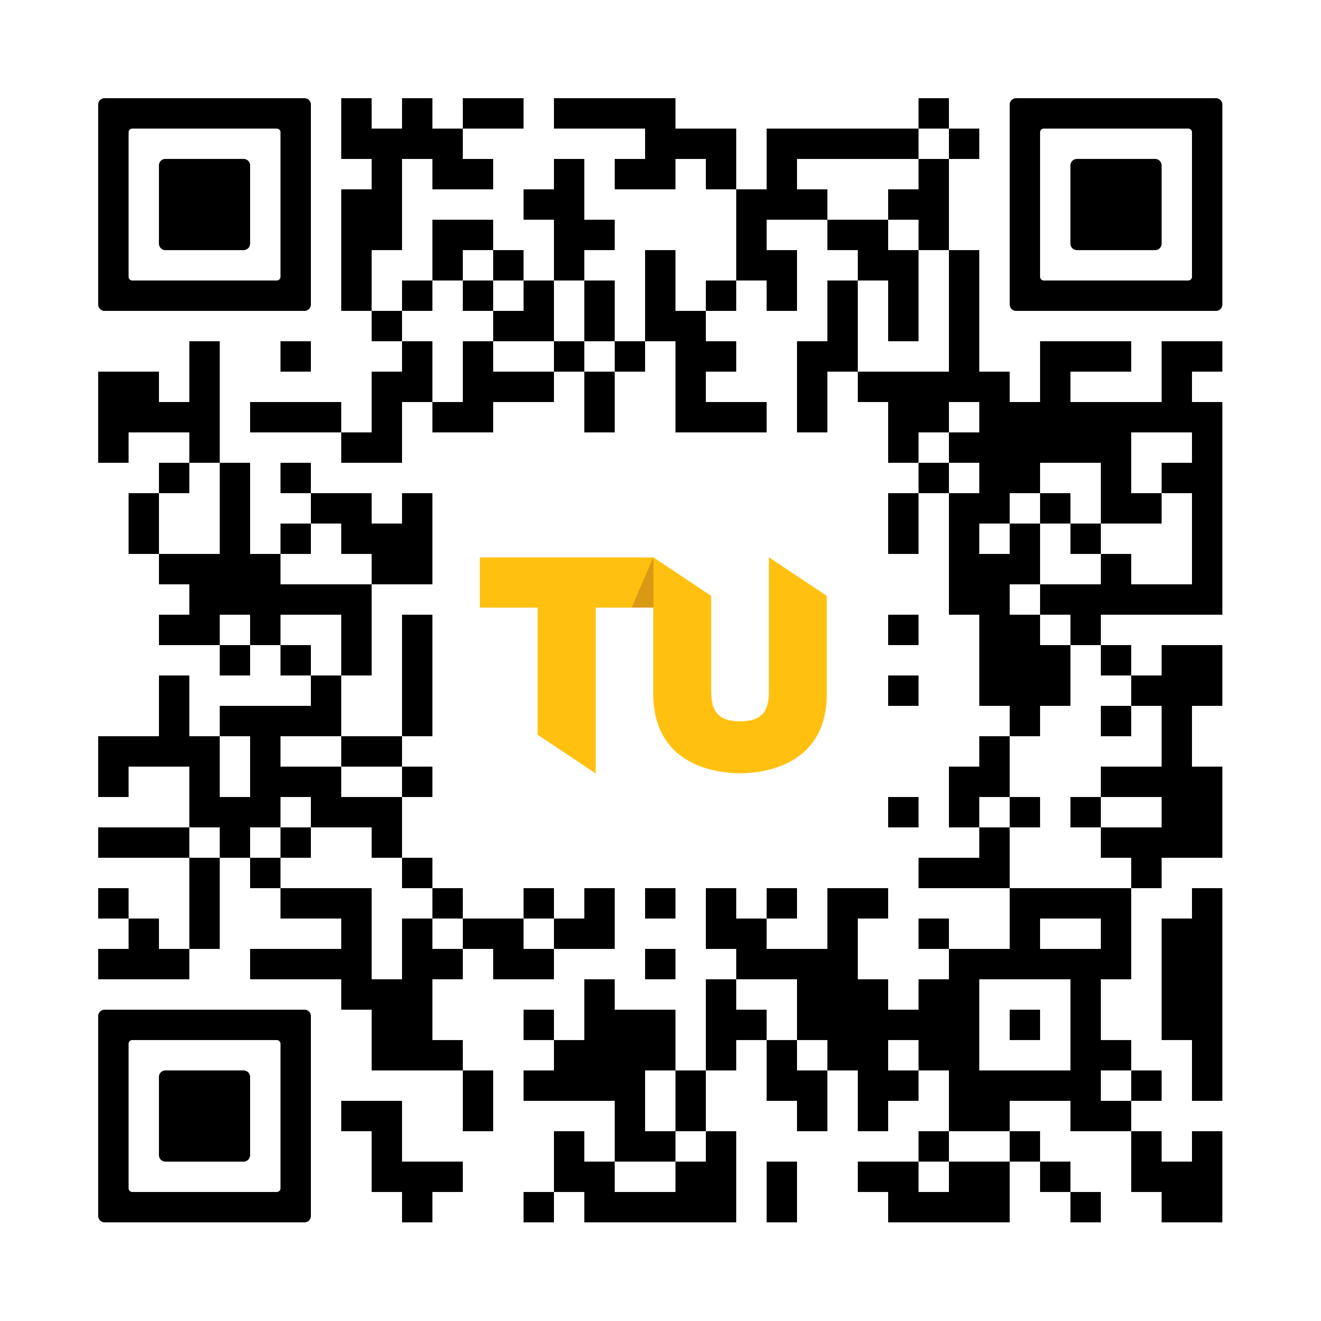
Faculty Development Research Committee (FDRC) Grant Program Overview
Deadline: January 30, 2025, 1 PM
  Certification and routing must be completed by 1/31/2025 1 PM
Available to full-time faculty members to further scholarship, advance research, develop material for publication, and/or support the development of scholarly projects that may garner external funding support
May request up to $6,000
  Maximum $4,000 stipend
  Conference travel is not permitted
Project Period: 7/1 – 5/31
Guidelines and Application are located at towson.edu/fdrcgrants

Slide 3
FDRC Grant Eligibility
Eligibility Criteria
  Must be a full-time faculty member
  May not have a current active FDRC award
  Must be up-to-date on reports for any past awards
  May receive 2 awards every 5 years
  Must submit a complete application that complies with the guidelines
  Must submit and certify the proposal by the deadlines
Proposals are reviewed for eligibility by the OSPR.
Review committee will not accept proposals that do not meet the eligibility criteria and do not adhere to the required formatting guidelines.

Slide 4
FDRC Proposal Format
Online Application Form
  PI/Co-PI Information
  General Project Information
  Budget & Budget Justification
Proposal Narrative
  Five double-spaced pages
    Statement of the problem: (what is the problem that you plan to address; how does the project add to your field)
    Project Objectives
    Plan to Accomplish the Work: (e.g.: Methodology or details of what you will be doing! Include a timetable!)
    Feasibility: Is the work doable?
    Project Impact
References/Bibliography
3-page CV for each PI/Co-PI
Attachments (Optional!)
Upload PDF files to online form

Slide 5
FDRC Proposal Review Process
Proposals are sent to the FDRC Committee:
  12 voting members, 2 from each college
Committee members individually assign scores to the five evaluation criteria
  Statement of the problem
  Project objectives
  Plan to accomplish work
  Project feasibility (includes budget)
  Project impact
OSPR compiles and distributes the scores to committee
Proposals are discussed and final decisions are sent to the Provost’s office
Letters are sent to all applicants

Slide 6
FDRC Tips for Success
Let your chair and dean know you plan to apply early. Ask if/how they want to see your proposal before it is submitted.
Keep in mind that your proposal will be read by faculty members from diverse disciplines.
  Minimize disciplinary jargon and explain terms that will not be understood.
  Ask yourself, are there conventions in my field that might be questioned by faculty members from other colleges? If so, explain why they are right for your project
Proofread and have someone else read your proposal.
If you are working with students, remember that these are faculty research grants. Including students is laudable, but the goal of the project should be your productivity/scholarship, not your student’s.
Take advantage of an OSPR compliance review
  Email files to ospr@towson.edu early, or
  Submit at least 24 hours prior to the 1/30 1 p.m. deadline

Slide 7
Submitting Your Proposal - Overview
Scan for Guidelines and Application!
Submit no later than 1 PM on the deadline
Remember, if you submit 24 hours in advance, you will receive a courtesy review for completeness and formatting
  You will have more time for Kuali certification and routing
Kuali certification and routing must be completed by 1 PM the day after the deadline
  All PIs/Co-PIs must certify and route
  OSPR initiates this step
Once PI/Co-PI routing is complete, the proposal is transmitted to chair(s) and dean(s) for review and approval.

Slide 8
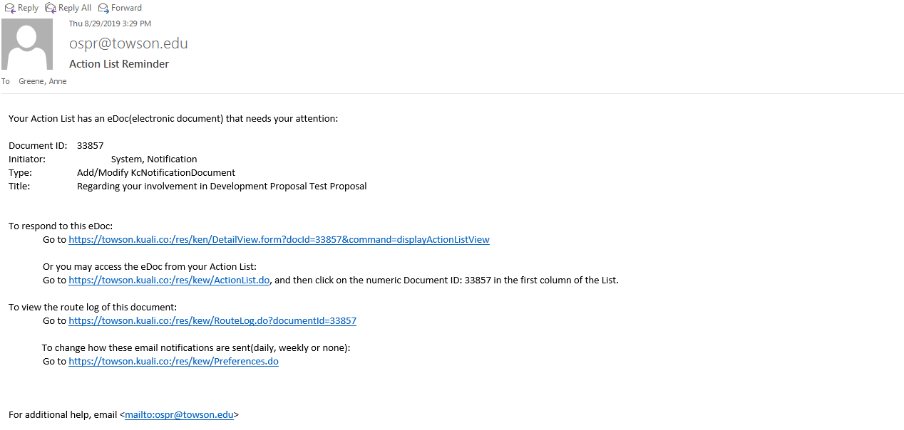
Step 1: Certification
This email is for informational purposes only. Take action in the next email link.

Slide 9
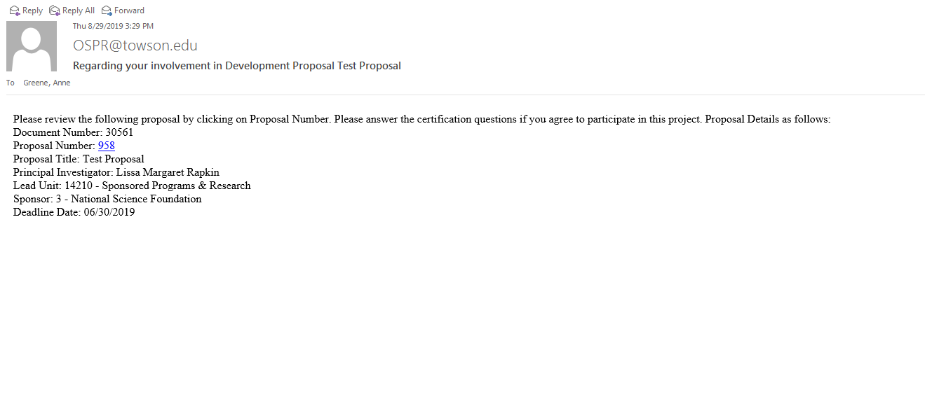
Step 1: Certification
Click on the blue proposal number to access the certification questions.

Slide 10
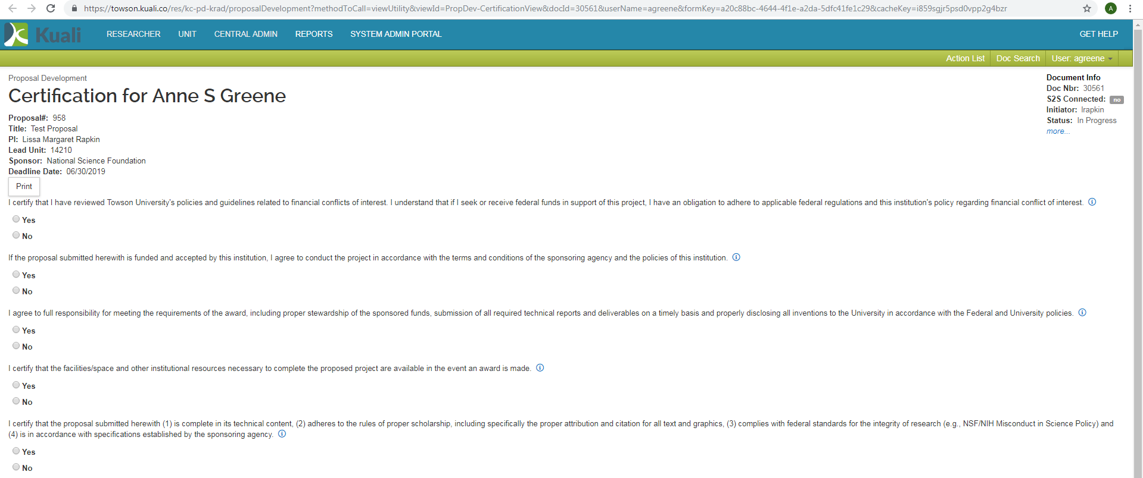
Step 1: Certification Questions
Read the questions thoroughly and answer them.

Slide 11
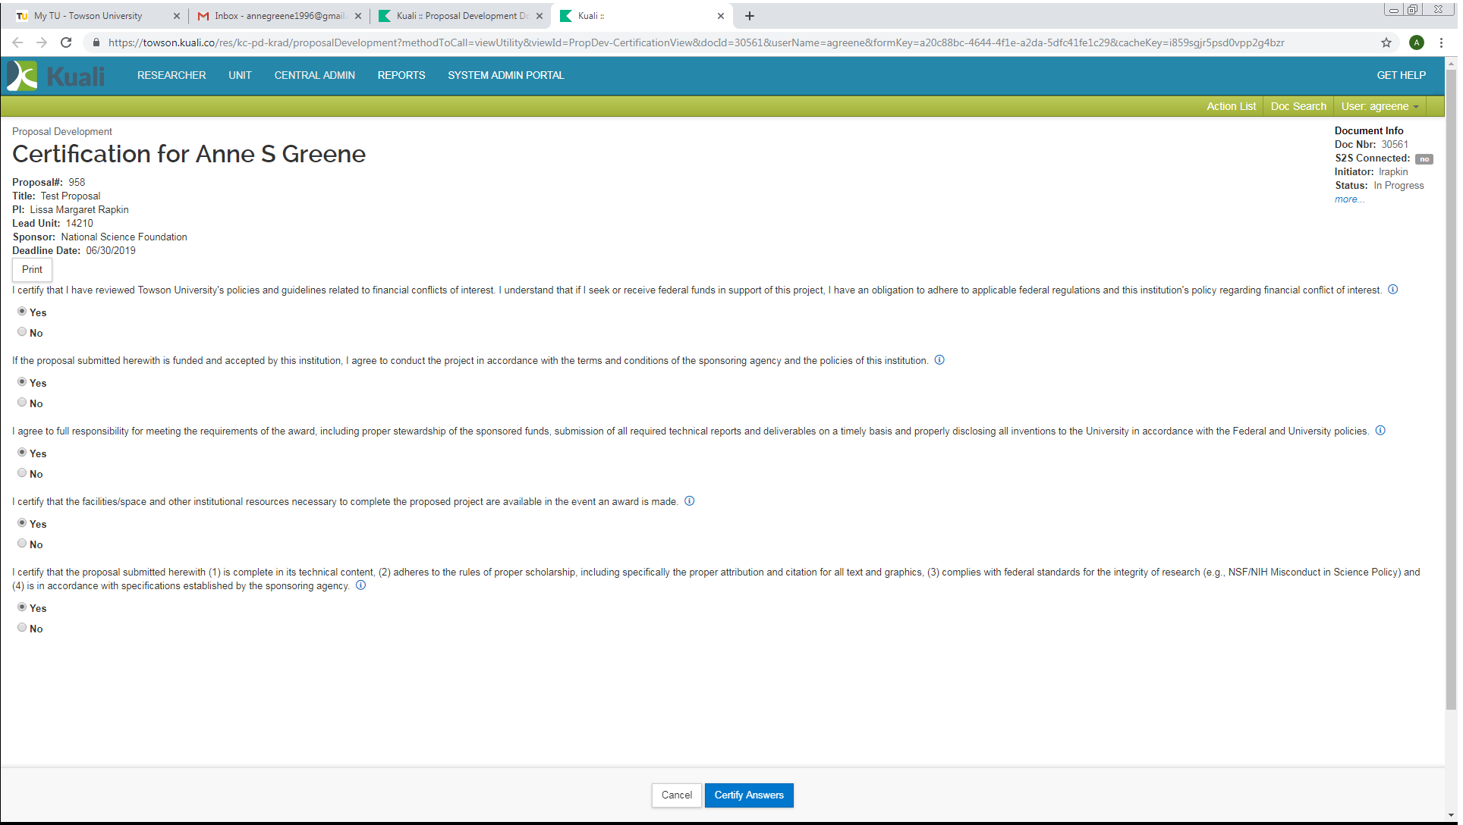
Step 1: Certification Completion
Click on the blue button to certify your answers.

Slide 12
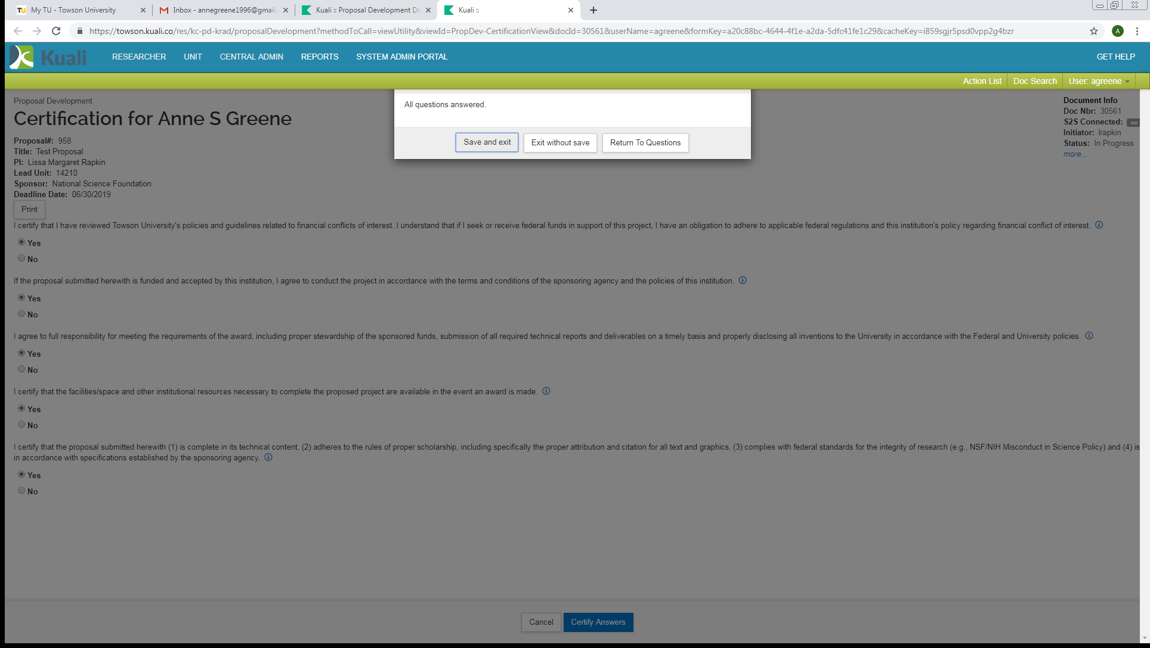
Step 1: Certification Completion
Click Save and exit.

Slide 13
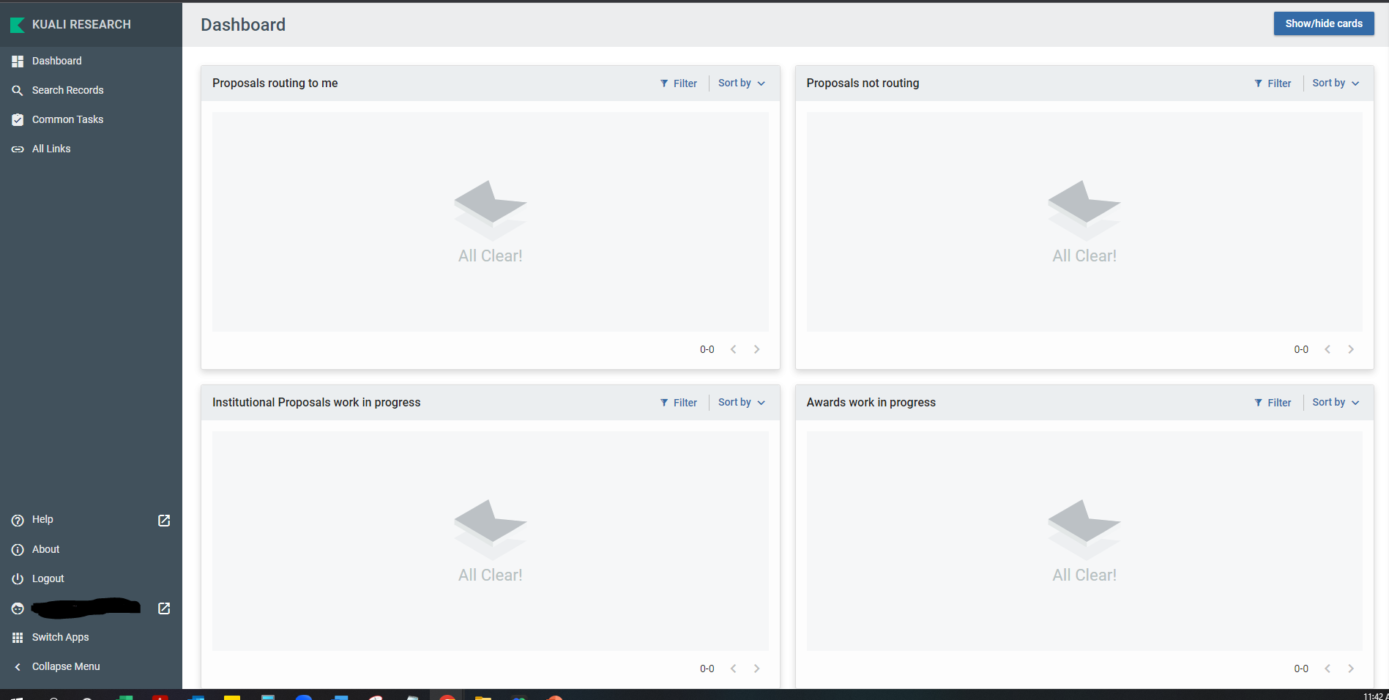
Step 1: After Certification
This is your Kuali Research Dashboard. You may now exit.

Slide 14
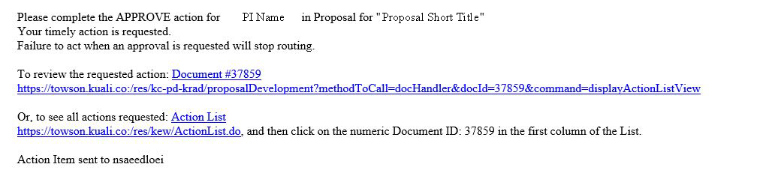
Step 2: PI/Co-PI Routing Approval
Click on the first link referenced above to access routing approval.
If you lose either email, you can always access Kuali with your TU NetID and password:
https://towson.kuali.co/res

