Slide 1
Kuali Protocols
User Guide
Review guide for faculty, staff, and students submitting IRB protocols

Slide 2

What is Kuali Protocols?
Kuali Protocols is a software system used to electronically submit, review, approve and monitor active IRB protocols. Paper submissions are no longer accepted.
The system streamlines the IRB review process and serves as a centralized, electronic record keeping system accessible by both IRB administrators and investigators.
All TU faculty, staff, and students have access to the portal by logging in with their netID username and password.

Slide 3
How does the system work?
Easy! The electronic form mimics the original hardcopies of the applications (accelerated vs. standard/full board), but is condensed into one single form. Investigators will have a general questionnaire screen that, when completed, will populate the appropriate submission (acc. vs. ST/FB) and its corresponding questions.
Users can upload and label attachments at the end of their application.
Review comments are made directly to the application fields to help investigators easily identify what areas need revising and,
When Principal Investigators (PIs) revise their submission, it will automatically track changes within the application for the IRB to review.
System generated reminders are sent to PIs for continuing renewal, expiration, and more.
BONUS:
The CITI training website is integrated into Kuali Protocols, so all TU users who have completed CITI training will have their certificates directly uploaded into the application in the “People” field.

Slide 4
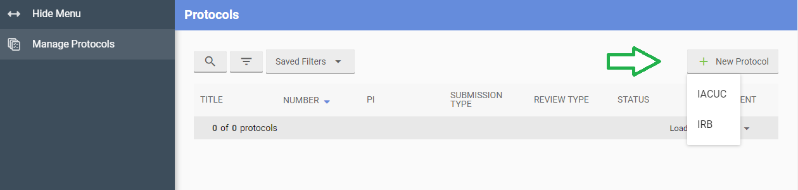
Your Protocol Dashboard
Once you login you will be brought to your Protocols Dashboard. This dashboard will display all protocols that have been submitted in the system.
To create a new IRB protocol application, click on the “+ New Protocol” icon in the top right corner.
Then select “IRB.”
*Note: Do NOT submit IACUC protocols through the system. This is for administrators only!

Slide 5
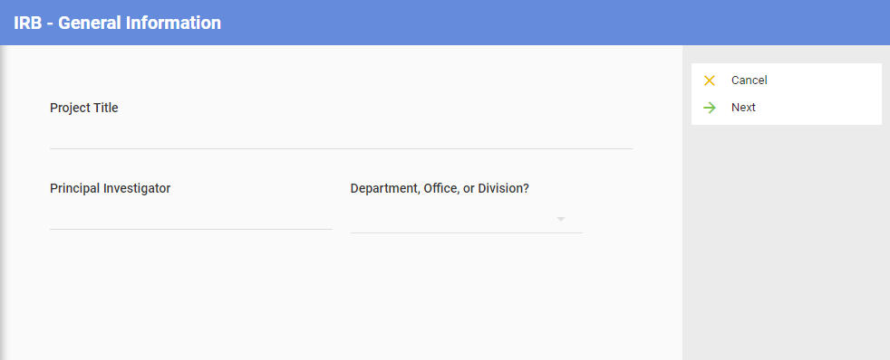
Continuing with your submission…
You will be brought to the IRB General Information screen below
All TU faculty, staff, and students should be able to search for and select their name from the pulldown menu for “Principal Investigator.” To search, start typing your last name and the available selections should pre-populate.
  If you do not see your name, please contact the OSPR office at 410-704-2236 or email at irb@towson.edu.
Use the pulldown menu under “Department, Office, or Division?” to select the appropriate department or office you are employed with. If you are a student, select your major’s department.

Slide 6
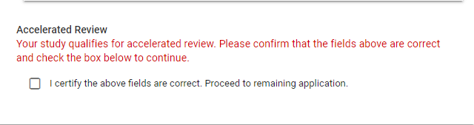
Submission Continued…
The “next” button will guide you through what is required for the protocol to be saved. If you choose “Cancel” the protocol will not be saved and the system will return you to the Researcher’s dashboard.
Complete the general questionnaire that appears on the next screen. All fields are required in order to proceed to the remaining application.
After you complete the questionnaire, the form will generate a message verifying which application review type you qualify for (accelerated or standard/full board). You will need to review and certify that you selected the appropriate fields before you can continue to complete the application.
Note: If you qualify for standard or full board review, please make sure you are submitting in time for the next deadline. These applications will be submitted in full to the IRB on the day or day after the deadline (1 business day).

Slide 7
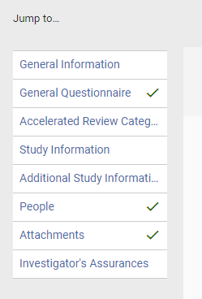
Submission Continued…
Once you have verified that your study qualifies for the appropriate review type and click “Next,” the system will take you to the entire protocol view so additional information can be added and edited. All sections must be completed before the Protocol can be submitted for review.
The panel on the left hand side will indicate which sections of the application are complete with a green check mark. The user can also navigate to specific sections by clicking on each section.
Make sure to include all investigators included on the project in the “People” section.
You can add additional attachments (consent forms, surveys, etc) before submitting.

Slide 8
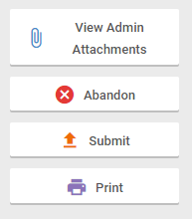
Submitting Your Protocol
Once you have signed off on the Investigator’s Assurances section, click on “Submit” in the right hand column.
You will receive a system generated notification that your protocol has been submitted for review. Note that this means it has not yet been submitted to an IRB reviewer and will need to be processed first. You will receive a separate notification once it has been fully processed and sent to an IRB reviewer.

Slide 9
What next?
You may receive approval or comments requiring further clarification and revising.
For more information on revising returned protocols, tracking changes, amending or renewing a protocol, visit the Kuali Protocols Support Page. You’ll find additional step-by-step instructions for each phase of a protocol’s lifespan.
Questions? Contact the IRB at irb@Towson.edu or 410-704-2236.

